Slide 1
Biogeology

Slide 2
Information
Asking Questions and Defining Problems
Analyzing and Interpreting Data
Constructing Explanations and Designing Solutions
Obtaining, Evaluating and Communicating Information
1. Patterns
2. Cause and Effect
7. Stability and Change

Slide 3

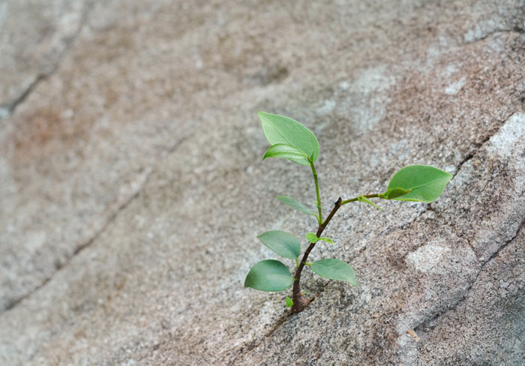

What does biogeology mean?
Biogeology is the study of how living things interact with the Earth itself.
Can you think of any examples of living things affecting
the physical characteristics of their environment?
Notes:
Teacher notes
Discuss students’ ideas for the question. Examples are given in more detail in subsequent slides. Remind students that humans are living things that affect the physical characteristics of their environment.
For more information on the impacts of human activity, please refer to the Impacts of Human Activity presentation.
Photo credit: © sevenke, Shutterstock.com 2018

Slide 4
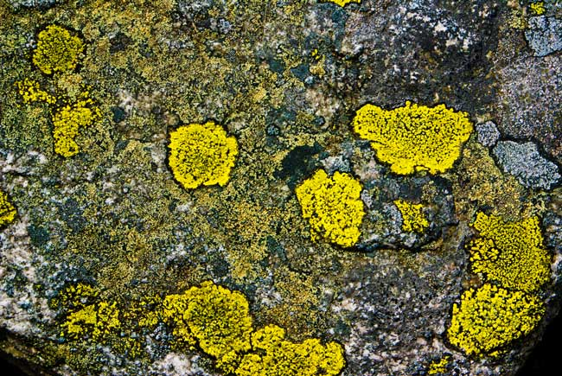
Interacting with the environment
All living things can affect their environment.
Lichen lives on rocks. It produces chemicals that break down rock. This provides the lichen with the nutrients it needs.
Notes:
Photo credit: © oleandra, Shutterstock.com 2018

Slide 5
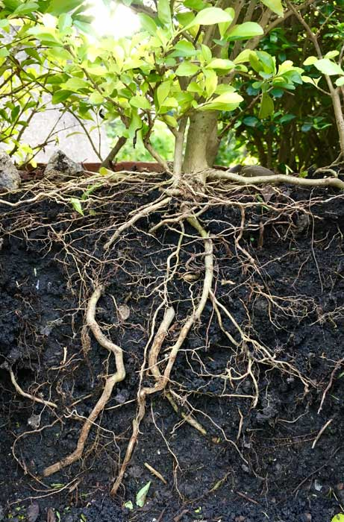
How do plants change their environment? (1)
Plants can change the physical characteristics of
their environment.
The roots of plants can hold soil together, reducing the impact of wind and water.
This helps to prevent wind and water erosion.
Notes:
Teacher notes
Students can observe this phenomenon using models. You could set up trays containing soil - one containing growing grass and one without. Students could tilt the trays and pour water over them to mimic rain and then measure the amount of sediment that is washed away in each tray.
Photo credit: © Kobkit Chamchod, Shutterstock.com 2018

Slide 6
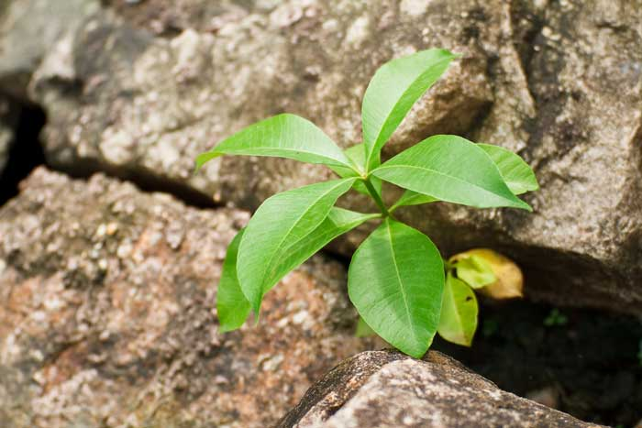
How do plants change their environment? (2)
Plants can also cause the weathering of rocks.
Plant and tree roots can find their way into a crack in a rock.
This then puts pressure on the crack, causing it
to become deeper
or wider.
Notes:
Teacher notes
You could set up an experiment using lima beans to show biological weathering by plants. Soak the beans overnight, then plant them in small cups and cover with soil. Add a layer of plaster of Paris. After a few days the seeds will germinate and eventually cause the plaster of Paris to crack.
Photo credit: © photonewman, Shutterstock.com 2018

Slide 7

How do plants change their environment? (3)

Slide 8
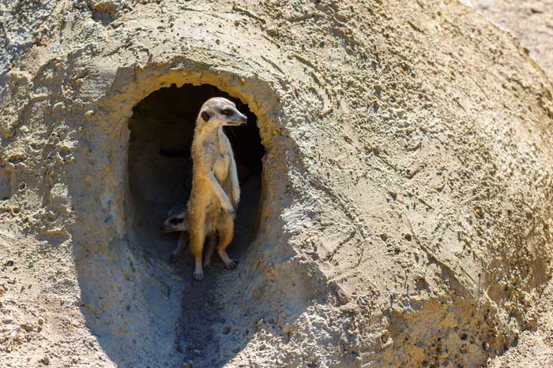
Animals and the environment
Animals can also contribute to weathering.
Many types of animals dig holes to look for food or to create burrows for shelter.
If an animal digs into a crack in a rock it can cause it to shatter, split or break.
Notes:
Photo credit: © Pereslavtseva Katerina, Shutterstock.com 2018

Slide 9

Rainfall
Can you explain any relationships you notice?
Notes:
Teacher notes
Help students to compare the two images. The rainfall data was taken for one month in March, 2004. Ask students if they think that this snapshot of rainfall in one month will give fully reliable evidence on the climate of an area.
This slide covers the Science and Engineering Practices:
Analyzing and Interpreting Data: Analyze and interpret data to make sense of phenomena, using logical reasoning, mathematics and/or computation.
Constructing Explanations and Designing Solutions: Construct an explanation of observed relationships (e.g., the distribution of plants in the back yard).
Obtaining, Evaluating and Communicating Information: Communicate scientific and/or technical information orally and/or in written formats, including various forms of media which may include tables, diagrams and charts.

Slide 10
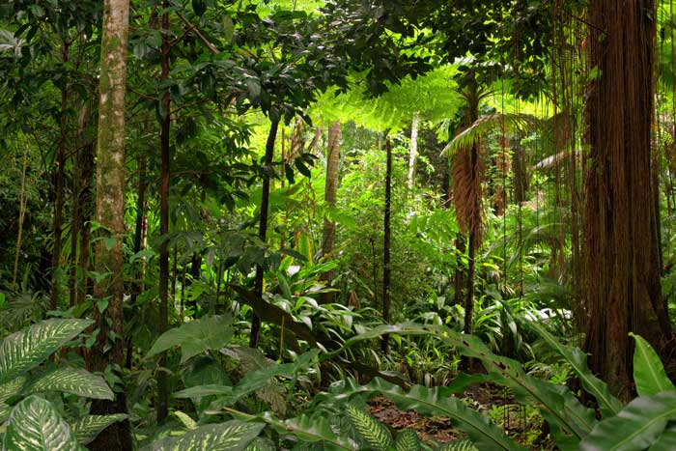
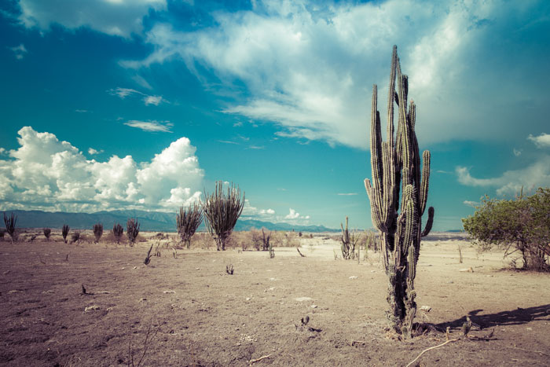
How does rainfall change the environment?
Areas with a high amount of rainfall tend to have more vegetation.
Areas with very low rainfall are likely to be desert environments.
Do you think rainfall will also affect the number and types of animals found in a region?
Notes:
This slide covers the Science and Engineering Practice:
Asking Questions and Defining Problems: Ask questions that can be investigated and predict reasonable outcomes based on patterns such as cause and effect relationships.
Photo credits: Rainforest © AustralianCamera; desert © Ilyshev Dmitry, both at Shutterstock.com 2018

