Slide 1
Characteristics

Slide 2
Information
Planning and Carrying Out Investigations
Analyzing and Interpreting Data
Using Mathematics and Computational Thinking
Constructing Explanations and Designing Solutions
Engaging in Argument from Evidence
Obtaining, Evaluating and Communicating Information
1. Patterns
2. Cause and Effect

Slide 3


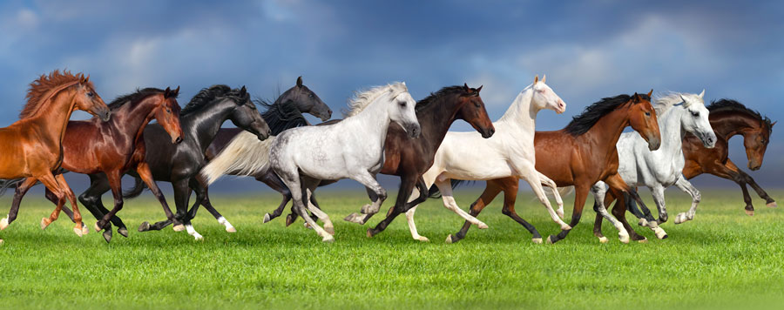

What is a population?
A population is a group of the same type of animal.
Can you see any similarities or differences between the members of this population? What evidence do you have?
Notes:
Teacher notes
In order to provide evidence, ask students to choose a specific trait (colour, markings, etc.) and calculate the percentage of the population that have that trait. Use this information to draw a pie chart showing all the different variations of the trait and percentage of population with that trait. Students can then present their data with a reasoned argument to show that there is variation in traits in a population.
This slide covers the Science and Engineering Practices:
Analyzing and Interpreting Data: Use observations (firsthand or from media) to describe patterns and/or relationships in the natural and designed world(s) in order to answer scientific questions and solve problems.
Analyzing and Interpreting Data: Represent data in tables and/or various graphical displays (bar graphs, pictographs, and/or pie charts) to reveal patterns that indicate relationships.
Using Mathematics and Computational Thinking: Describe, measure, and/or compare quantitative attributes of different objects and display the data using simple graphs.
Engaging in Argument from Evidence: Construct an argument with evidence to support a claim.
Obtaining, Evaluating, and Communicating Information: Communicate information or design ideas and/or solutions with others in oral and/or written forms using models, drawings, writing, or numbers that provide detail about scientific ideas, practices, and/or design ideas
Photo credit: © Callipso, Shutterstock.com 2018

Slide 4
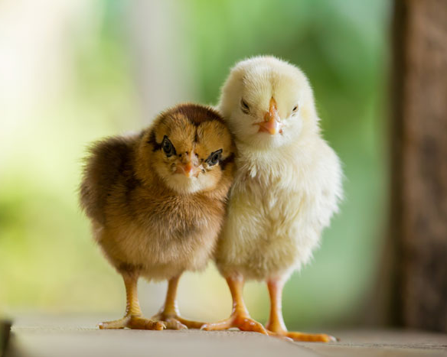
Why are individuals different?
Why are individuals in a population similar but different?
Different organisms vary in how they look and function because they have different inherited information.
Even siblings are different, because offspring acquire a mix of traits from their parents.
Notes:
Photo credit: © Santirat Praeknokkaew, Shutterstock.com 2018

Slide 5

Traits
Do all traits come from parents?
No, some are affected by the environment.
For example, if a pet dog is fed too much food and not given enough exercise, this is likely to affect its size and weight.
Notes:
Teacher notes
If appropriate, encourage students to answer the question and to think of any traits that they have that they have not inherited from their own parents.
Photo credit: © bugpor, Shutterstock.com 2018

Slide 6

Plants and nutrients
Notes:
Teacher notes
Discuss what students are going to measure and observe, specifically: the height from soil level to the tip of the shoot, color and number of leaves.
This slide covers the Science and Engineering Practice:
Planning and Carrying Out Investigations: Plan and conduct an investigation collaboratively to produce data to serve as the basis for evidence, using fair tests in which variables are controlled and the number of trials considered.

Slide 7
Plants and nutrients experiment (1)
Notes:
This slide covers the Science and Engineering Practice:
Planning and Carrying Out Investigations: Make predictions about what would happen if a variable changes.

Slide 8
Plants and nutrients experiment (2)
Notes:
Teacher notes
Ask students to describe the plants in the two groups after the two weeks.
This slide covers the Science and Engineering Practice:
Planning and Carrying Out Investigations: Plan and conduct an investigation collaboratively to produce data to serve as the basis for evidence to answer a question.

Slide 9
Plants and nutrients experiment (3)
Notes:
This slide covers the Science and Engineering Practices:
Analyzing and Interpreting Data: Compare predictions (based on prior experiences) to what occurred (observable events).
Constructing Explanations and Designing Solutions: Use evidence (e.g., measurements, observations, patterns) to construct or support an explanation or design a solution to a problem.

Slide 10
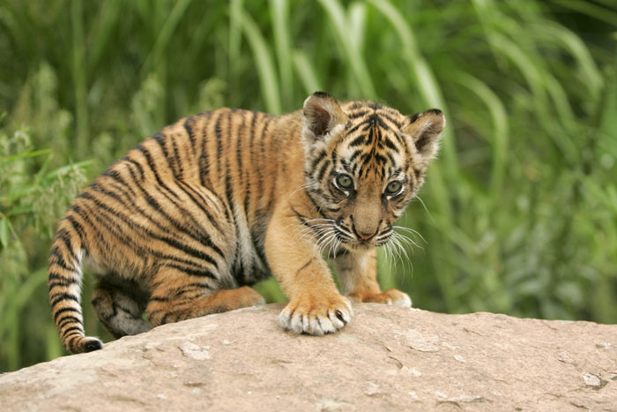
How are characteristics affected?
  Many characteristics can be affected by both inheritance and environment.
For example, a tiger may be born with inherited traits to be a good hunter, with a muscular body type, good eyesight and sharp teeth and claws.
However, if it is kept in captivity it may not have the opportunity to learn to hunt.
Notes:
Photo credit: © Bildagentur Zoonar GmbH, Shutterstock.com 2018

Slide 11
Why are characteristics important?

