Slide 1
Cycling Matter

Slide 2
Information
Developing and Using Models
Constructing Explanations and Designing Solutions
1. Patterns
2. Cause and Effect
4. Systems and System Models
5. Energy and Matter

Slide 3

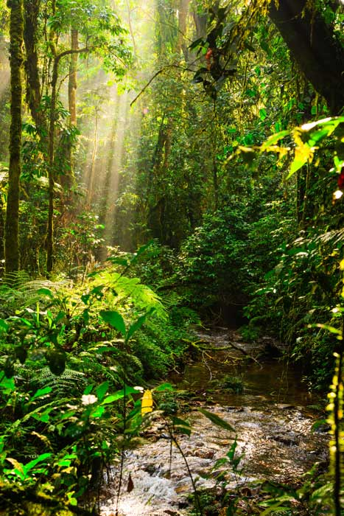

What is matter?
All living and non-living things are made of matter.
Matter is constantly moving between plants, animals,
microbes and the environment.
This is because mass cannot
be created or destroyed.
The matter inside living things contains lots of carbon and water.
Notes:
Teacher notes
You might need to remind students that matter is anything that takes up space and has mass and weight.
For more information on matter, please refer to the Particles presentation.
Photo credit: © Radek Borovka, Shutterstock.com 2018
3

Slide 4
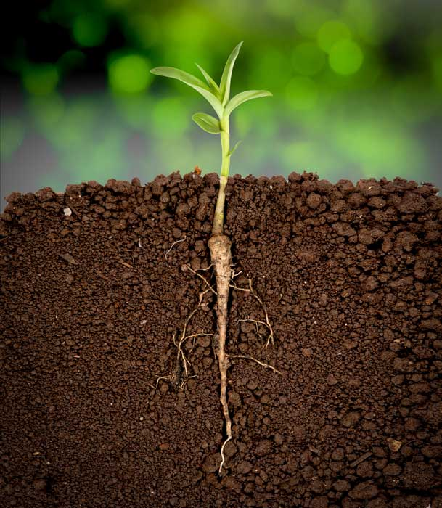
Photosynthesis
Plants take matter from the soil in the form of water, and from the air in the form of carbon dioxide.
Plants convert these
into sugar, using
energy from the sun.
Carbon dioxide
This process is called photosynthesis.
The sugar is new
matter that is then stored in the plant.
Water
Notes:
Photo credit: © showcake, Shutterstock.com 2018

Slide 5

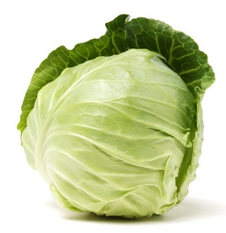
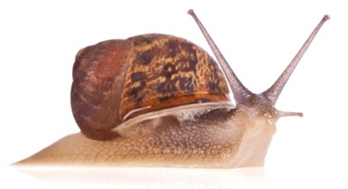
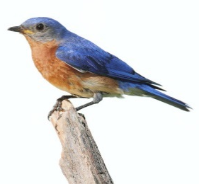
Energy transfer
When an animal eats a plant, matter is transferred from the plant to the animal.
If this animal is eaten by another animal, the matter is transferred again.
Do you think animals need matter from anywhere else in their environment?
Notes:
This slide covers the Science and Engineering Practice:
Constructing Explanations and Designing Solutions: Use evidence (e.g., measurements, observations, patterns) to construct or support an explanation or to design a solution to a problem.
Photo credits: Cabbage © JIANG HONGYAN; Garden snail © StockPhotosArt; Eastern Bluebird © Steve Byland, all at Shutterstock.com 2018

Slide 6
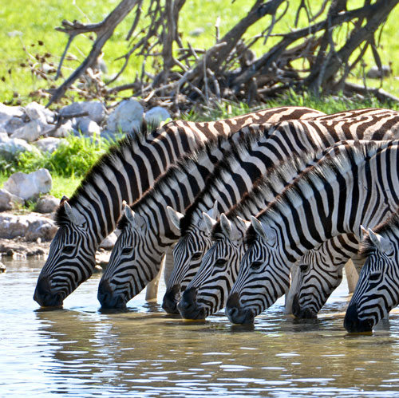
Using matter from the environment
Animals also take matter from their environment in the form
of gases and water.
Most animals need to breathe gases to survive. Gases contain matter
and come from the air.
Many animals also need
to drink water from their environment to survive.
Notes:
Photo credits: © lumen-digital, Shutterstock.com 2018

Slide 7
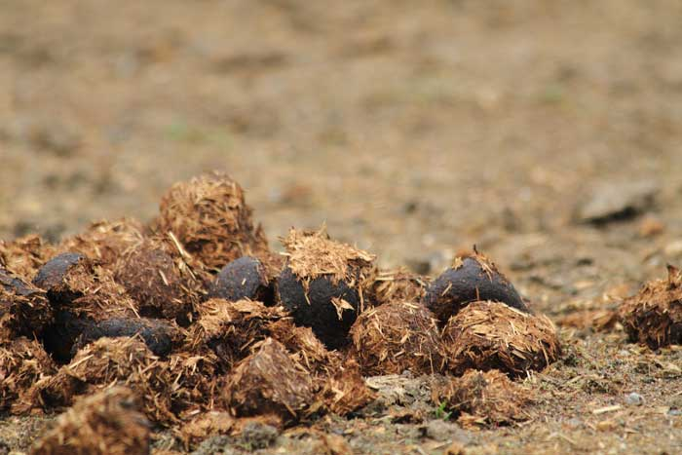
Waste matter
All organisms release waste matter throughout their lives.
Organisms release waste matter as solids, liquids and gases.
When an animal dies, what do you think happens
to all the matter it contains?
Notes:
This slide covers the Science and Engineering Practice:
Constructing Explanations and Designing Solutions: Use evidence (e.g., measurements, observations, patterns) to construct or support an explanation or to design a solution to a problem.
Photo credit: © Jiri Vaclavek, Shutterstock.com 2018

Slide 8
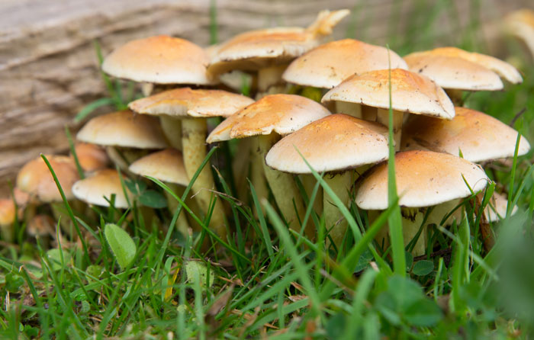
Decomposition
When an organism dies, or produces waste, the matter it contains is transferred back to the environment.
Decomposers return the matter to the air and earth, in the form of water, carbon and some other substances.
The cycle can then begin again.
Notes:
Teacher notes
You could ask students what would happen to the cycle if we took out decomposers. How would this affect the cycle?
Photo credit: © Nick Hawkes, Shutterstock.com 2018

Slide 9
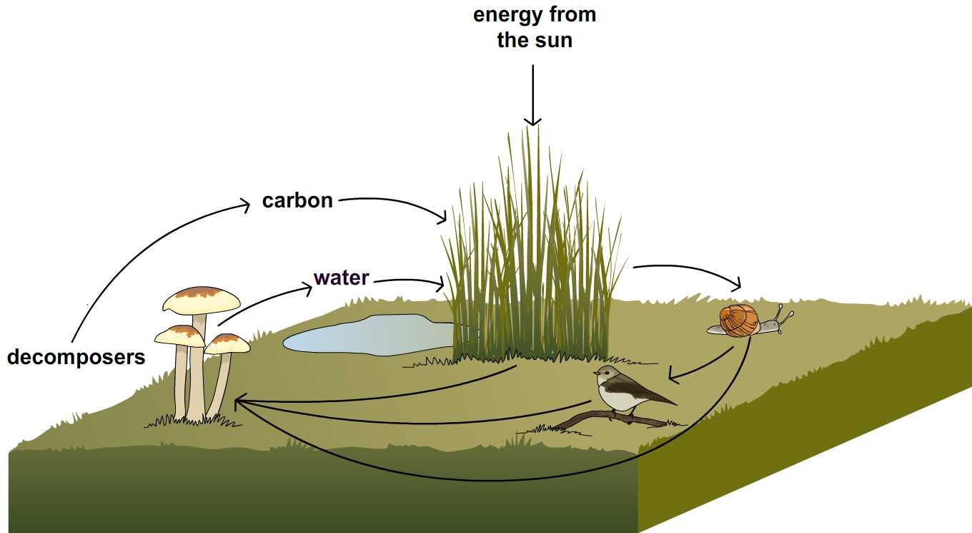
The cycle of matter
Can you describe the processes in this diagram?
Notes:
Teacher notes
Before revealing this model of the cycle of matter, you could challenge the students to make their own. Asking them to draw a diagram to show each stage, remind them that it is a cycle so the stages need to link together fully.
Students could also use this model to draw a model of a familiar food chain.
This slide covers the Science and Engineering Practice:
Developing and Using Models: Develop a model using an analogy, example, or abstract representation to describe a scientific principle or design solution.

