Slide 1
Forces

Slide 2
Information
Developing and Using Models
Engaging in Argument from Evidence
1. Patterns
2. Cause and Effect

Slide 3



What are forces?
Forces are everywhere in life. We cannot see a force, but we can see what it does.
Forces are either pushes or pulls.
When you push an object or pull a rubber band, this requires a force.
A force changes the speed of an object, its shape or the direction
it is moving in.
Notes:
Teacher notes
You could recap students’ understanding of pushes and pulls by asking them to give examples of both.
Photo credit: © Tong_stocker, Shutterstock.com 2018
3

Slide 4

Push and pull
The bigger the push or
pull, the more the speed
of an object can be changed.
In this example, the ball will travel faster when it is hit with a larger force.
If it is hit with a smaller force, the ball will travel more slowly.
Notes:
Photo credit: © Goran Bogicevic, Shutterstock.com 2018

Slide 5

What happens when you push an object?

Slide 6

Friction
If a soccer ball is kicked, it will eventually stop moving.
What causes it to stop? What force is acting on it?
It slows down due to a force called friction.
Friction is a resisting force.
It occurs when two surfaces slide over each other.
Notes:
Teacher notes
More information on friction can be found in the Friction presentation.
Photo credit: © macknimal, Shutterstock.com 2018

Slide 7
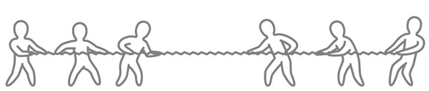
What happens when forces are balanced?
There is always more than one force acting on an object.
If an object isn’t moving, it means these forces must be balanced. The size of the force in each direction is equal.
400 N
400 N
For example, in this tug of war, both groups are pulling equally hard. There is no movement.
Notes:
Teacher notes
When forces are balanced, this either means that the object isn’t moving or that it continues to move at a constant speed.
Photo credit: © karpenko_ilia, Shutterstock.com 2018

Slide 8
What happens when forces are unbalanced?
An object will move when the forces acting on it are unbalanced. This means that the size of the forces acting on the object are unequal.
What will happen in this tug of war if one group
pulls harder?
400 N
500 N
Which direction will it move?
It will move in the direction of the largest force.
Notes:
Photo credit: © karpenko_ilia, Shutterstock.com 2018

Slide 9


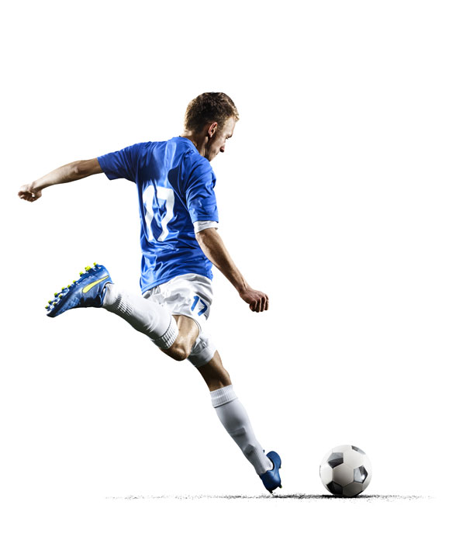
Balanced and unbalanced forces
Look at these examples. Do they show balanced or unbalanced forces?
If the forces are unbalanced, in which direction will movement happen?
Notes:
Teacher notes
You could set up some simple practical demonstrations and ask students to say whether the forces are balanced or unbalanced. You could use a hair dryer and ping pong ball, some balancing scales, a tug of war and someone sitting on a chair.
This slide covers the Science and Engineering Practices:
Engaging in Argument from Evidence: Construct and/or support an argument with evidence, data, and/or a model.
Photo credit: © Tong_stocker; Books on the table © donatas1205; Professional football soccer player © Eugene Onischenko, all at Shutterstock.com 2018

Slide 10
Forces in motion (1)
Notes:
Teacher notes
Students could carry out an investigation into motion by making their own pendulum. They can first predict how it will behave and then observe this.
This slide covers the Science and Engineering Practices:
Developing and Using Models: Develop and/or use models to describe and/or predict phenomena.
Engaging in Argument from Evidence: Construct and/or support an argument with evidence, data, and/or a model.

Slide 11
Forces in motion (2)
Notes:
This slide covers the Science and Engineering Practices:
Developing and Using Models: Develop and/or use models to describe and/or predict phenomena.
Engaging in Argument from Evidence: Construct and/or support an argument with evidence, data, and/or a model.

Slide 12
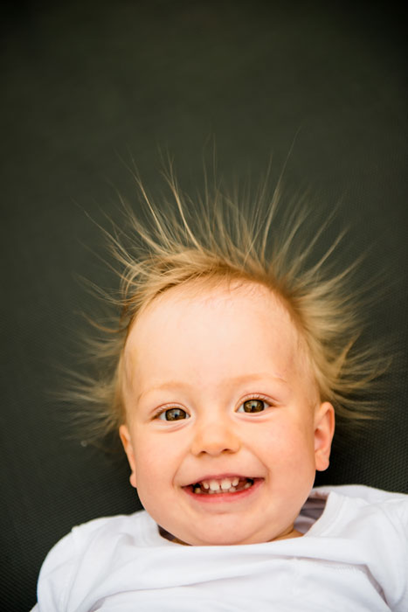
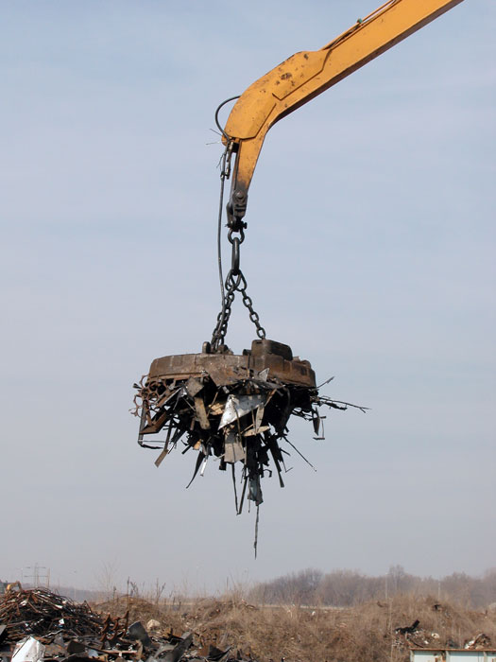
Non-contact forces
Objects in contact exert forces on each other. However, some forces can act on an object without touching it.
What non-contact forces are causing these effects?
electrical forces
magnetic forces
Notes:
Teacher notes
Non-contact forces also include gravity. More information on gravity can be found in the Gravity presentation.
Photo credits: Baby © Martin Novak; Magnet on crane © dvande, both at Shutterstock.com 2018

Slide 13
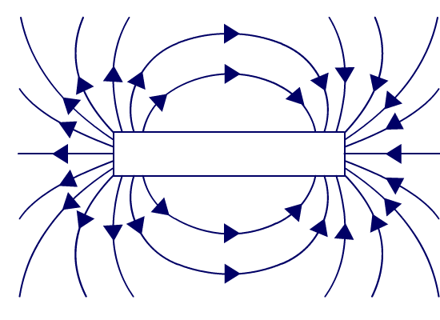

Magnetic forces
Magnets can apply a push or pull force to something without touching it due to a magnetic field.
Objects in the magnetic field can be attracted or repelled by the magnet.
Notes:
Teacher notes
For more about magnets and magnetic fields, see the Magnets presentation.

Slide 14
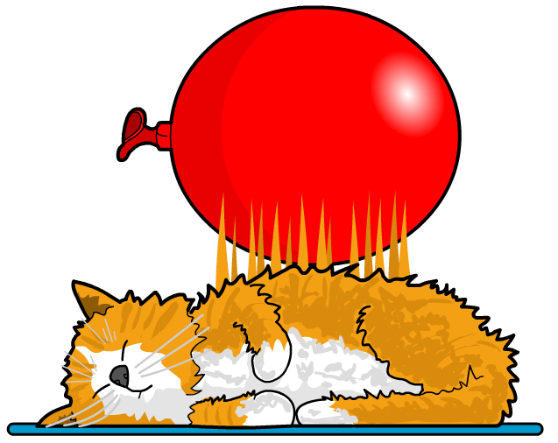
Electrical forces
When you rub a balloon on your hair, you can then ‘stick’ it to the wall. This is due to electrical forces.
All objects have charge. There are two types of charge: positive and negative.
Electrical force is how
these charges interact
with each other.
Opposite charges attract, identical charges repel.
Notes:
Teacher notes
As you rub a balloon on your head, you are charging it by giving it a negative charge. This causes the positive charges in the wall to pull on the negative balloon and attract it to the wall!

