Slide 1
Cells

Slide 2
Information
Using Mathematics and Computational Thinking
1. Patterns
3. Scale, Proportion, and Quantity
6. Structure and Function

Slide 3

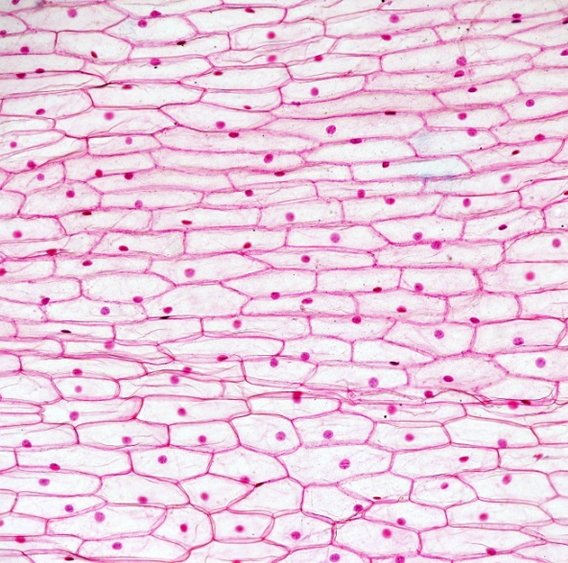

What is a cell?
A cell is the basic building block of life, from which all living organisms are made.
Unicellular organisms, such as bacteria, consist
of just a single cell.
Multicellular organisms consist of many cells – humans are made from an estimated 50 trillion cells!
Notes:
Teacher notes
Unicellular organisms are also called single-celled organisms.
There is considerable uncertainty about the number of cells in a human body. Estimates vary from 10 trillion to 100 trillion cells.
Photo credit: onion skin cells © D. Kucharski and K. Kucharska, Shutterstock.com 2018

Slide 4

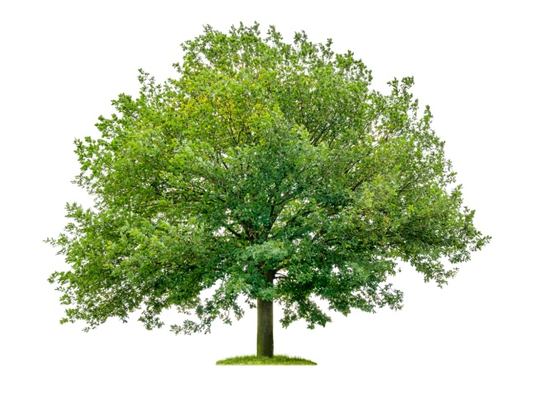
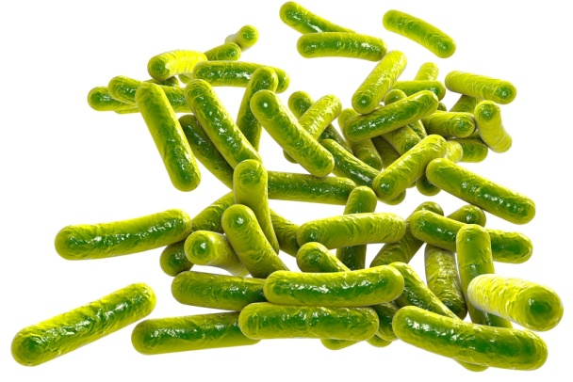
Types of cell
Cells can be divided into two main groups:
Eukaryotic cells
These include cells that
form animals and plants.
Prokaryotic cells
These include bacterial cells.
These two groups of cells vary significantly in both their structure and size.
Notes:
Photo credits: Elephant © Sevenke, Oak tree © Zerbor, rod shaped bacteria © Kateryna Kon, all at Shutterstock.com 2018

Slide 5
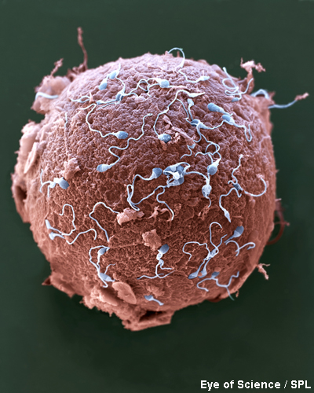
How big is a cell?
Most eukaryotic cells are between 10 µm and 100 µm in size – around the diameter of a human hair – and too
small to see without a microscope.
The largest cell in the human body is the female egg cell, at around 100 µm in diameter.
The smallest human cell is the sperm cell, at around 5 µm long.
Prokaryotic cells are much smaller
than eukaryotic cells.
Notes:
Teacher notes
One micrometer (µm), also known as a micron, is equal to one-millionth of a meter. 1 µm = 0.000001 m.
Photo credit: © Eye of Science, Science Photo Library 2018
Colored scanning electron micrograph (SEM) of sperm (blue) attempting to penetrate a human egg (red). Each sperm (spermatozoa) has a rounded head and a long tail with which it swims. Women usually release one egg (ovum) per month, whereas men release millions of sperm in each ejaculation. Only one of these sperm can penetrate the egg's thick outer layer (zona pellucida) and fertilize it. Fertilization occurs when the sperm's genetic material (deoxyribonucleic acid, DNA) fuses with the egg's DNA. When this occurs, the egg forms a barrier to other sperm. Magnification: ×650 when printed 10 centimeters wide.

Slide 6

How do the sizes of cells compare?
The average prokaryotic cell is about 10 times smaller
than the average eukaryotic cell.
This means that, in general, eukaryotic cells are one order
of magnitude larger than prokaryotic cells.
10 times larger = 1 order of magnitude
100 times larger = 2 orders of magnitude
1,000 times larger = 3 orders of magnitude
With each order of magnitude, there is difference by a scale of 10.
If cell A is 5 µm wide and cell B is 500 µm wide, to what
order of magnitude is cell B larger than cell A?
Notes:
Teacher notes
Discuss students’ ideas for the question. Cell B is 2 orders of magnitude larger than cell A. This is because cell B is 100 times larger than cell A.
This slide covers the Science and Engineering Practice:
Using Mathematics and Computational Thinking: Use mathematical, computational, and/or algorithmic representations of phenomena or design solutions to describe and/or support claims and/or explanations.

Slide 7
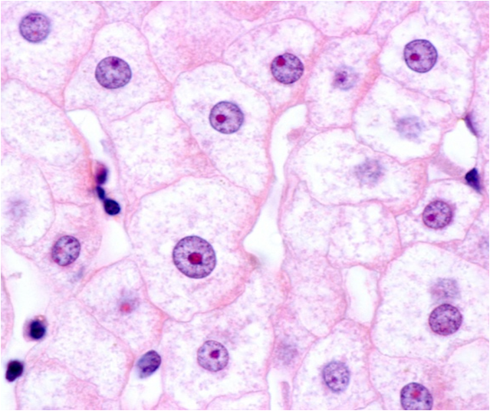
Cell structure
Inside cells are many parts called sub-cellular structures.
Each type of sub-cellular structure has a specific role that contributes to the overall function of the cell.
One of the most important sub-cellular structures found in all eukaryotic cells is the nucleus. It contains a cell’s
genetic information.
Unlike eukaryotic cells, prokaryotic cells do not
have a nucleus.
Notes:
Photo credit: liver cells (hepatocytes) © Jose Luis Calvo, Shutterstock.com 2018

Slide 8


Exploring animal cells
Notes:
Teacher notes
This click and reveal activity could be used to check students’ understanding of the sub-cellular structures found in animal cells.

Slide 9
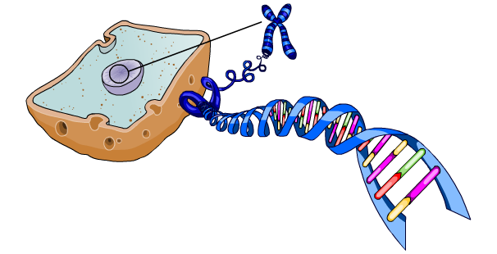
What is the nucleus?
The nucleus stores and protects the cell’s genetic material from chemicals in the cytoplasm.
Inside the nucleus are chromosomes.
Each chromosome contains many genes and is made of DNA. The genes are the instructions that tell the cell how to function.
cell
chromosome
nucleus
DNA
Notes:
Teacher notes
Remind students that a gene is a short section of DNA found in a chromosome. Each gene controls a particular characteristic of the organism.
For more information on DNA and genes, please refer to the DNA and the Genome presentation.

Slide 10
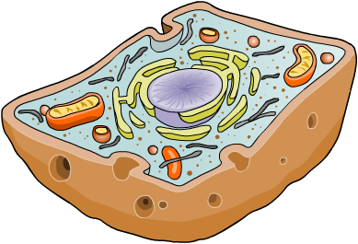
Mitochondria and ribosomes
The mitochondria are the power houses of cells. They are the site of aerobic cellular respiration.
mitochondrion
Cellular respiration releases energy which is used by cells
to carry out living processes.
The ribosomes are one of the smallest sub-cellular structures
and the site of protein synthesis.
ribosome
Genes in the nucleus contain instructions that tell the ribosomes how to make new proteins from amino acids.
Notes:
Teacher notes
Aerobic cellular respiration requires oxygen to occur. In eukaryotic cells, anaerobic respiration occurs in the cytoplasm via a different set of chemical reactions.
The singular of mitochondria is mitochondrion.
For more information on cellular respiration, please refer to the Cellular Respiration presentation.

Slide 11
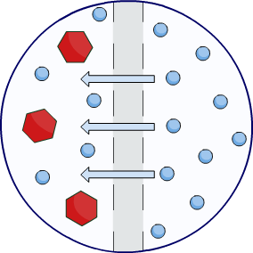
The role of the cell membrane
The cell membrane surrounds the entire contents of a cell.
Its main role is to control what substances are able to pass in and out of the cell.
Receptor molecules on the
cell membrane recognize specific substances. Some substances
are allowed to pass freely, while others are prevented from crossing.
This enables the cell membrane to act as a selective barrier.
The cell membrane also supports
the cell and can influence its shape.
Notes:
Teacher notes
In the image, the blue molecules can pass across the (grey) cell membrane freely, but the red molecules cannot.
As a result of their selectivity, cell membranes are described as “partially permeable.”
For more information on transport across cell membranes, please refer to the Cell Transport presentation.

Slide 12
Exploring plant cells
Notes:
Teacher notes
This click and reveal activity could be used to check students’ understanding of the sub-cellular structures found in plant cells.

Slide 13
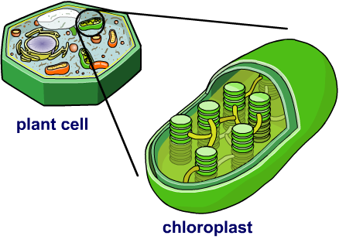
What are chloroplasts?
Plants are able to produce their own food. This is because some plant cells contain chloroplasts, which are able to carry out photosynthesis.
A green pigment in chloroplasts called chlorophyll absorbs
the energy in sunlight.
During photosynthesis, this energy is used to convert carbon dioxide and water into glucose and oxygen.
Notes:
Teacher notes
Chloroplasts are between 2 µm and 10 µm in diameter.
For more information on the role of chloroplasts in photosynthesis, please refer to the Photosynthesis presentation.

Slide 14
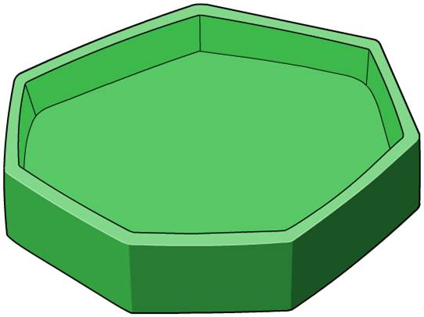
What is a cell wall?
All plant cells have a cell wall that surrounds the
cell membrane.
It is made from cellulose, a type of carbohydrate.
The role of the cell wall is to maintain the cell’s shape and
to strengthen the cell by
providing structural support.
Unlike the cell membrane,
the cell wall does not control
what can pass through it.
Algal cells are a type of single-celled eukaryotic organism that also have a cell wall made of cellulose.

Slide 15
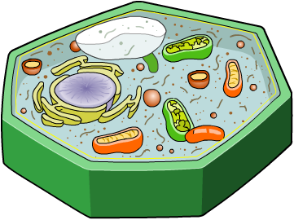
What is a vacuole?
The vacuole is a compartment found within plant cells,
filled with a fluid called cell sap.
vacuole
Functions of the vacuole include:
storing waste products
maintaining the water and
pH balance of the cell
maintaining cell shape.
The size of the vacuole depends on how much water the plant has absorbed through its roots.
Notes:
Teacher notes
Some animal cells have a small/temporary vacuole involved in digestion or secretion.
Some bacterial cells also have vacuoles.

Slide 16
Locating sub-cellular structures
Notes:
Teacher notes
Appropriately colored voting cards could be used with this classification activity to increase class participation.

Slide 17
Which sub-cellular structure?
Notes:
Teacher notes
This activity could be used to check students’ understanding of cell structure and function. Students could work individually or in small groups, with mini-whiteboards used to convey the answers.

Slide 18
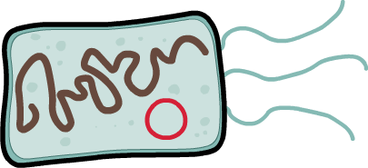
Structure of bacterial cells
Bacterial cells are a type of prokaryotic cell. They look very different to animal and plant cells.
cell membrane
The most noticeable difference is the lack of a nucleus and mitochondria.
ribosome
However, there are some
similarities. Like eukaryotic
cells, bacterial cells have a
cell membrane, cytoplasm
and ribosomes.
cytoplasm
Notes:
Teacher notes
Ribosomes in prokaryotic cells are smaller than those in eukaryotic cells.

Slide 19

Sub-cellular structures in a bacterial cell

Slide 20
Bacterial DNA
Bacteria cells have no nucleus to protect their genetic material. Instead, their DNA is found free in the cytoplasm.
The majority of their genetic material is contained within a single loop of chromosomal DNA.
chromosomal
DNA
Many bacterial cells also contain circular structures
called plasmids, which
also contain DNA.
A bacterial cell can contain more than one plasmid.
circular
plasmid DNA

Slide 21
Other bacterial structures
Some bacteria have one or more flagella.
Flagella are tail-like structures that can spin to allow the bacterial cell to move.
The cell membrane of some bacterial cells are surrounded by a cell wall.
flagellum
As in plant cells, its role is
to protect and strengthen
the bacterial cell.
cell wall
Some bacterial cells have neither of these structures, while others have both.
Notes:
Teacher notes
The singular of flagella is flagellum.

