Slide 1
Cellular Respiration

Slide 2
Information
Asking Questions and Defining Problems
Planning and Carrying Out Investigations
Constructing Explanations and Designing Solutions
1. Patterns
2. Cause and Effect
5. Energy and Matter

Slide 3

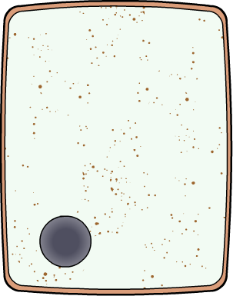



What is cellular respiration?
All organisms need a supply of energy to survive. This is because all living processes use energy. Together, these processes are known as the metabolism of an organism.
The process providing this energy
is called cellular respiration.
Cellular respiration is referred
to as a universal chemical process because it is continuously occurring in all living cells.
Cellular respiration can occur aerobically (with oxygen),
or anaerobically (without oxygen). It is an exothermic reaction which means it releases energy into the environment.
Notes:
Teacher notes
It might be necessary to remind students that cellular respiration is not the same as breathing.

Slide 4


What do organisms need energy for?
Cells need the energy released by cellular respiration to carry out all living processes.
What are some of these living processes?
Movement – energy is needed for muscle cells to contract.
Biosynthesis – chemical reactions
that build large molecules from smaller ones. For example, proteins are built from amino acids.
Thermoregulation – cellular respiration is used by many organisms to keep
themselves warm.

Slide 5
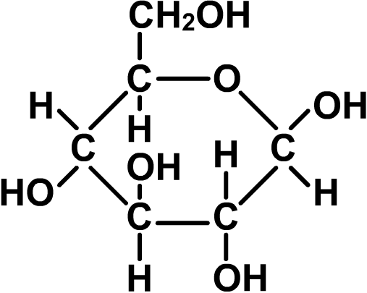
Aerobic respiration
Aerobic respiration takes place continuously in plants and animals, as well as in some microorganisms. However, it can only occur if there is a supply of oxygen available.
During aerobic respiration, glucose reacts with oxygen in a reaction called oxidation.
Glucose contains a source
of energy. When it reacts with oxygen, this energy is released. The energy is used to support living processes.
Carbon dioxide and water are
produced as waste products.
glucose
Notes:
Teacher notes
The chemical formula for glucose is C₆H₁₂O₆.

Slide 6


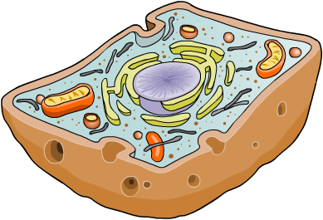
The aerobic reaction
This is the reaction for aerobic respiration:
+
carbon
dioxide
+
glucose
oxygen
water
+
( energy)
C₆H₁₂O₆
O₂
CO₂
H₂O
The energy released is transferred to a molecule called ATP. ATP transports the energy to wherever it is needed in the cell.
In eukaryotic cells,
including animal and
plant cells, aerobic
respiration occurs
in the mitochondria.
mitochondria
Notes:
Teacher notes
The chemical formulae provided do not provide a balanced equation. They are intended to enable students to recognize the individual components of the aerobic respiration reaction.
ATP is adenosine triphosphate.

Slide 7


Aerobic respiration: true or false?
Notes:
Teacher notes
This exercise could be used to assess students’ understanding of aerobic respiration.

Slide 8
Using a respirometer

Slide 9


Investigating respiration
Notes:
This slide covers the Science and Engineering Practices:
Asking Questions and Defining Problems: Ask questions that can be investigated within the scope of the school laboratory, research facilities, or field (e.g., outdoor environment) with available resources and, when appropriate, frame a hypothesis based on a model or theory.
Planning and Carrying Out Investigations: Plan and conduct an investigation individually and collaboratively to produce data to serve as the basis for evidence, and in the design: decide on types, how much, and accuracy of data needed to produce reliable measurements and consider limitations on the precision of the data (e.g., number of trials, cost, risk, time), and refine the design accordingly.
Constructing Explanations and Designing Solutions: Make a quantitative and/or qualitative claim regarding the relationship between dependent and independent variables.

Slide 10
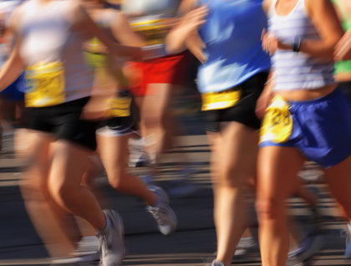
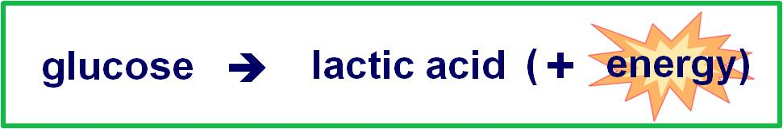
Anaerobic respiration in muscle
When a muscle cell does not have the necessary oxygen to break down glucose, it must carry out anaerobic respiration.
This can occur during
vigorous exercise, if the
demand for oxygen by
the muscles exceeds the
amount that can be
delivered by the blood.
The equation for anaerobic respiration in muscle is:
Notes:
Teacher notes
Students should understand that anaerobic respiration does not replace aerobic respiration through out the body during exercise. Only the muscle cells that require more energy will carry out anaerobic respiration if there is not enough oxygen present.
Cardiac muscle cells do not carry out anaerobic respiration.
Photo credit: © Suzanne Tucker, Shutterstock 2018

Slide 11

What is anaerobic respiration?
Aerobic respiration uses oxygen to break down glucose.
It releases a lot of energy from each glucose molecule by breaking it down completely through the process of oxidation.
Anaerobic respiration takes place without oxygen.
Less energy is released per glucose molecule in anaerobic respiration. This is because the oxidation of glucose is incomplete.
As a result, fewer ATP molecules
are produced in anaerobic respiration than aerobic respiration.
Notes:
Teacher notes
In aerobic respiration, 38 ATP molecules are formed from each glucose molecule. In anaerobic respiration, only two ATP molecules are formed from a molecule of glucose, although more can be produced later when lactic acid breaks down.

Slide 12
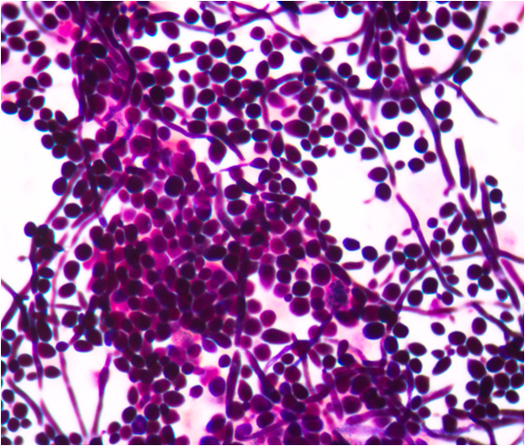
Anaerobic respiration in plants and yeast
Plants and some microorganisms, such as yeast (a type
of fungus), can also carry out anaerobic respiration if the supply of oxygen is limited.
This can happen in the root
cells of plants growing in
waterlogged soil, or bacteria
infecting deep wounds.
The products of anaerobic
respiration in plants and some microorganisms are
different to muscle cells:
glucose
carbon dioxide + ethanol (+ energy)
Notes:
Teacher notes
Although some bacteria make lactic acid during anaerobic respiration, most microorganisms produce ethanol.
Photo credit: budding yeast cell structure © toeytoey, Shutterstock.com 2018

Slide 13
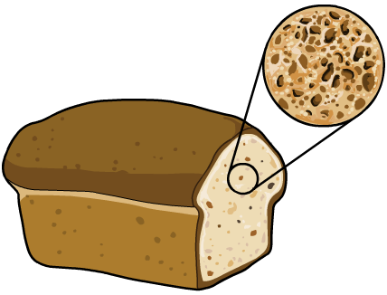
Uses of yeast (1)
Anaerobic respiration in yeast is called fermentation.
Fermentation is an important process in the manufacture
of products, including bread and alcoholic drinks.
Yeast added to bread dough
uses carbohydrates in the flour
to carry out cellular respiration.
The carbon dioxide produced
causes bread to rise. It also
creates gas pockets in the
dough, giving baked bread
a spongy texture.
Notes:
Teacher notes
Ask students to suggest why they think yeast can respire using carbohydrates. Carbohydrates are made from many individual sugar molecules joined together.

Slide 14
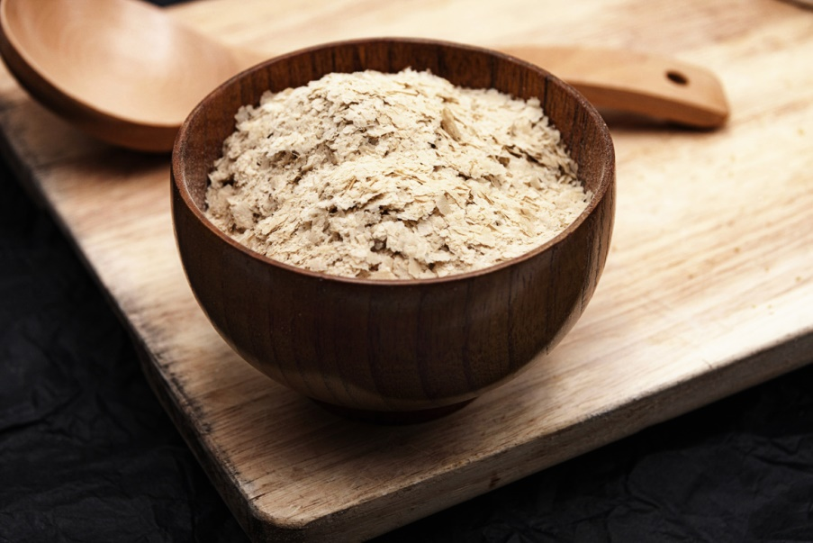
Uses of yeast (2)
During fermentation, anaerobic respiration in yeast cells converts glucose into ethanol. Ethanol is a type of alcohol.
The amount of ethanol that can be produced is limited. Once a certain concentration of ethanol is reached, it becomes toxic to the yeast.
The glucose comes from different sources depending on
the type of alcoholic drink being produced. In winemaking, natural sugars in the grapes are used by the yeast to respire.
Notes:
Photo credit: yeast flakes © QuinVa Stock, Shutterstock.com 2018

Slide 15
Aerobic versus anaerobic respiration
Let’s take a look at some of the similarities and differences between aerobic and anaerobic respiration.
aerobic respiration | anaerobic respiration | both
requires oxygen to occur
occurs in the absence of oxygen
occur in animals
and plants
glucose is oxidized completely
glucose is not oxidized completely
involve oxidation of glucose
produces the greatest number of ATP molecules per glucose molecule
produces lactic
acid
release energy from glucose
enables fermentation
produce ATP

