Slide 1
Ecosystem Dynamics

Slide 2
Information
Developing and Using Models
Constructing Explanations and Designing Solutions
Engaging in Argument from Evidence
Obtaining, Evaluating and Communicating Information
1. Patterns
2. Cause and Effect
3. Scale, Proportion, and Quantity
4. Systems and System Models
7. Stability and Change

Slide 3
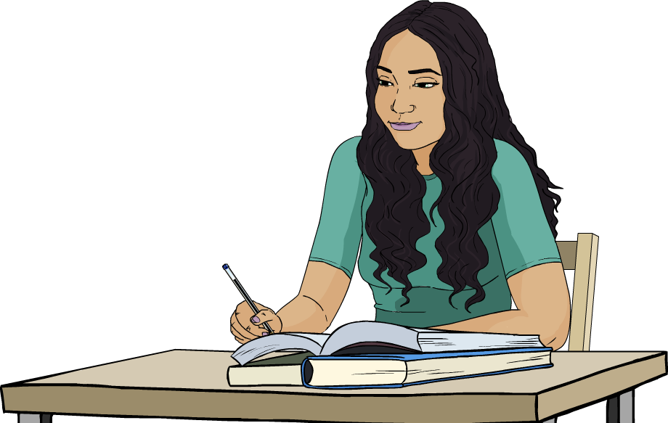

Ecosystem stability
A stable ecosystem has characteristics that stay relatively constant over time.
This includes biotic characteristics, such as the numbers
and types of organisms, and abiotic characteristics.
The components of a stable ecosystem exist in an equilibrium.
If a change occurs,
a stable ecosystem is
capable of returning to
its equilibrium state.

Slide 4
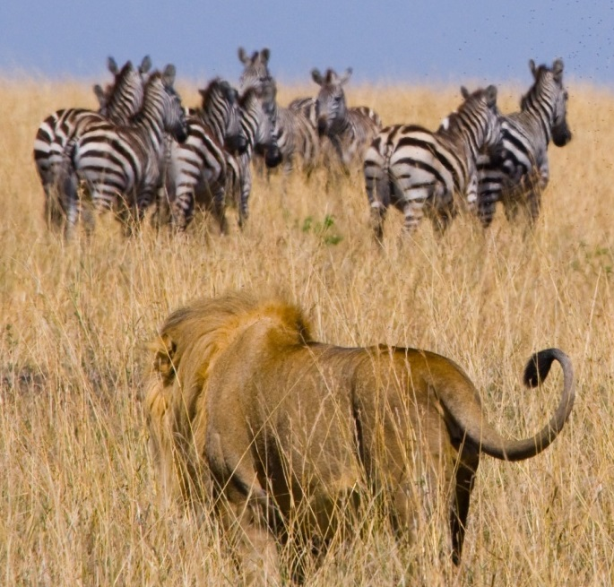
Factors that cause change
Different types of factors can cause change in an ecosystem.
Abiotic (non-living) factors include temperature, light intensity, soil pH and mineral composition, water availability, humidity and concentrations of oxygen and carbon dioxide.
Biotic (living) factors include predators, pathogens, food availability and competition.
Notes:
Photo credit: © GUDKOV ANDREY, Shutterstock.com 2018

Slide 5


Physical factors affecting organisms

Slide 6


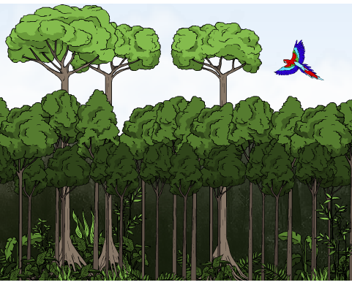
Forest ecosystems
Some forest ecosystems have existed for thousands of years. They are examples of stable ecosystems.
Biodiversity is high and small changes are absorbed through natural feedback processes.
For example, a tree falling over creates change in the area it once filled.
Can you explain how?
Over time, regrowth occurs and the area returns to a similar state.
Notes:
Teacher notes
The fall of a tree in a forest causes many localized changes. Organisms that once lived in the tree lose their habitat. The gap alters the microclimate for the surrounding organisms. Changes in light intensity, temperature and humidity support the growth of other trees and plants, as well as the other organisms they can support. Over time, the gap created by the original tree is filled and the ecosystem returns to its equilibrium position.
This slide covers the Science and Engineering Practices:
Constructing Explanations and Designing Solutions: Apply scientific ideas, principles, and/or evidence to provide an explanation of phenomena and solve design problems, taking into account possible unanticipated effects.
Obtaining, Evaluating, and Communicating Information: Communicate scientific and/or technical information or ideas (e.g. about phenomena and/or the process of development and the design and performance of a proposed process or system) in multiple formats (including orally, graphically, textually, and mathematically).

Slide 7
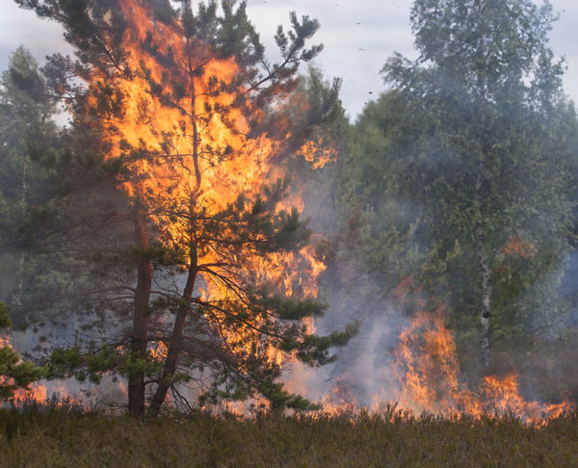
Resilience and resistance
A resilient ecosystem is an ecosystem that can return to its former state after experiencing a change.
A resistant ecosystem can experience a change without being affected by it.
Forest ecosystems can be severely damaged by fires. However, some can regrow relatively quickly.
These ecosystems are resilient but not resistant.
Notes:
Photo credit: © Viesinsh, Shutterstock.com 2018

Slide 8
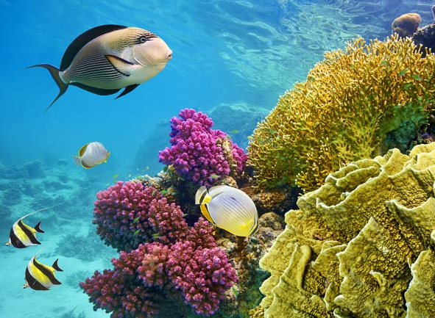
Stability and biodiversity
Resilient ecosystems are usually associated with high biodiversity.
Different species have different adaptations and are suited to a range of niches within the ecosystem.
If a change occurs, ecosystems with high biodiversity are more likely to have a range of organisms that can grow and reproduce in new conditions.
This means that high biodiversity allows an ecosystem to respond and recover after a change.
Notes:
Photo credit: © Helen Hotson, Shutterstock.com 2018

Slide 9
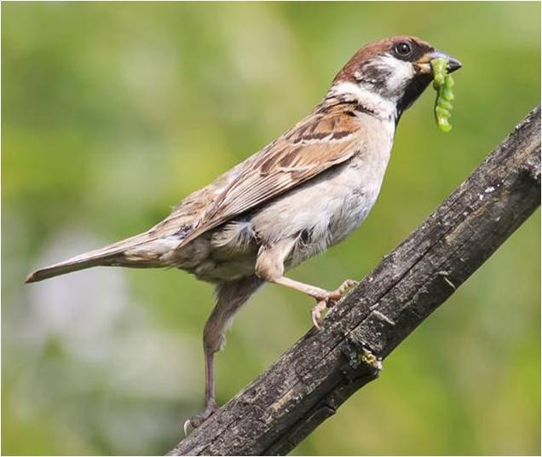
Interdependence
Stable ecosystems often experience natural fluctuations in the population numbers of some species.
Different species within an ecosystem are connected.
They depend on each other
for food, shelter, pollination
and reproduction. This is called interdependence.
Interdependence means
that a change in one species will affect others in the same ecosystem.
Notes:
Photo credit: © Bachkova Natalia, Shutterstock.com 2018

Slide 10
Predator–prey relationships
Interdependence can be seen in the population numbers of predator and prey species in a food chain.
Can you identify the predator and prey species in this
food chain?
plant
snowshoe hare
lynx
In some ecosystems, the population numbers of hare and lynx rise and fall in linked cycles.
These are known as predator–prey cycles.
Notes:
Teacher notes
Students should be able to identify that the lynx is the predator species and the snowshoe hare is the prey species in the food chain shown.
This slide covers the Science and Engineering Practices:
Constructing Explanations and Designing Solutions: Apply scientific ideas, principles, and/or evidence to provide an explanation of phenomena and solve design problems, taking into account possible unanticipated effects.
Obtaining, Evaluating, and Communicating Information: Communicate scientific and/or technical information or ideas (e.g. about phenomena and/or the process of development and the design and performance of a proposed process or system) in multiple formats (including orally, graphically, textually, and mathematically).

Slide 11
Predator–prey populations
Notes:
Teacher notes
The data on population sizes of the snowshoe hare and its chief predator, the lynx, were estimated from the number of furs for sale at trading posts in Hudson Bay, Canada.
Students could be asked:
what happens to the hare population when the lynx population increases?
Following an increase in lynx population, the hare population decreases.
what happens to the lynx population when the hare population decreases?
Following a decrease in hare population, the lynx population decreases.
This slide covers the Science and Engineering Practice:
Constructing Explanations and Designing Solutions: Make a quantitative and/or qualitative claim regarding the relationship between dependent and independent variables.

Slide 12
Predator–prey cycles (1)
Notes:
This slide covers the Science and Engineering Practice:
Developing and Using Models: Develop, revise, and/or use a model based on evidence to illustrate and/or predict the relationships between systems or between components of a system.

Slide 13
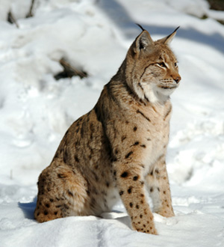
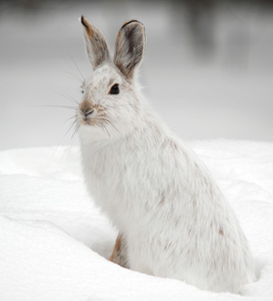
Predator–prey cycles (2)
Both the hare and the lynx populations follow a cyclical
pattern, where they regularly rise and fall in size.
The hare population changes due to both the vegetation growing season and changes in the lynx population.
The lynx is dependent on hares for food, so as the hare population changes so does the lynx population.
The hare and lynx are interdependent.
Notes:
Photo credit: lynx © Eduard Kyslynskyy; hare © nialet, both at Shutterstock.com 2018

Slide 14
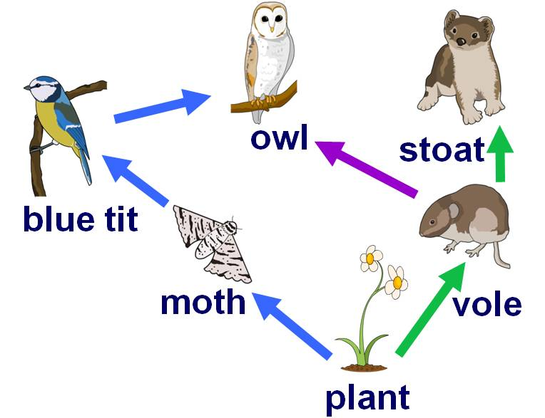
Interdependence in a food web
Interdependence
Complex food webs connect many species within an ecosystem.
Species within a food web
are interdependent.
A change in the population number of one species
will affect other species
within the same food web.
What will happen to the population of blue tits and stoats if moths are removed from this food web?
Notes:
Teacher notes
Removing moths from this ecosystem will cause a decrease in blue tit population and an increase in plant numbers. The increase in plant numbers would increase the population of voles, which could lead to an increase in stoat population. Owls would become more dependent on voles for food due to the decrease in blue tit population.
For more information about food chains, please refer to the Feeding Relationships presentation.
This slide covers the Science and Engineering Practices:
Constructing Explanations and Designing Solutions: Apply scientific ideas, principles, and/or evidence to provide an explanation of phenomena and solve design problems, taking into account possible unanticipated effects.
Obtaining, Evaluating, and Communicating Information: Communicate scientific and/or technical information or ideas (e.g. about phenomena and/or the process of development and the design and performance of a proposed process or system) in multiple formats (including orally, graphically, textually, and mathematically).

Slide 15
Changes in food webs activity
Notes:
This slide covers the Science and Engineering Practice:
Constructing Explanations and Designing Solutions: Apply scientific ideas, principles, and/or evidence to provide an explanation of phenomena and solve design problems, taking into account possible unanticipated effects.

Slide 16
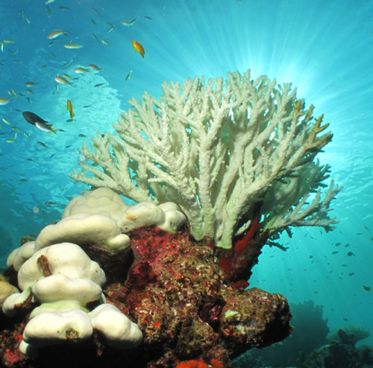
Extreme changes
Ecosystems cannot remain stable in the face of an extreme change.
If an extreme change occurs, a stable ecosystem is unable to return to its equilibrium state.
This can cause the ecosystem to be replaced by a different type of stable ecosystem.
This is known as a regime shift.
Notes:
Teacher notes
A regime shift may also be known as a phase shift. The image shows coral bleaching in a stressed reef ecosystem. Some coral reefs can recover from bleaching, whereas others undergo a regime shift. Hard coral reefs have been documented shifting to soft coral or sponge based ecosystems, as well as sea urchin barrens.
Photo credit: © acro_phuket, Shutterstock.com 2018

Slide 17
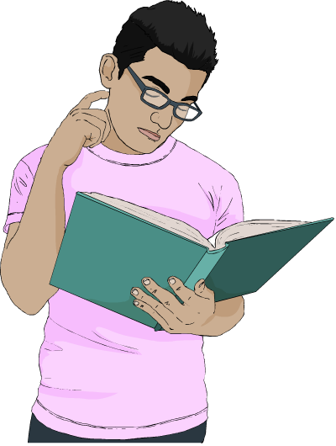
Regime shift
A regime shift is an extreme and abrupt change to an alternative type of ecosystem.
The new ecosystem is a
new stable state, with its own
feedback systems that allow
it to absorb change.
This means that regime shifts are difficult to reverse.

Slide 18
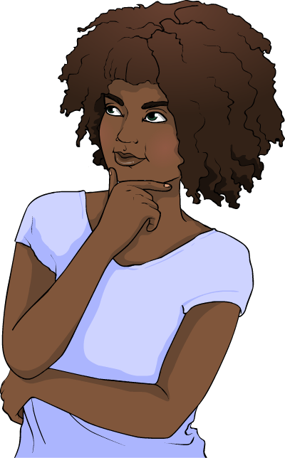
What causes a regime shift?
Multiple changes acting together over a long period of time increase the likelihood of a regime shift.
In isolation, each change may be
absorbed by the ecosystem with little
noticeable impact.
However, in combination, the
changes weaken the ecosystem,
reducing its resilience.
Eventually, a threshold is reached,
past which the ecosystem is no longer
stable and a regime shift occurs.

Slide 19
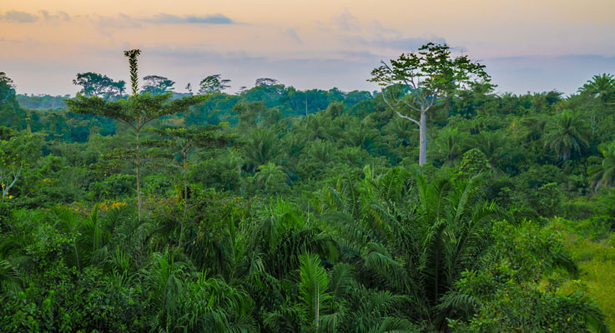
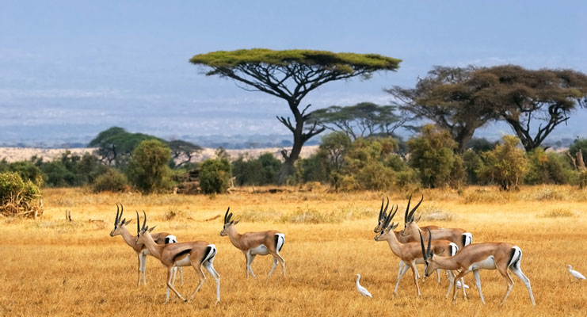
Forest and savannah ecosystems
Tropical forest and savannah are two common types of stable ecosystem that exist in similar geographical areas.
Changes in one ecosystem can cause a regime shift that produces the other ecosystem.
Fire, extreme weather and pressures from herbivores, humans and soil conditions are drivers of change in these ecosystems.
Notes:
Teacher notes
It should be stressed to students that each ecosystem exists as a diverse, complex and stable ecosystem in its own right; savannah is not a degraded version of forest.
The exact reasons causing regime shifts in these ecosystems are not fully understood and this is an area of active research.
Photo credit: forest © Fabian Plock, savannah © Oleg Znamenskiy, both at Shutterstock.com 2018

Slide 20
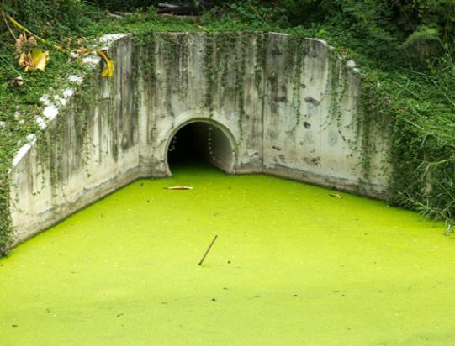
Human impact on ecosystem change
Human activities can be a source of pressure on ecosystems that forces regime shifts.
Overuse of resources, change in land use and pollution are drivers of change in ecosystems.
Pollution can cause eutrophication in aquatic ecosystems.
In this process, a clear
water ecosystem supporting a wide range of organisms changes to a system that supports a smaller number
of organisms.
Notes:
Photo credit: © Lodimup, Shutterstock.com 2018

Slide 21
Eutrophication
Notes:
Teacher notes
This five-stage animation illustrates the process of eutrophication. Suitable prompts could include:
Why do fertilizers make algae grow?
Increased amount of algae will reduce the amount of sunlight reaching plants. What effect will this have?
What will happen to the dead plants?
Why will bacterial decomposition of plants affect fish and other animal life in the lake?
Students can investigate eutrophication for themselves. Jars can be set up with a set amount of algae and different amount of phosphate in each. They can be left for a few days and then an oxygen probe can be used to measure the amount of dissolved oxygen in the water in each jar.
This slide covers the Science and Engineering Practice:
Constructing Explanations and Designing Solutions: Apply scientific ideas, principles, and/or evidence to provide an explanation of phenomena and solve design problems, taking into account possible unanticipated effects.

Slide 22
Eutrophication activity
Notes:
Teacher notes
This ordering activity could be used as an introductory or summary activity on eutrophication. Mini-whiteboards could be used to make this a whole-class exercise.
This slide covers the Science and Engineering Practice:
Constructing Explanations and Designing Solutions: Apply scientific ideas, principles, and/or evidence to provide an explanation of phenomena and solve design problems, taking into account possible unanticipated effects.

Slide 23
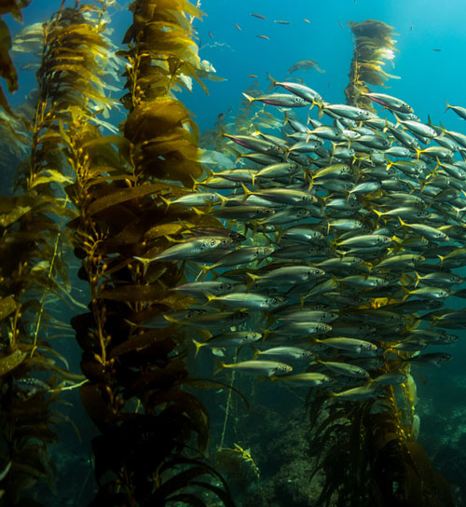
Change in kelp ecosystems (1)
Kelp is a type of seaweed. Kelp forests are stable marine ecosystems with a high biodiversity.
In these ecosystems, large fish species such as cod, haddock and wolffish prey on sea urchin species, which in turn eat kelp.
In some areas, such as the Northwest Atlantic, overfishing
has caused large reductions
in the populations of these
predatory fish.
What effect do you think this
has had on the ecosystem?
Notes:
Teacher notes
Similar to trees in a terrestrial forest, kelp forests support a large abundance and diversity of organisms. They provide habitats for thousands of species of fish and invertebrates, as well as supporting food chains that include fishing birds, otters, seals and porpoise.
Help students to apply their knowledge of food chains to answer the question. They should be able to deduce that a reduction in predators will cause an increase in the population size of prey species. This is discussed in more detail on the next slide.
This slide covers the Science and Engineering Practices:
Constructing Explanations and Designing Solutions: Apply scientific ideas, principles, and/or evidence to provide an explanation of phenomena and solve design problems, taking into account possible unanticipated effects.
Obtaining, Evaluating, and Communicating Information: Communicate scientific and/or technical information or ideas (e.g. about phenomena and/or the process of development and the design and performance of a proposed process or system) in multiple formats (including orally, graphically, textually, and mathematically).
Photo credit: © Kirk Wester, Shutterstock.com 2018

Slide 24
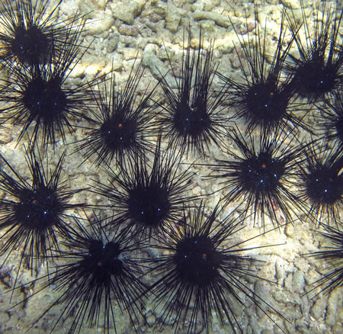
Change in kelp ecosystems (2)
Without their natural predators, sea urchin populations increase significantly.
The sea urchins eat the kelp forests faster than they
can regrow.
This causes the forests to
be destroyed, and a new ecosystem state, called an urchin barren, exists instead.
Continued grazing by the urchins prevents regrowth
of the kelp forest.
How is biodiversity affected by this change?
Notes:
Teacher notes
Regime shifts from kelp forests to urchin barrens have been well documented in areas including Maine, Nova Scotia, the Aleutian Islands, Norway and Tasmania. Regrowth of kelp forests has been documented in areas where control of sea urchin populations has returned.
Help students to apply their understanding of biodiversity and the information provided to answer the question. They should be able to deduce that biodiversity in the urchin barren is much lower than in the kelp forest.
This slide covers the Science and Engineering Practices:
Constructing Explanations and Designing Solutions: Apply scientific ideas, principles, and/or evidence to provide an explanation of phenomena and solve design problems, taking into account possible unanticipated effects.
Engaging in Argument from Evidence: Construct, use, and/or present an oral and written argument or counter-arguments based on data and evidence.
Obtaining, Evaluating, and Communicating Information: Communicate scientific and/or technical information or ideas (e.g. about phenomena and/or the process of development and the design and performance of a proposed process or system) in multiple formats (including orally, graphically, textually, and mathematically).
Photo credit: © Jeanne Wassenaar, Shutterstock.com 2018

Slide 25

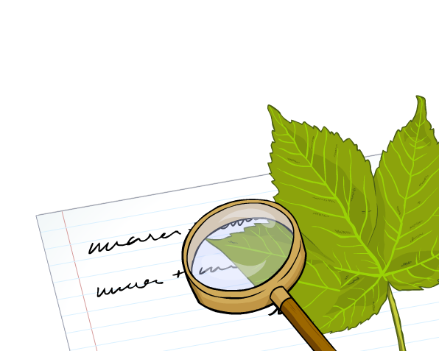
Regime shift activity
Write a report that describes a regime shift in an ecosystem of your choice.
Describe the changes that occurred and explain the reasons behind them.
You will need to gather and evaluate information from multiple authoritative sources to support your work.
Notes:
This slide covers the Science and Engineering Practices:
Constructing Explanations and Designing Solutions: Apply scientific ideas, principles, and/or evidence to provide an explanation of phenomena and solve design problems, taking into account possible unanticipated effects.
Engaging in Argument from Evidence: Construct, use, and/or present an oral and written argument or counter-arguments based on data and evidence.
Obtaining, Evaluating, and Communicating Information: Gather, read, and evaluate scientific and/or technical information from multiple authoritative sources, assessing the evidence and usefulness of each source.
Obtaining, Evaluating, and Communicating Information: Communicate scientific and/or technical information or ideas (e.g. about phenomena and/or the process of development and the design and performance of a proposed process or system) in multiple formats (including orally, graphically, textually, and mathematically).

