Slide 1
Changing Reaction
Rates

Slide 2
Information
Developing and Using Models
Planning and Carrying Out Investigations
Analyzing and Interpreting Data
Using Mathematics and Computational Thinking
Constructing Explanations and Designing Solutions
1. Patterns
2. Cause and Effect
3. Scale, Proportion, and Quantity
5. Energy and Matter

Slide 3



Reactions, particles and collisions
Collision theory says that reactions can only take place when particles collide with a certain amount of energy.
The minimum amount of energy needed for the particles to react is called the activation energy, and is different for each reaction.
The rate of a reaction depends on two things:
the frequency of collisions between particles
the energy with which particles collide.
If particles collide with less energy than the activation energy, they will not react. The particles will just bounce off each other.
Notes:
Teacher notes
For more information about rates of reaction, please refer to the Rate of Reaction presentation.

Slide 4


Collision theory

Slide 5
Graphing rates of reaction
Notes:
Teacher notes
This animated graph summarizes the qualitative information provided by the gradient of a graph that plots amount of product in a reaction against time.

Slide 6

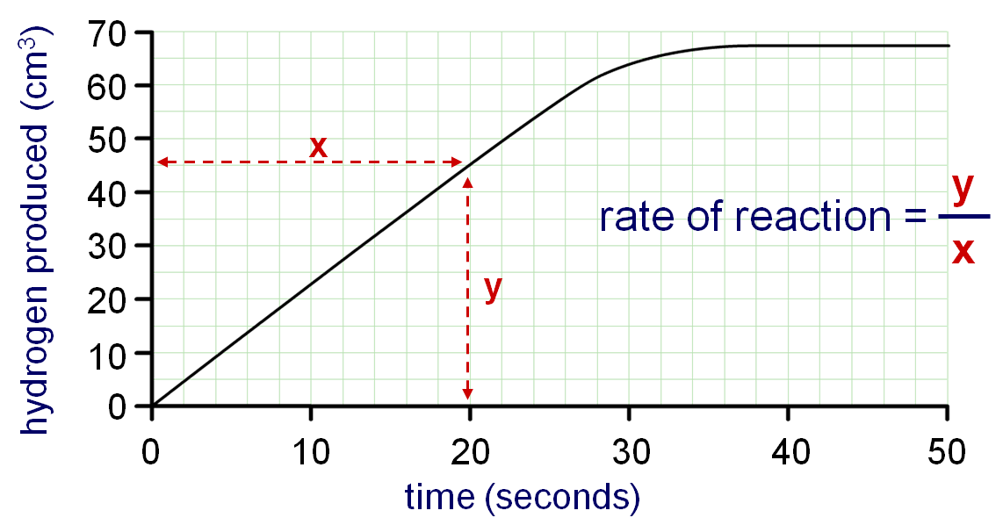
Calculating rate of reaction from graphs
How can the rate of reaction be calculated from a graph?
The gradient of the graph is equal to the initial rate of reaction at that time.
45 cm³
rate of reaction =
2.25 cm³/s
rate of reaction =
20 s
Notes:
This slide covers the Science and Engineering Practices:
Analyzing and Interpreting Data: Analyze data using tools, technologies, and/or models (e.g., computational, mathematical) in order to make valid and reliable scientific claims or determine an optimal design solution.
Using Mathematics and Computational Thinking: Apply ratios, rates, percentages, and unit conversions in the context of complicated measurement problems involving quantities with derived or compound units (such as mg/mL, kg/m3, acre-feet, etc.).

Slide 7
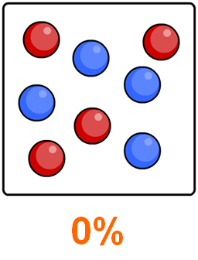
Changing the rate of reactions
Anything that increases the number of successful collisions between reactant particles will speed up a reaction.
What factors affect the rate of reactions?
increased temperature
increased concentration of dissolved reactants, and increased pressure of gaseous reactants
increased surface area of solid reactants
use of a catalyst.
Notes:
Teacher notes
For more information about catalysts, please refer to the Catalysts presentation.
This slide covers the Science and Engineering Practice:
Constructing Explanations and Designing Solutions: Apply scientific ideas, principles, and/or evidence to provide an explanation of phenomena and solve design problems, taking into account possible unanticipated effects.

Slide 8
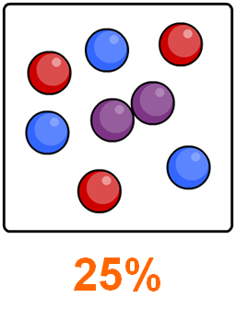
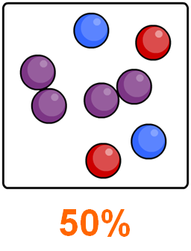
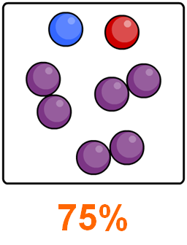
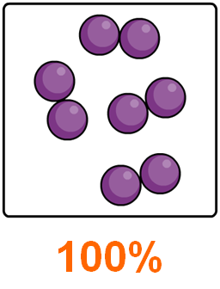



Slower and slower
Reactions do not proceed at a steady rate. They start off at a certain speed, then get slower and slower until they stop.
As the reaction progresses, the concentration of the reactants decreases.
This reduces the frequency of collisions between particles and so the reaction slows down.
reactants
percentage completion of reaction
product

Slide 9
Effect of temperature on rate
The higher the temperature, the faster the rate of a reaction. In many reactions, a rise in temperature of 10 °C causes the rate of reaction to approximately double.
Why does increased temperature increase the rate of reaction?
At a higher temperature, particles have more energy. This means they move faster and are more likely to collide with other particles.
When the particles collide, they do so with more energy, and so the number of successful collisions increases.
Notes:
This slide covers the Science and Engineering Practice:
Constructing Explanations and Designing Solutions: Apply scientific ideas, principles, and/or evidence to provide an explanation of phenomena and solve design problems, taking into account possible unanticipated effects.

Slide 10
Temperature and particle collisions
Notes:
Teacher notes
This simulation illustrates how increasing the temperature increases the number of collisions between particles.
This slide covers the Science and Engineering Practice:
Developing and Using Models: Develop, revise, and/or use a model based on evidence to illustrate and/or predict the relationships between systems or between components of a system.

Slide 11

How does temperature affect rate? (1)
The reaction between sodium thiosulfate and hydrochloric acid produces sulfur.
sodium
thiosulfate
+
hydrochloric
acid
sodium
chloride
+
sulfur
dioxide
+
+
sulfur
water
Na₂S₂O₃
(aq)
+
2HCl
(aq)
2NaCl
(aq)
+
SO₂
(g)
+
S
(s)
+
H₂O
(l)
Sulfur is solid and so it turns the solution cloudy.
How can this fact be used to measure the effect of temperature on the rate of a reaction?

Slide 12
How does temperature affect rate? (2)
Notes:
Teacher notes
This animation can be used to introduce the reaction between sodium thiosulfate and hydrochloric acid as a way of measuring the effect of temperature on rate of reaction. It could be shown as precursor to running the experiment in the lab, or to review the experiment.
The temperature can be changed by using the following method:
Measure the amounts of sodium thiosulfate and hydrochloric acid into separate boiling tubes.
Heat a water bath to the required temperature.
Put the boiling tubes into the water bath, and leave them there for at least a minute to allow their temperature to adjust.
Set up the dish on top of the paper with the cross, and pour the sodium thiosulfate into the dish.
Add the hydrochloric acid and start the timer.
This slide covers the Science and Engineering Practice:
Planning and Carrying Out Investigations: Make directional hypotheses that specify what happens to a dependent variable when an independent variable is manipulated.

Slide 13
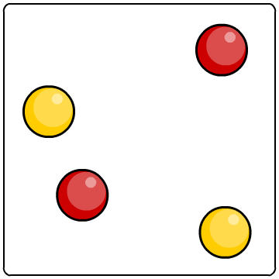
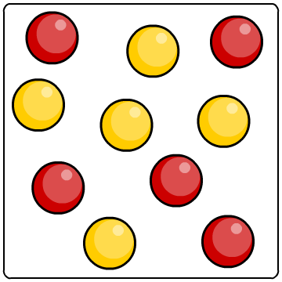
Effect of concentration on rate of reaction
The higher the concentration of a dissolved reactant, the faster the rate of a reaction.
Why does increased concentration increase the rate of reaction?
At a higher concentration, there are more particles in the same amount of space. This means that the particles are more likely to collide and therefore more likely to react.
lower concentration
higher concentration
Notes:
This slide covers the Science and Engineering Practice:
Constructing Explanations and Designing Solutions: Apply scientific ideas, principles, and/or evidence to provide an explanation of phenomena and solve design problems, taking into account possible unanticipated effects.

Slide 14
Concentration and particle collisions
Notes:
Teacher notes
This simulation illustrates how increasing the concentration increases the number of collisions between particles.
This slide covers the Science and Engineering Practice:
Developing and Using Models: Develop, revise, and/or use a model based on evidence to illustrate and/or predict the relationships between systems or between components of a system.

Slide 15
The effect of concentration on rate
Notes:
Teacher notes
This activity can be used to introduce the reaction between magnesium and hydrochloric acid as a way of measuring the effect of concentration on rate of reaction. It could be shown as a precursor to running the experiment in the lab, or as a summary activity.
Students may need reminding that 1 mole = 1 mol/dm³.
This slide covers the Science and Engineering Practices:
Planning and Carrying Out Investigations: Make directional hypotheses that specify what happens to a dependent variable when an independent variable is manipulated.
Analyzing and Interpreting Data: Analyze data using tools, technologies, and/or models (e.g., computational, mathematical) in order to make valid and reliable scientific claims or determine an optimal design solution.

Slide 16
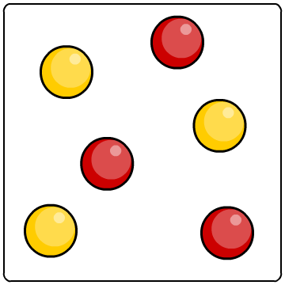
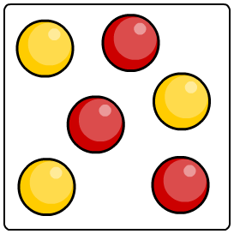
Effect of pressure on rate of reaction
Why does increasing the pressure of gaseous reactants increase the rate of reaction?
As the pressure increases, the space in which the gas particles are moving becomes smaller.
The gas particles become closer together, increasing the frequency of collisions. This means that the particles are more likely to react.
lower pressure
higher pressure
Notes:
This slide covers the Science and Engineering Practice:
Constructing Explanations and Designing Solutions: Apply scientific ideas, principles, and/or evidence to provide an explanation of phenomena and solve design problems, taking into account possible unanticipated effects.

Slide 17
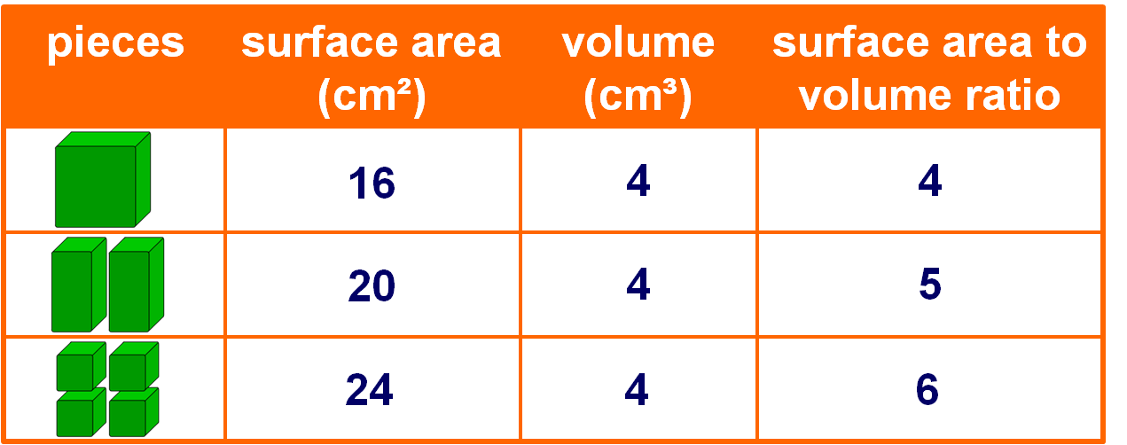
Surface area to volume ratio
For a solid with a fixed volume, the surface area will depend on how small the pieces are. The ratio between the surface area and the volume will affect the rate of reaction.
For example, suppose we have a solid rectangular prism with dimensions 2 cm × 2 cm × 1 cm. The surface area to volume ratios for different sized pieces are shown in the table below.

Slide 18
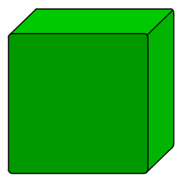
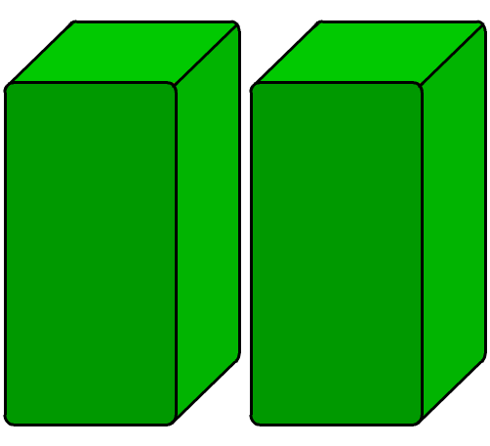
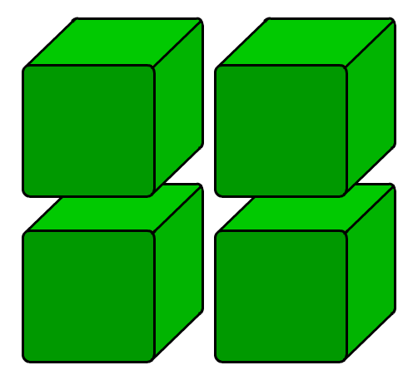
Effect of surface area on rate of reaction
Any reaction involving a solid can only take place at the surface of the solid. If the solid is split into several pieces, the surface area to volume ratio increases.
What effect will this have on rate of reaction?
low surface area
high surface area
This means that there is an increased area for the reactant particles to collide with.
Smaller pieces have a larger surface area to volume ratio. This means more collisions and a greater chance of reaction.
Notes:
This slide covers the Science and Engineering Practice:
Constructing Explanations and Designing Solutions: Apply scientific ideas, principles, and/or evidence to provide an explanation of phenomena and solve design problems, taking into account possible unanticipated effects.

Slide 19
Surface area and particle collisions
Notes:
Teacher notes
This simulation illustrates how increasing the surface area increases the number of collisions between particles and solid reactants.
This slide covers the Science and Engineering Practice:
Developing and Using Models: Develop, revise, and/or use a model based on evidence to illustrate and/or predict the relationships between systems or between components of a system.

Slide 20
Reaction between a carbonate and an acid
Marble chips are made of calcium carbonate. They react with hydrochloric acid to produce carbon dioxide.
calcium
carbonate
+
hydrochloric
acid
calcium
chloride
+
+
carbon
dioxide
water
CaCO₃ (s)
+
2HCl
(aq)
CaCl₂
(aq)
H₂O
(l)
CO₂
(g)
+
+
The effect of increased surface area on the rate of reaction can be measured by comparing how quickly the mass of the reactants decreases using marble chips of different sizes.

Slide 21
The effect of surface area on rate
Notes:
Teacher notes
This animation can be used to introduce the reaction between marble chips (calcium carbonate) and hydrochloric acid as a way of measuring the effect of surface area on rate of reaction. It could be shown as a precursor to running the experiment in the lab, or as a summary activity.
This slide covers the Science and Engineering Practices:
Planning and Carrying Out Investigations: Make directional hypotheses that specify what happens to a dependent variable when an independent variable is manipulated.
Analyzing and Interpreting Data: Analyze data using tools, technologies, and/or models (e.g., computational, mathematical) in order to make valid and reliable scientific claims or determine an optimal design solution.

