Slide 1
Concentration of Solutions

Slide 2
Information
Developing and Using Models
Planning and Carrying Out Investigations
Analyzing and Interpreting Data
Using Mathematics and Computational Thinking
3. Scale, Proportion, and Quantity

Slide 3





Measuring concentrations
There are two ways of measuring concentration:
mass per unit volume, e.g. grams per decimeter cubed (g/dm³)
moles per unit volume, e.g. moles per decimeter cubed (mol/dm³).
A cubic decimeter (dm³) is a unit of volume. 1 dm³ is equivalent to 1,000 cm³.
multiply by 1,000
cm³
dm³
divide by 1,000
Notes:
Teacher notes
Students may be used to using pints or liters to measure liquids. However, these are not used for scientific measurements because they are not SI units (International System of Units). The official unit for volume is derived from meters, which is the SI base unit for length. As a point of reference, 1 dm³ = 1 liter.
This slide covers the Science and Engineering Practice:
Using Mathematics and Computational Thinking: Apply ratios, rates, percentages, and unit conversions in the context of complicated measurement problems involving quantities with derived or compound units (such as mg/mL, kg/m3, acre-feet, etc.).

Slide 4


Volume unit conversions
Notes:
Teacher notes
This activity could be used to test students’ familiarity with converting between cubic centimeters and cubic decimeters. There are five questions in total.
This slide covers the Science and Engineering Practice:
Using Mathematics and Computational Thinking: Apply ratios, rates, percentages, and unit conversions in the context of complicated measurement problems involving quantities with derived or compound units (such as mg/mL, kg/m3, acre-feet, etc.).

Slide 5
Concentrations in g/dm³
The following equation gives concentration in g/dm³:
mass dissolved (g)
concentration =
volume of solution (dm³)
If 1.0 g of solid sodium hydroxide is dissolved in 250 cm³ of water, what is the concentration in g/dm³?
1 g
1 g
1
g
concentration =
=
=
250 cm³
0.25 dm³
0.25
dm³
= 4 g/dm³
convert the units
Notes:
This slide covers the Science and Engineering Practices:
Using Mathematics and Computational Thinking: Apply techniques of algebra and functions to represent and solve scientific and engineering problems.
Using Mathematics and Computational Thinking: Apply ratios, rates, percentages, and unit conversions in the context of complicated measurement problems involving quantities with derived or compound units (such as mg/mL, kg/m3, acre-feet, etc.).

Slide 6
Calculating concentrations in g/dm³
Notes:
Teacher notes
This activity could be used to test students’ familiarity with calculating concentrations in g/dm³. There are four questions in total.
This slide covers the Science and Engineering Practices:
Using Mathematics and Computational Thinking: Apply techniques of algebra and functions to represent and solve scientific and engineering problems.
Using Mathematics and Computational Thinking: Apply ratios, rates, percentages, and unit conversions in the context of complicated measurement problems involving quantities with derived or compound units (such as mg/mL, kg/m3, acre-feet, etc.).

Slide 7
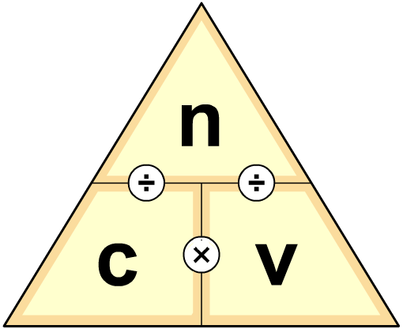
Concentrations in mol/dm³
To calculate concentration in mol/dm³:
number of moles (mol)
concentration =
volume of solution (dm³)
This equation can be added to a formula
triangle to rearrange the formula:
n
c =
v
n =
c
v
n
v =
c
Notes:
Teacher notes
Ensure students understand how to use the formula triangle:
To calculate the concentration, cover the “c” in the triangle and use the calculation shown: c = n/v.
To calculate the volume, cover the “v” in the triangle and use the calculation shown: v = n/c.
To calculate moles, cover the “n” in the triangle and use the calculation shown: n = cv.

Slide 8
Concentrations in mol/dm³ – example
If 1.0 g of solid sodium hydroxide (NaOH) is dissolved in 250 cm³ of water, what is the concentration in mol/dm³?
n
?
The question provides the volume but not the number of moles.
The following formula is required:
c =
=
v
0.25 dm³
mass
1g
number of moles =
=
= 0.025 mol
molar mass
40 g/m
Remember, molar mass = relative formula mass (RFM)
Now substitute 0.025 mol into the original formula:
0.025 mol
c =
= 0.1 mol/dm³
0.25 dm³
Notes:
Teacher notes
Students should recall that molar mass is equivalent to the relative atomic mass (RAM) of an element, or the relative formula mass (RFM) of a compound. The RFM of sodium hydroxide is 40 g/mol.
This slide covers the Science and Engineering Practice:
Using Mathematics and Computational Thinking: Apply techniques of algebra and functions to represent and solve scientific and engineering problems.

Slide 9
Concentrations in mol/dm³: practice
Notes:
Teacher notes
This activity could be used to test students’ familiarity with calculating concentrations in mol/dm³. There are 4 questions in total. Rearrangements of c = n/v are not required in this activity, but are covered in the following slides.
This slide covers the Science and Engineering Practice:
Using Mathematics and Computational Thinking: Apply techniques of algebra and functions to represent and solve scientific and engineering problems.

Slide 10
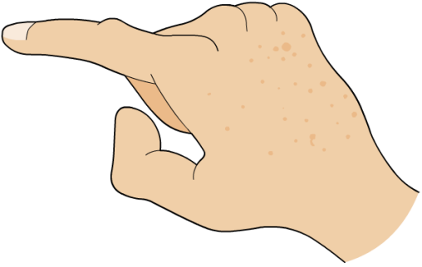
Rearranging formulae – example 1
What volume of 0.8 mol/dm³ potassium bromide solution contains 1.6 moles of potassium bromide (KBr)?
v = n / c
This calculation is simply a matter of substituting the values into the rearranged formula:
v = n / c = 1.6 / 0.8
= 2 dm³
Notes:
This slide covers the Science and Engineering Practice:
Using Mathematics and Computational Thinking: Apply techniques of algebra and functions to represent and solve scientific and engineering problems.

Slide 11

Rearranging formulae – example 2
How many moles of copper sulfate are there in 250 cm³
of 0.2 mol/dm³ copper sulfate solution (CuSO₄)?
n = cv
Step 1: convert the units
Step 2: substitute into the formula
250 cm³ = 0.25 dm³
n = cv = 0.2 × 0.25
= 0.05 mol
Notes:
This slide covers the Science and Engineering Practice:
Using Mathematics and Computational Thinking: Apply techniques of algebra and functions to represent and solve scientific and engineering problems.

Slide 12
Calculating mass of solute
What mass of copper sulfate (CuSO₄) was used to make 250 cm³ of 0.2 mol/dm³ copper sulfate solution?
Step 1: Calculate the number of moles of copper sulfate.
Step 2: Rearrange the moles formula to give the mass value.
This is simply an extension of the previous calculation, from which the moles of copper sulfate was found to be 0.05 mol.
mass of copper sulfate = number of moles × molar mass
= 0.05 × 159.6
= 8.0 g
Notes:
Teacher notes
Step 1 of this calculation has already been performed in the previous slide. All that is left is step 2, which is to rearrange the moles formula to find the mass value as shown.
The following molar mass values were used in this calculation:
copper: 63.5
sulfur: 32.1
oxygen: 16.0
This slide covers the Science and Engineering Practice:
Using Mathematics and Computational Thinking: Apply techniques of algebra and functions to represent and solve scientific and engineering problems.

Slide 13
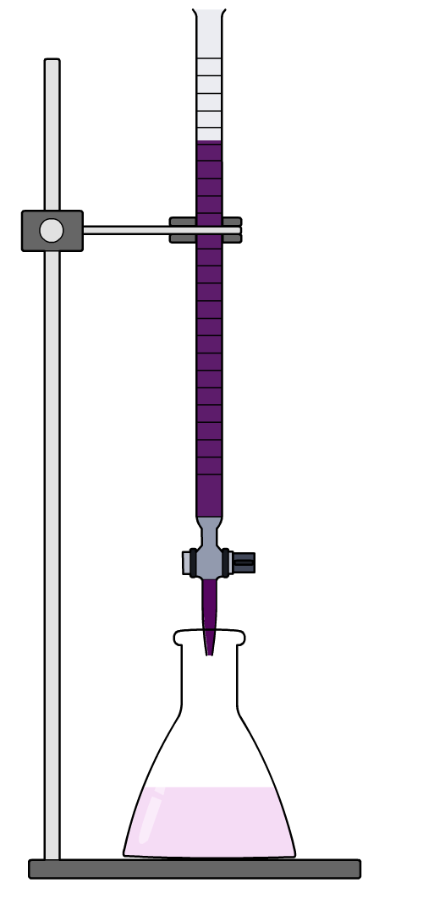
Titrations
A titration is a technique used to accurately determine the concentration of a substance in solution.
During a titration, a solution of known concentration, called a standard solution, is added to a solution of
unknown concentration.
The purpose of a titration is to determine
the volume of solution required to reach an endpoint. An endpoint is an observable physical change, such as a color change.
Why is measuring the volume useful?
Notes:
Teacher notes
Measuring volume is useful because volume is linked to concentration by this formula: concentration = moles ÷ volume.
If the volumes of the reactants are known, the unknown concentration value can be found. The experimental method for doing this is covered on the following slides.

Slide 14
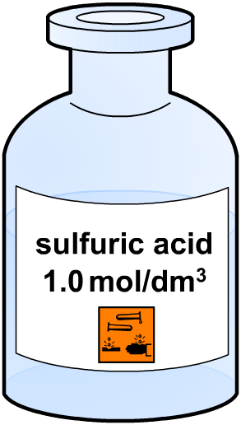
Finding an unknown concentration
Volume can be used to determine the concentration by
using the following relationship:
number of moles (mol)
concentration =
volume of solution (dm³)
An unknown concentration value can be found if the following values are known:
number of moles in solution
volume of solution.
These values can be found through a titration.

Slide 15
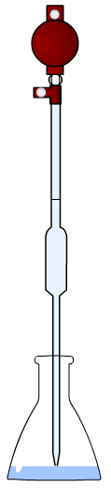
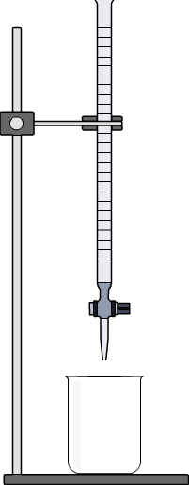
Titration equipment
The following laboratory equipment is required to perform
a titration:
safety
filler
burette
stand
pipette
conical
flask
beaker

Slide 16
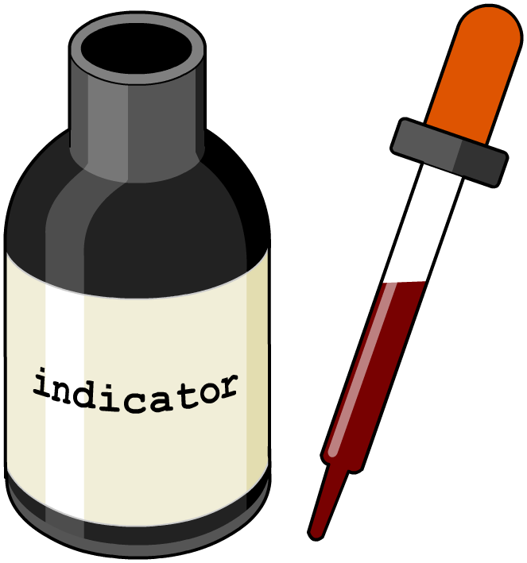
Indicators
The endpoint of a titration is often marked by a color change. This is provided by an indicator solution.
Indicators are substances which change color according to the pH of a solution.
A small amount of suitable indicator solution is added to one of the solutions during a titration.
When the indicator changes color, the endpoint of the
titration has been reached.

Slide 17

Performing a titration
Notes:
Teacher notes
Titrations can also be performed in the preparation of a soluble salt. The titration enables the reactants to be added to one another in exactly the right proportions, such that at the end of the reaction the solution contains only salt and water. The use of a pipette filler enables the amount of liquid in the pipette to be accurately controlled. Titrations should be repeated several times in order to increase the reliability of the result. The meniscus is the curved upper surface of the liquid in the burette.
The calculation of an unknown concentration using the results of a titration is covered in the following section.
This slide covers the Science and Engineering Practice:
Planning and Carrying Out Investigations: Plan and conduct an investigation individually and collaboratively to produce data to serve as the basis for evidence, and in the design: decide on types, how much, and accuracy of data needed to produce reliable measurements and consider limitations on the precision of the data (e.g., number of trials, cost, risk, time), and refine the design accordingly.

Slide 18
Titration apparatus
Notes:
This slide covers the Science and Engineering Practice:
Planning and Carrying Out Investigations: Select appropriate tools to collect, record, analyze, and evaluate data.

Slide 19

Evaluating data quality (1)
Titrations should always be repeated several times. This allows the quality of the titration data to be evaluated. It is important to work out how precise and accurate the data is.
Accuracy: how close the data is to the true value.
Precision: a measure of the spread of data.

Slide 20
Evaluating data quality (2)
Are these titration results precise?
0.42 mol/dm³
0.53 mol/dm³
0.65 mol/dm³
These titration results are not precise. The concentrations are very different and the range of the results is large.
range = 0.65 – 0.42 = 0.23 mol/dm³
Precise results will all have a similar value. The precision of a
set of results can be measured by determining the uncertainty.
uncertainty = ½ × range of results
The higher the value of uncertainty, the less precise the results.
Notes:
Teacher notes
The concentrations have been calculated from reacting volume data (obtained from a titration). They are not precise because they do not all have a similar value and the range of results is large. This means that there is a large amount of uncertainty in the titration results.
This slide covers the Science and Engineering Practice:
Analyzing and Interpreting Data: Consider limitations of data analysis (e.g., measurement error, sample selection) when analyzing and interpreting data.

Slide 21

Experimental procedure
How to ensure data is accurate and precise:
add the liquid from the burette dropwise as you approach the endpoint
use a suitable indicator that has a clear color change at the endpoint
make sure there are no air bubbles in the pipette or burette.
If the results are accurate, precise and there are no problems with the experimental method, then the results are valid.

Slide 22
Using titration results
How are the results of a titration used to calculate the unknown molar concentration of a solution?
Step 1: Write a balanced equation for the reaction.
Step 2: Calculate the number of moles of standard solution by rearranging the concentration formula:
moles = concentration × volume
Step 3: Use the balanced equation to determine the number of moles for the solution under investigation.
Step 4: Use the concentration formula to determine the unknown molar concentration:
molar concentration = moles ÷ volume
Notes:
This slide covers the Science and Engineering Practice:
Developing and Using Models: Develop and/or use a model (including mathematical and computational) to generate data to support explanations, predict phenomena, analyze systems, and/or solve problems.

Slide 23

Titration calculations: worked example (1)
The endpoint of a titration was reached when 20 cm³ of
0.1 mol/dm³ sodium hydroxide was added to 25 cm³ of hydrochloric acid. What is the concentration of the acid?
1. Write a balanced equation for the reaction:
2. Calculate the number of moles of sodium hydroxide:
moles = concentration (mol/dm³) × volume (dm³)
= 0.1 × (20 ÷ 1,000)
= 0.002 mol NaOH
Notes:
This slide covers the Science and Engineering Practice:
Using Mathematics and Computational Thinking: Apply techniques of algebra and functions to represent and solve scientific and engineering problems.

Slide 24

Titration calculations: worked example (2)
3. The balanced equation from step 1 shows that one mole of HCl reacts with one mole of NaOH:
Therefore 0.002 moles of NaOH will react with:
0.002 moles of HCl.
4. Use the number of moles to calculate the molar concentration of the hydrochloric acid:
molar concentration
moles
0.002
=
=
volume (dm³)
(25 ÷ 1,000)
= 0.08 mol/dm³
Notes:
This slide covers the Science and Engineering Practices:
Using Mathematics and Computational Thinking: Apply techniques of algebra and functions to represent and solve scientific and engineering problems.
Using Mathematics and Computational Thinking: Apply ratios, rates, percentages, and unit conversions in the context of complicated measurement problems involving quantities with derived or compound units (such as mg/mL, kg/m3, acre-feet, etc.).

Slide 25
Titration calculations: questions
Notes:
Teacher notes
This activity could be used to test students’ familiarity with titration calculations. There are 3 questions in total.
This slide covers the Science and Engineering Practices:
Using Mathematics and Computational Thinking: Apply techniques of algebra and functions to represent and solve scientific and engineering problems.
Using Mathematics and Computational Thinking: Apply ratios, rates, percentages, and unit conversions in the context of complicated measurement problems involving quantities with derived or compound units (such as mg/mL, kg/m3, acre-feet, etc.).

