Slide 1
Polymers

Slide 2
Information
Constructing Explanations and Designing Solutions
1. Patterns
3. Scale, Proportion, and Quantity

Slide 3

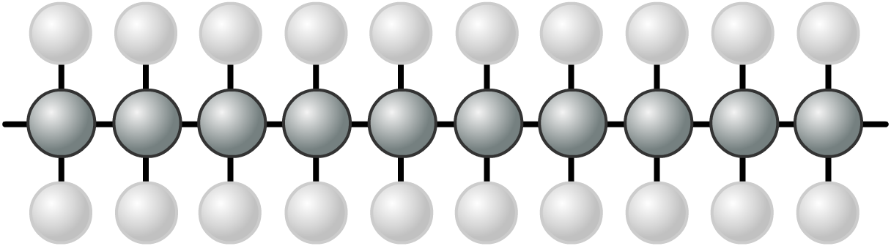
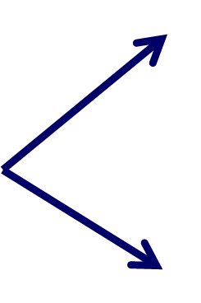
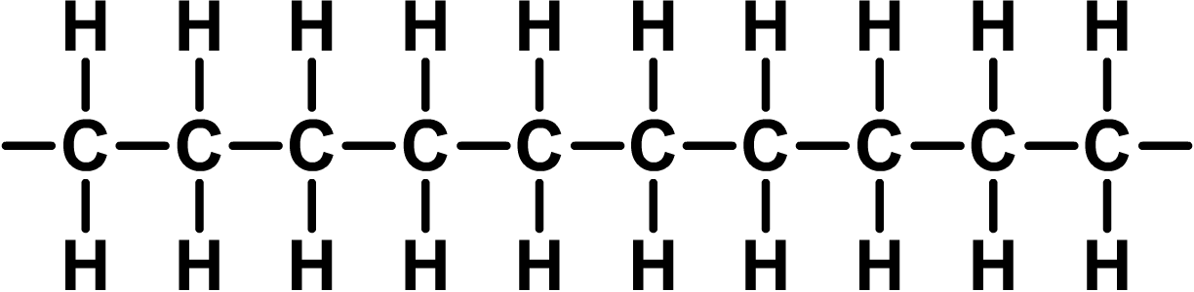

Structure of polymers
Polymers are long chains of atoms joined together by strong covalent bonds.
covalent bond
The building blocks of polymers are called monomers. These join together to form long polymer molecules in a polymerization reaction.
Notes:
Teacher notes
The individual monomers are joined together via covalent bonds.

Slide 4
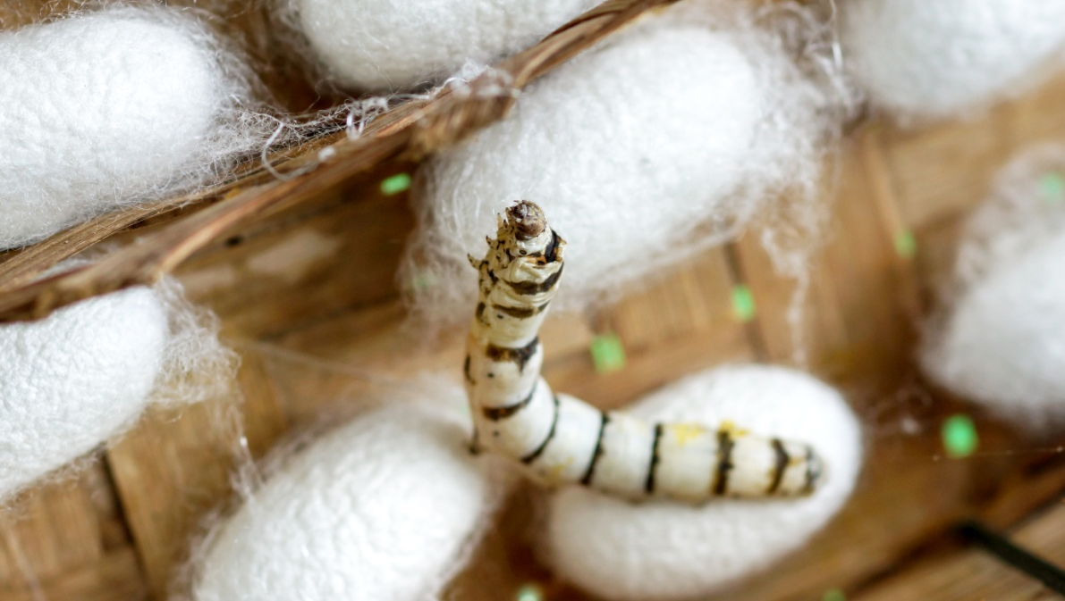
Natural polymers
All living things, from plants to animals, are made of polymers. Polymers from living things are called natural polymers.
Natural polymers include:
silk
DNA
protein
rubber
starch.
Some natural polymers can be extracted and converted into useful products. For example, silk produced by silkworms is used to make clothing.
Notes:
Teacher notes
Polymers of silk are used to make fibers for clothing. Individual fibers of silk are extracted from the cocoon. The silkworms are killed during this process.
DNA are long molecules found in the nucleus of cells that drive the majority of cellular processes.
Proteins are long polymers found in all organisms.
Rubber can occur naturally or be man-made. Natural rubber is extracted from certain trees.
Starch is produced by plants for energy storage.
Photo credit: silkworm and cocoon © Noppharat4569, Shutterstock.com 2018

Slide 5
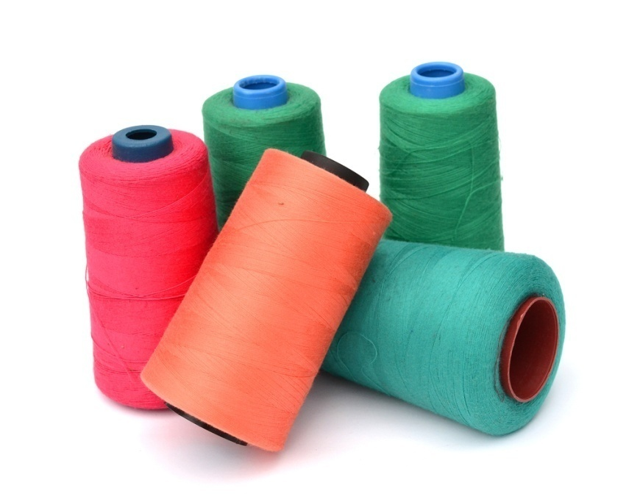
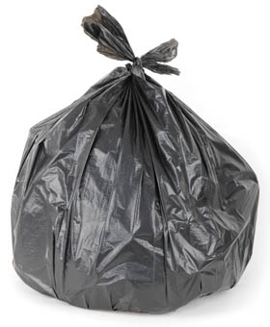
Synthetic polymers
Polymers that are synthesized in a laboratory are called synthetic polymers. These are made from substances extracted from the Earth’s crust.
Synthetic polymers include:
nylon
polyester
polyethene
polystyrene
Kevlar.
These polymers can be designed to have particular properties specific to their function.
Notes:
Teacher notes
Crude oil is extracted from the Earth’s crust and used to make polymers.
Nylon is used as a fiber in clothing and carpeting.
Polyester is used as a fiber to make clothes and is also used to make plastic products, such as drinks bottles.
Poly(ethene) is made up of monomers of the alkene ethene. This polymer is used to make a range of different plastics such as plastic bottles and plastic bags.
Polystyrene is a brittle polymer used to make inexpensive packaging such as foam cups.
Kevlar is very strong, and is used in bulletproof vests and to reinforce car tires.
Photo credit: bag © tkemot; nylon © coloa studio, both at Shutterstock.com 2018

Slide 6


Natural and synthetic polymers
Notes:
Teacher notes
Appropriately colored voting cards could be used with this classification activity to increase class participation.

Slide 7

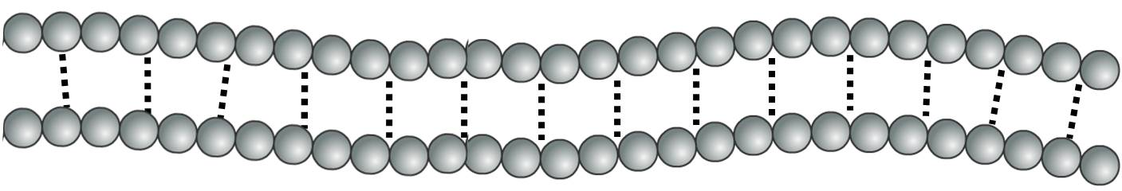
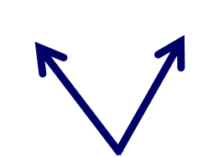
Intermolecular forces
Multiple polymer molecules are held together by intermolecular forces.
intermolecular forces
These forces determine the properties of the polymer.
Substances made of polymers are solid at room temperature due to the strong intermolecular forces between the polymer molecules.
Notes:
This slide covers the Science and Engineering Practice:
Constructing Explanations and Designing Solutions: Apply scientific ideas, principles, and/or evidence to provide an explanation of phenomena and solve design problems, taking into account possible unanticipated effects.

Slide 8
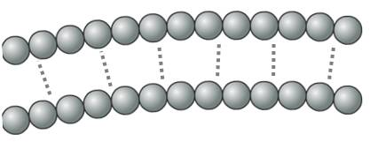
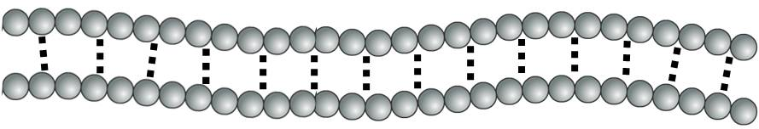
Chain length and intermolecular forces
The intermolecular (IM) forces increase as the molecules get larger.
This means that the intermolecular forces are stronger between polymers with longer chains.
short chain =
weaker IM forces
long chain =
stronger IM forces
Longer-chain polymers will be harder, stronger and have higher melting points.
Notes:
This slide covers the Science and Engineering Practice:
Constructing Explanations and Designing Solutions: Apply scientific ideas, principles, and/or evidence to provide an explanation of phenomena and solve design problems, taking into account possible unanticipated effects.

Slide 9
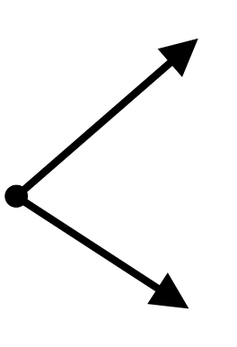
What joins monomers together?
Polymerization is the reaction used to convert monomers into polymers. The monomers in a polymer are joined together by covalent bonds between atoms.
In a covalent bond, each atom shares one or more electrons with another atom. The bonds are sometimes shown as lines.
covalent bond

Slide 10
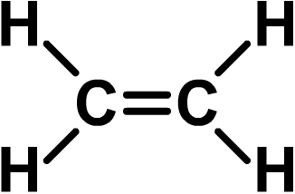
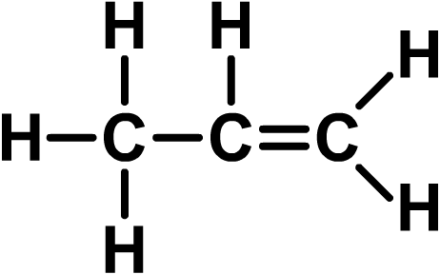
What are polymers made from?
Many polymers are formed from alkenes. Alkenes are a family of hydrocarbon molecules with the general formula C_{n}H_{2n}.
Alkenes are unsaturated compounds. This means they contain at least one covalent double bond between two carbon atoms (C=C). The double bond makes them very reactive.
The simplest alkene is ethene (C₂H₄).
The second simplest alkene is propene (C₃H₆).
Notes:
Teacher notes
For more information about alkenes and hydrocarbons, please refer to the Alkenes presentation.

Slide 11
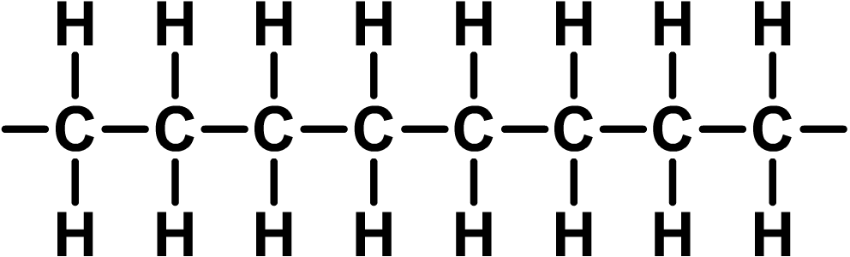

Addition polymerization
The process by which alkenes are joined together is called addition polymerization.
Addition polymerization involves the reaction of many unsaturated monomers to form a saturated polymer.
All of the atoms in the alkene are used to make the polymer, so no other products are formed.
ethene monomers
polyethene
Notes:
Teacher notes
A saturated polymer is one which has no double bonds.

Slide 12
How is polyethene made?
Notes:
Teacher notes
This interactive animation illustrates the formation of poly(ethene) as an example of addition polymerization. Suitable prompts could include:
What special property of ethene enables it to be used in making polymers?
What has to happen to start the process?
Why is the process called addition polymerization?
Polymerization needs either very high temperatures and pressures or a catalyst to keep it going.
Please note, poly(ethene) is also often referred to as polythene.

Slide 13
Naming polymers

Slide 14
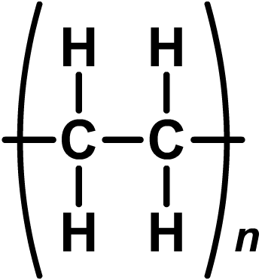
Drawing polymers
Polymers contain thousands of molecules, so how can their structures be easily drawn?
Part of the polymer molecule can be drawn:
A better way is to show a shorthand formula:
The “n” means that the polymer contains a very large number of the repeating unit shown in the brackets.

Slide 15
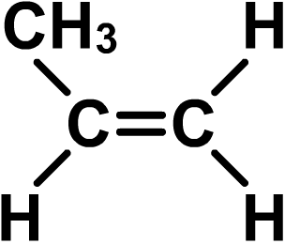
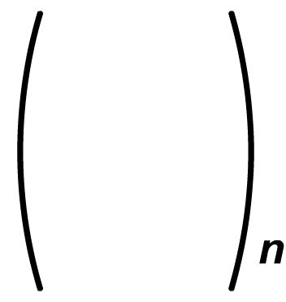
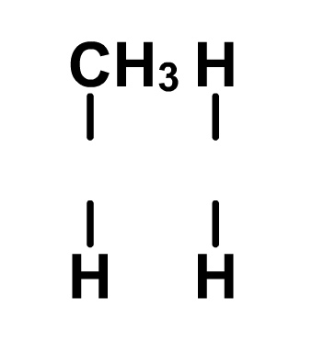
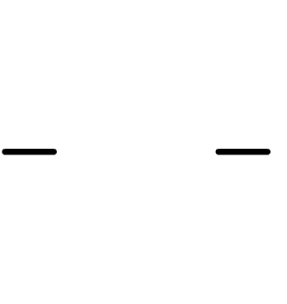
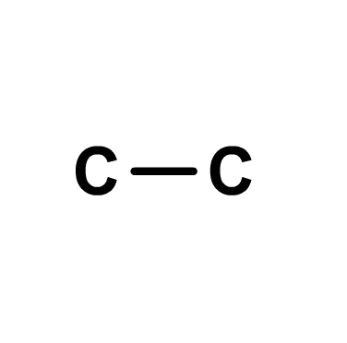
Drawing shorthand formulae
What is the shorthand formula for poly(propene)?
The monomer is propene (C₃H₆):
which can
be drawn as:
1. Draw the two C atoms that were in the double bond with a single covalent bond.
2. Draw the brackets and the “n.”
3. Add the links outside the brackets.
4. Add the atoms that were attached to each C atom of the double bond.
poly(propene)

Slide 16
Which polymer?

Slide 17
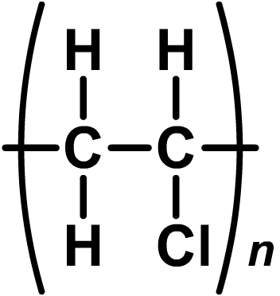
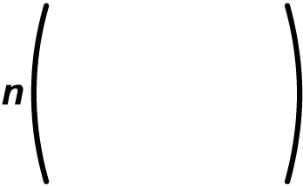
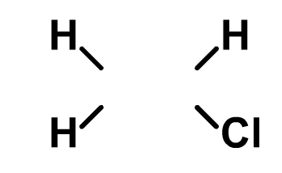
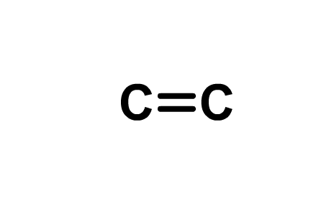
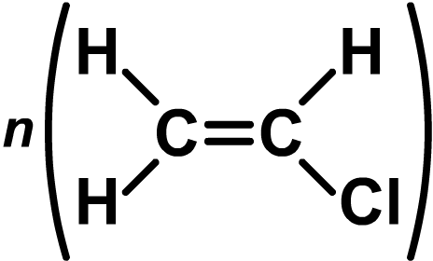

What’s the monomer?
What is the monomer of poly(vinylchloride) (PVC)?
Follow these steps to determine the monomer of a polymer:
1. Draw the two C atoms that have a single bond in the shorthand formula so that they are joined with a double covalent bond.
2. Add the atoms attached to
each C atom.
3. Draw the brackets and “n.”
The equation for the reaction can be drawn as:

Slide 18
Which monomer?

Slide 19

Condensation polymerization
Polymers are also formed by condensation polymerization.
The monomers join together in condensation reactions to form long chains of polymers.
A small molecule, such as water, is removed during the reaction and a covalent bond is formed between the two monomers.
Nylon is a type of condensation polymer.
Notes:
Photo credit: © coloa studio, Shutterstock.com 2018

Slide 20
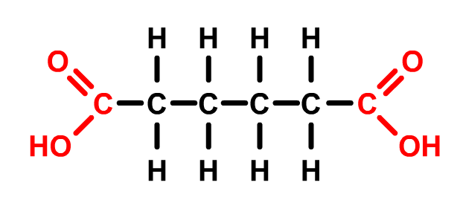
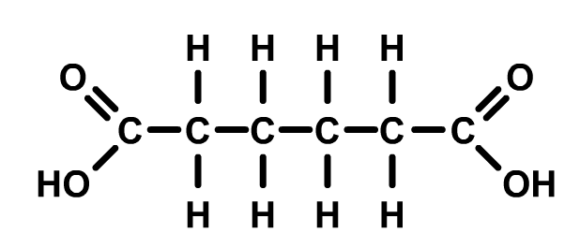


Monomers for condensation polymers
Condensation polymerization involves monomers with two functional groups. A functional group is a group of atoms that are involved in chemical reactions.
The simplest condensation polymers are formed by the polymerization of two different monomers.
Each monomer has two functional groups that are the same.
An example of a simple condensation polymer, formed from two different monomers, is polyester.
functional groups
Notes:
Teacher notes
The functional groups shown here are carboxyl groups. Often, different monomers will have different functional groups.
More complex condensation polymers involve more than two different types of monomer.

Slide 21
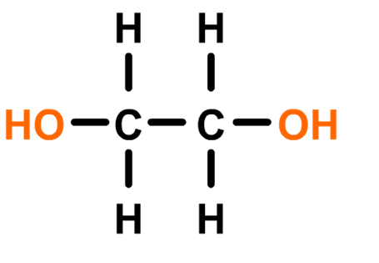
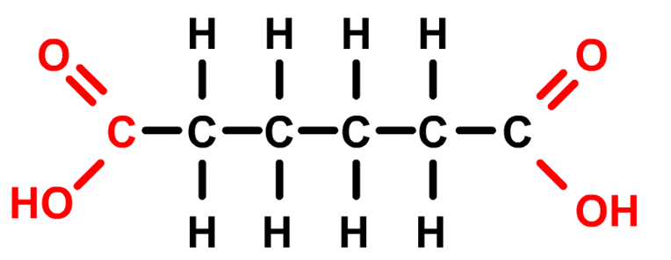
How are polyesters made? (1)
A polyester is a type of condensation polymer formed from the condensation reaction between two different types of monomer.
One monomer contains two alcohol functional groups.
The other monomer contains two carboxyl functional groups.
Notes:
Teacher notes
The alcohol monomer contains two functional alcohol groups, so it is known as a diol. The carboxylic acid monomer contains two carboxyl functional groups, so it is known as a dicarboxylic acid.

Slide 22
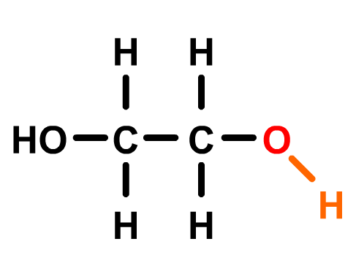
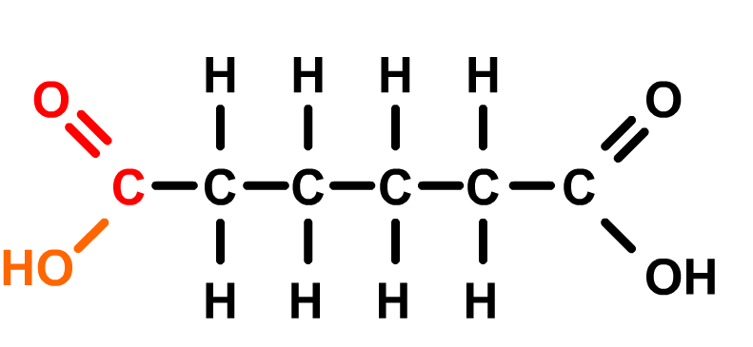

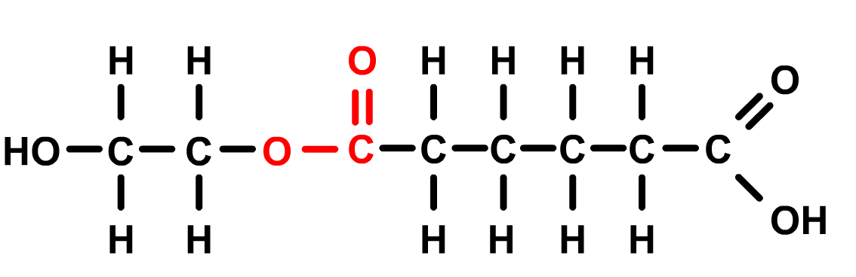
How are polyesters made? (2)
One type of polyester is formed by the condensation polymerization of ethane diol and hexanedioic acid.
The first step in the formation of the polyester is shown below:
+
ethane diol
hexanedioic acid
+ H₂O
start of polyester
water
Notes:
Teacher notes
The condensation reaction between the two monomers is shown here.
The water molecule is formed from the H atom of the alcohol hydroxyl group (-OH), and the -OH from the carboxylic acid carboxyl group (COOH).
The bond formed between the alcohol group on one monomer and the carboxyl group of another monomer during a condensation reaction is called an ester link.
Following consecutive condensation reactions between the monomers, the final polyester is formed.

Slide 23
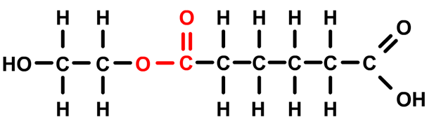
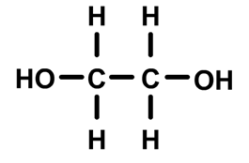
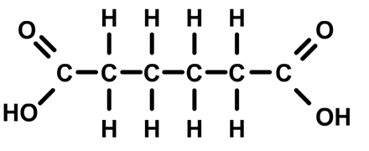
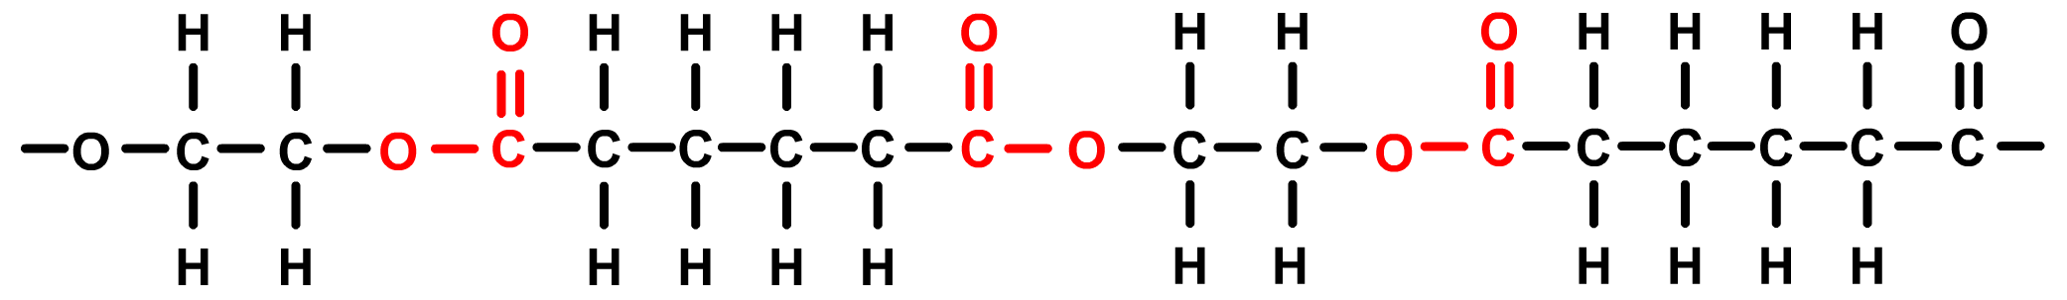
Polyesters: building the polymer
The polyester is extended further by the addition of more monomers. Water is released during each condensation reaction.
+
+
Multiple rounds of condensation reactions occur to form the final polyester polymer:
Notes:
Teacher notes
It is important students remember that each addition of a monomer (through condensation reactions) involves the production of a water molecule.

Slide 24
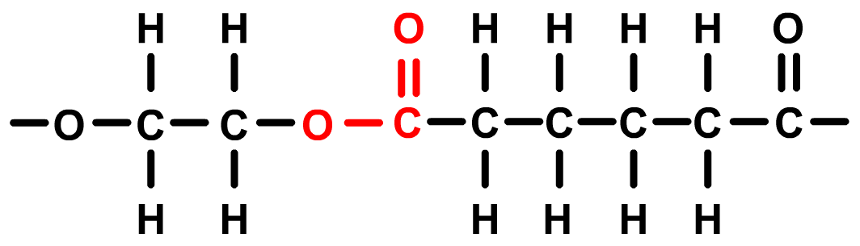
Repeating units and polyesters
To avoid having to write out the whole chain, a shorthand formula is used to show only the repeating unit in the polymer.
n
The “n” means that the polymer contains a very large number of the repeating unit shown in the brackets.

Slide 25
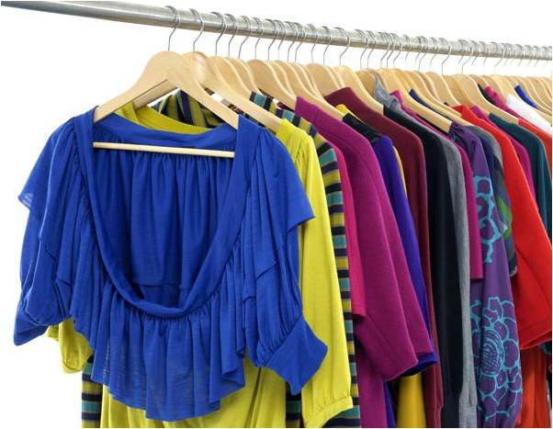
Different polyesters
All polyesters are made by the reaction between a carboxylic acid with two -COOH groups and an alcohol with two -OH groups.
However, the different polyesters vary in how they are made and the structure of the monomers used to make them.
Polyesters have many different uses, including:
clothing
plastic bottles
food packaging.
Notes:
Photo credit: © 101imges, Shutterstock.com 2018

Slide 26
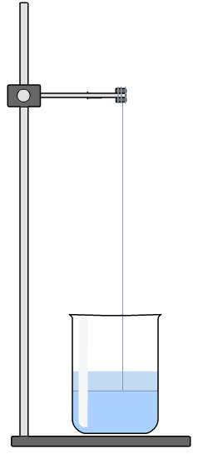
Making condensation polymers: nylon
Nylon is a condensation polymer produced in the fabric industry. The condensation reaction occurs at very high temperatures, producing molten nylon.
Nylon can also be produced in a laboratory without the need for heating.
nylon
Aqueous solutions of the monomers are added to a beaker. A gray film of nylon will form that can be pulled out of the solution as a thread, using tweezers or a rod.
Notes:
Teacher notes
As condensation reactions are endothermic processes, heat is often required for condensation polymerization to take place.
Nylon is formed from the condensation polymerization of two types of monomers; one containing two carboxyl groups and the other containing two amine groups.
Experimental procedure:
1,6-diaminohexane solution is added to a beaker. The cyclohexane solution is added carefully down the side of the beaker to minimize mixing. The cyclohexane solution forms a layer at the top of the beaker. This creates an interface between the two solutions, where a gray film of nylon forms. Tweezers can be used to lift some of the nylon out of the beaker, this can then be pulled over a rod on a clamp. It is possible to pull a few meters of the nylon out of the beaker using the rod.

