Slide 1
Reacting
Masses

Slide 2
Information
Developing and Using Models
Using Mathematics and Computational Thinking
3. Scale, Proportion, and Quantity
5. Energy and Matter

Slide 3




What is a mole?
A mole is an SI unit that is used to denote the number of atoms or molecules in a given amount of substance.
A mole is defined as the number of atoms in exactly 12 g of carbon-12.
Moles can be used to balance equations and calculate the masses of reactants and products. The number of moles in a sample is calculated using this equation:
mass of substance (g)
number of moles (mol) =
molar mass (g/mol)
Notes:
Teacher notes
An SI unit is part of the “International System of Units” – abbreviated from the French Système international d'unités. There are seven base units, each representing a different measurement of physical quantity. The mole is the unit that measures amount of substance, and its unit symbol is mol.
One mole of any substance contains 602,000,000,000,000,000,000,000 (6.02 × 10²³) particles.
This presentation is accompanied by the worksheet Reacting Masses.
This slide covers the Science and Engineering Practice:
Developing and Using Models: Develop and/or use a model (including mathematical and computational) to generate data to support explanations, predict phenomena, analyze systems, and/or solve problems.

Slide 4

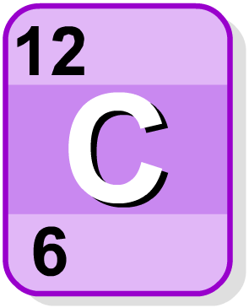
Molar mass
The molar mass is the mass in grams of one mole of a substance.
relative atomic mass
For elements, this is simply the relative atomic mass (r.a.m.) value in grams/mol.
For compounds, the molar mass is equal to the relative formula mass (r.f.m.) value in grams/mol.
Some elements exist as molecules, for example, O₂.
The relative formula mass will need to be used for these elements rather than the atomic mass.

Slide 5
Calculations using Avogadro’s constant
The number of particles (atoms or molecules) of a substance can be calculated using Avogadro’s constant.
The number of particles in a substance can be calculated by:
number of particles = moles × Avogadro’s constant
How many atoms are in 10 g of aluminum (Al)?
molar mass of Al = r.a.m = 27
moles of Al = mass ÷ molar mass = 10 ÷ 27 = 0.370 moles
number of atoms in 0.370 moles of aluminum:
6.02 × 10²³ × 0.370 moles = 2.23 × 10²³ atoms
Notes:
This slide covers the Science and Engineering Practices:
Using Mathematics and Computational Thinking: Use mathematical, computational, and/or algorithmic representations of phenomena or design solutions to describe and/or support claims and/or explanations.
Using Mathematics and Computational Thinking: Apply techniques of algebra and functions to represent and solve scientific and engineering problems.

Slide 6
The stoichiometric coefficient
The stoichiometric coefficient is the number in front of each reactant and product in a chemical equation.
It is not necessary to write a stoichiometric coefficient of 1, and so the equation becomes:
The coefficient balances the number of atoms on both the reactant and product sides of the equation.
Notes:
Teacher notes
Conservation of atoms means that the number of atoms in the reactants equals the number of atoms in the products. In this example there are 2 Na atoms, 4 H atoms, 6 O atoms and 1 S atom on both the reactant and product sides of the equation.
This slide covers the Science and Engineering Practice:
Using Mathematics and Computational Thinking: Use mathematical, computational, and/or algorithmic representations of phenomena or design solutions to describe and/or support claims and/or explanations.

Slide 7

Using moles to balance equations (1)
The stoichiometric coefficients can be determined using the known masses of reactants and products:
Step 1: Write the unbalanced equation for the reaction.
Step 2: Use the given mass values to calculate the number of moles for each reactant and product.
Step 3: Convert the moles into simple, whole number ratios.
Step 4: Write out the balanced equation using the whole number ratio values.
Notes:
This slide covers the Science and Engineering Practice:
Using Mathematics and Computational Thinking: Use mathematical, computational, and/or algorithmic representations of phenomena or design solutions to describe and/or support claims and/or explanations.

Slide 8

Using moles to balance equations (2)
54 g of aluminum (Al) reacts with 159 g of iron(III) oxide (Fe₂O₃) to produce 111 g of iron (Fe) and 101 g of aluminum oxide (Al₂O₃). What is the balanced equation for this reaction?
Step 1: Write the equation for the reaction.
Step 2: Use the given mass values to calculate the number of moles for each reactant and product.
moles of Al = 54 ÷ 27 = 2 mol
moles of Fe₂O₃ = 159 ÷ 160 = 0.99 = 1 mol
moles of Fe = 111 ÷ 56 = 1.98 = 2 mol
moles of Al₂O₃ = 101 ÷ 102 = 0.99 = 1 mol
Notes:
This slide covers the Science and Engineering Practices:
Using Mathematics and Computational Thinking: Use mathematical, computational, and/or algorithmic representations of phenomena or design solutions to describe and/or support claims and/or explanations.
Using Mathematics and Computational Thinking: Apply techniques of algebra and functions to represent and solve scientific and engineering problems.

Slide 9



Using moles to balance equations (3)
Step 3: Convert the moles into simple whole number ratios.
Al : Fe₂O₃ : Fe : Al₂O₃
2 moles of aluminum react with 1 mole of iron oxide to produce 2 moles of iron, and 1 mole of aluminum oxide.
2 : 1 : 2 : 1
Step 4: Write out the balanced equation using the whole number ratio values.
Notes:
This slide covers the Science and Engineering Practices:
Using Mathematics and Computational Thinking: Use mathematical, computational, and/or algorithmic representations of phenomena or design solutions to describe and/or support claims and/or explanations.
Using Mathematics and Computational Thinking: Apply ratios, rates, percentages, and unit conversions in the context of complicated measurement problems involving quantities with derived or compound units (such as mg/mL, kg/m3, acre-feet, etc.).

Slide 10

Limiting reactants
The amount of product formed in a reaction will depend on the limiting reactant.
This is the reactant that runs out first, bringing the reaction to an end.
The other reactant(s) are said to be “in excess.” This means that there will be some left after the reaction.

Slide 11

Limiting reactants and balanced equations
You can use balanced equations to identify limiting reactants.
For example, if 2 moles of aluminum are reacted with
5 moles of iron oxide, which is the limiting reactant?
From the equation we know that 2 moles of aluminum react with 1 mole of iron oxide.
This means that 4 moles of iron oxide will be left (5 – 1 = 4). The iron oxide is in excess and the aluminum is therefore the limiting reactant.
Notes:
Teacher notes
A balanced symbol equation is required in order for the limiting reactant to be identified.
This slide covers the Science and Engineering Practices:
Using Mathematics and Computational Thinking: Use mathematical, computational, and/or algorithmic representations of phenomena or design solutions to describe and/or support claims and/or explanations.
Using Mathematics and Computational Thinking: Apply ratios, rates, percentages, and unit conversions in the context of complicated measurement problems involving quantities with derived or compound units (such as mg/mL, kg/m3, acre-feet, etc.).

Slide 12

What’s the mass?
If 28 g of iron reacts with excess copper sulfate solution, what mass of copper will be made?
Two different methods can be used to answer this question:
​using relative atomic mass (r.a.m.) and ratios
​using mole calculations.
Remember:
mass of substance
number of moles =
molar mass
Notes:
This slide covers the Science and Engineering Practice:
Using Mathematics and Computational Thinking: Use mathematical, computational, and/or algorithmic representations of phenomena or design solutions to describe and/or support claims and/or explanations.

Slide 13
Using relative atomic mass
Working out reacting masses using relative atomic mass:
Step 1: Write a balanced equation for the reaction.
Step 2: Write down the relative atomic mass(r.a.m.) or relative formula mass(r.f.m.) of the reactants and products.
Step 3: Multiple the r.a.m. or r.f.m. by the stoichiometric coefficient (the large number before each substance in the equation).
Step 4: Use the balanced equation to write down the ratios of reactants and products.
Step 5: Convert this into a ratio of reacting masses.
Step 6: Multiply the ratio by the known mass (from the question).
Notes:
Teacher notes
If the stoichiometric coefficient for all substances in the reaction is 1, step 3 can be skipped.
This slide covers the Science and Engineering Practice:
Using Mathematics and Computational Thinking: Use mathematical, computational, and/or algorithmic representations of phenomena or design solutions to describe and/or support claims and/or explanations.

Slide 14

Using r.a.m.: worked example (1)
If 28 g of iron reacts with excess copper sulfate solution, what mass of copper will be made?
Step 1: Write a balanced equation for the reaction.
Step 2: Write down the relevant r.a.m.
Fe = 56, Cu = 64
Step 3: As the stoichiometric coefficient for each substance is 1, we can continue to step 4.
Step 4: Write down the ratio of reactants and products.
Cu:Fe = 1:1
Notes:
This slide covers the Science and Engineering Practices:
Using Mathematics and Computational Thinking: Use mathematical, computational, and/or algorithmic representations of phenomena or design solutions to describe and/or support claims and/or explanations.
Using Mathematics and Computational Thinking: Apply ratios, rates, percentages, and unit conversions in the context of complicated measurement problems involving quantities with derived or compound units (such as mg/mL, kg/m3, acre-feet, etc.).

Slide 15

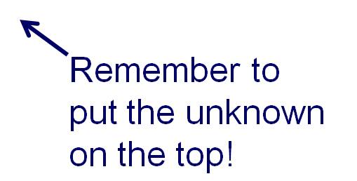
Using r.a.m.: worked example (2)
Step 5: Convert to ratio of reacting masses.
Ratio of Cu to Fe = 1:1 = 64 g : 56 g =
64 ÷ 56
Step 6: Multiply the ratio by the known mass
(from the question).
64
mass of Cu formed =
28 g ×
56
= 32 g of Cu
Notes:
This slide covers the Science and Engineering Practices:
Using Mathematics and Computational Thinking: Use mathematical, computational, and/or algorithmic representations of phenomena or design solutions to describe and/or support claims and/or explanations.
Using Mathematics and Computational Thinking: Apply techniques of algebra and functions to represent and solve scientific and engineering problems.
Using Mathematics and Computational Thinking: Apply ratios, rates, percentages, and unit conversions in the context of complicated measurement problems involving quantities with derived or compound units (such as mg/mL, kg/m3, acre-feet, etc.).

Slide 16


Reacting masses and scale factors
Notes:
Teacher notes
This activity tests students’ ability to calculate reacting masses using r.a.m and ratios. There are five questions in total.
This slide covers the Science and Engineering Practices:
Using Mathematics and Computational Thinking: Apply techniques of algebra and functions to represent and solve scientific and engineering problems.
Using Mathematics and Computational Thinking: Apply ratios, rates, percentages, and unit conversions in the context of complicated measurement problems involving quantities with derived or compound units (such as mg/mL, kg/m3, acre-feet, etc.).

Slide 17
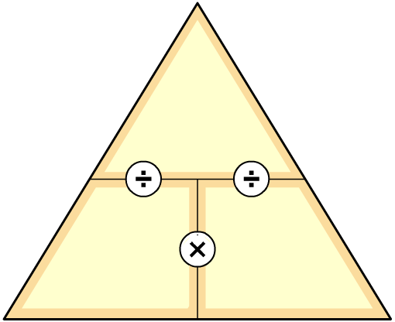
Using moles
How do you work out reacting masses using moles?
Step 1: Write a balanced equation for the reaction.
Step 2: Turn the given mass value into the number of moles.
Step 3: Use the balanced equation to work out the number
of moles of the unknown substance.
Step 4: Convert moles into mass using the formula:
mass
moles =
mass
÷ molar mass
molar mass
This is rearranged to give:
mass = moles × molar mass
moles
Notes:
Teacher notes
The molar mass is simply the r.a.m value for elements, therefore r.a.m can be substituted into the formula in step 4.
The equation for moles has been rearranged to make mass the subject of the equation. This allows the mass to be calculated from the moles and molar mass.
Explain to students how to use the triangle:
To calculate mass, cover “mass” in the triangle. This shows: mass = moles × molar mass
To calculate moles, cover “moles” in the triangle. This shows: moles = mass ÷ molar mass
To calculate molar mass, cover “molar mass” in the triangle. This shows: molar mass = mass ÷ moles
This slide covers the Science and Engineering Practice:
Using Mathematics and Computational Thinking: Use mathematical, computational, and/or algorithmic representations of phenomena or design solutions to describe and/or support claims and/or explanations.

Slide 18
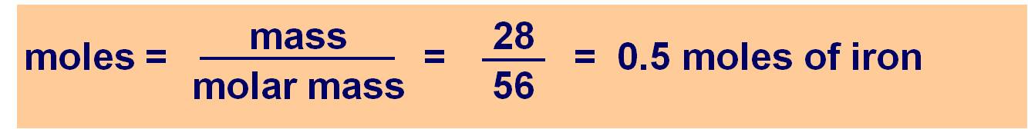
Using moles: worked example (1)
If 28 g of iron reacts with excess copper sulfate solution, what mass of copper will be made?
Step 1: Write a balanced equation for the reaction:
FE + CuSO  Cu + FeSo₄
Step 2: Turn the mass of iron into moles of iron:
Notes:
Teacher notes
In the example here, fractions have been used to represent the division calculation.
This slide covers the Science and Engineering Practices:
Using Mathematics and Computational Thinking: Use mathematical, computational, and/or algorithmic representations of phenomena or design solutions to describe and/or support claims and/or explanations.
Using Mathematics and Computational Thinking: Apply techniques of algebra and functions to represent and solve scientific and engineering problems.

Slide 19

Using moles: worked example (2)
Step 3: Use the balanced equation to work out how many moles of copper should be made:
FE + CuSO  Cu + FeSo₄
1 mole of Fe makes 1 mole of Cu
Step 4: Convert moles of copper into mass of copper:
mass = moles × r.a.m
= 0.5 × 64
= 32 g of Cu
Notes:
This slide covers the Science and Engineering Practices:
Using Mathematics and Computational Thinking: Use mathematical, computational, and/or algorithmic representations of phenomena or design solutions to describe and/or support claims and/or explanations.
Using Mathematics and Computational Thinking: Apply techniques of algebra and functions to represent and solve scientific and engineering problems.
Using Mathematics and Computational Thinking: Apply ratios, rates, percentages, and unit conversions in the context of complicated measurement problems involving quantities with derived or compound units (such as mg/mL, kg/m3, acre-feet, etc.).

Slide 20
Using moles in calculations
Notes:
Teacher notes
This activity tests students’ ability to calculate reacting masses using moles. There are four questions in total.
This slide covers the Science and Engineering Practice:
Using Mathematics and Computational Thinking: Apply techniques of algebra and functions to represent and solve scientific and engineering problems.

