Slide 1
Types of Chemical
Bonds

Slide 2
Information
Developing and Using Models
Constructing Explanations and Designing Solutions
1. Patterns
3. Scale, Proportion, and Quantity

Slide 3





Why do atoms form bonds?
Notes:
Teacher notes
The element with electron configuration 2,8,8 is Argon (Ar).
This slide covers the Science and Engineering Practice:
Developing and Using Models: Develop, revise, and/or use a model based on evidence to illustrate and/or predict the relationships between systems or between components of a system.

Slide 4
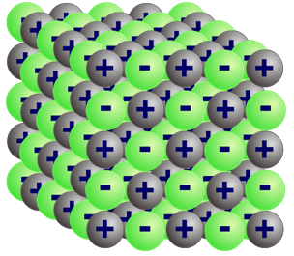
What is ionic bonding?
Compounds that contain ions are called ionic compounds. These compounds are usually formed by a reaction between a metal and a non-metal.
Why do these substances react together and form bonds?
The metal and non-metal atoms have incomplete outer electron shells and so are unstable.
Electrons are transferred from the metal atoms to the non-metal atoms. The metal and the non-metal atoms form ions with completely full outer shells and become stable.
The positive and negative ions are strongly attracted to each other. This electrostatic attraction is called ionic bonding.

Slide 5
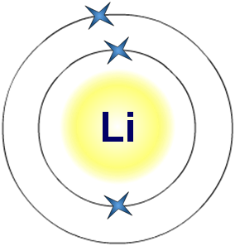
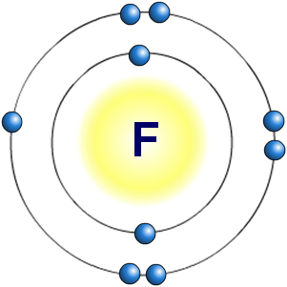
Group 1 and Group 7 elements
The alkali metals, found in Group 1 in the periodic table, react with non-metals to form ionic compounds.
The alkali metals all have one electron in their outer shell.
They lose this electron to form an ion with a single positive charge.
2.1
The halogens, found in Group 7 in the periodic table, react with the alkali metals to form ionic compounds.
The halogens all have seven electrons in their outer shell. They gain an extra electron to form an ion with a single negative charge.
2.7

Slide 6
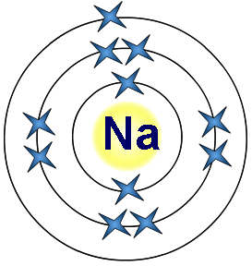

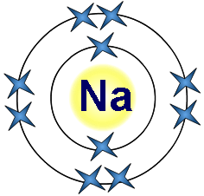

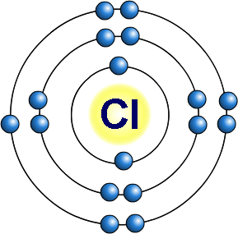
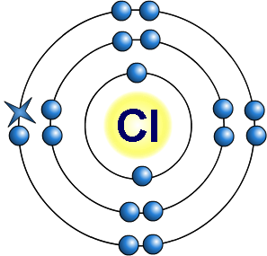
How are ionic bonds formed? (1)
Sodium chloride is an ionic compound formed by the reaction between the alkali metal sodium and the halogen chlorine.
+
Sodium has 1 electron
in its outer shell.
By losing this electron,
it has a filled outer shell and forms a positive ion.
2.8.1
[2.8]⁺
Chlorine has 7 electrons in its outer shell.
-
By gaining an electron from sodium, it has a filled outer shell and forms a negative ion.
2.8.7
[2.8.8]–
Notes:
This slide covers the Science and Engineering Practice:
Developing and Using Models: Develop, revise, and/or use a model based on evidence to illustrate and/or predict the relationships between systems or between components of a system.

Slide 7
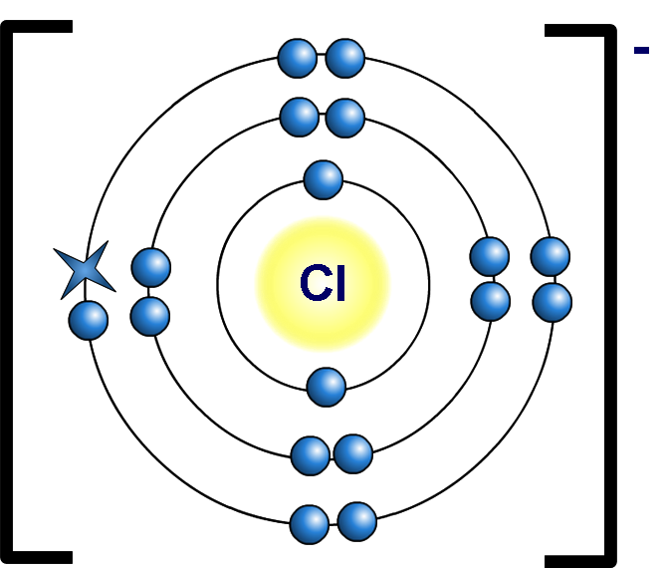
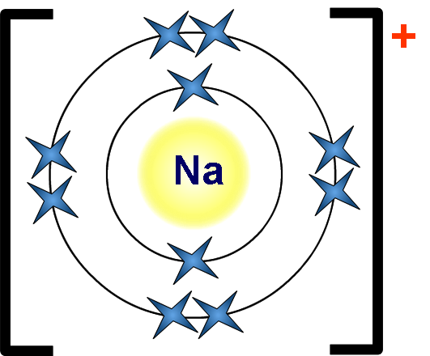
How are ionic bonds formed? (2)
The positive sodium ions and the negative chloride ions are strongly attracted to each other.
It is this electrostatic attraction that forms ionic bonds in sodium chloride and other ionic compounds.
Notes:
This slide covers the Science and Engineering Practice:
Developing and Using Models: Develop, revise, and/or use a model based on evidence to illustrate and/or predict the relationships between systems or between components of a system.

Slide 8
Formation of an ionic bond
Notes:
Teacher notes
This two-part interactive animation shows how bonding occurs in two compounds – sodium chloride and magnesium oxide. It shows how the ions are formed, which electrons are transferred and how this leads to the formation of the ionic lattices.
This slide covers the Science and Engineering Practice:
Developing and Using Models: Develop, revise, and/or use a model based on evidence to illustrate and/or predict the relationships between systems or between components of a system.

Slide 9
Ions and ionic bonding – summary
Notes:
Teacher notes
This completing sentences activity could be used as an introductory or summary activity on ions and ionic bonding.

Slide 10
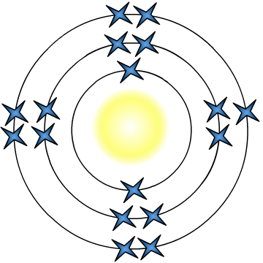
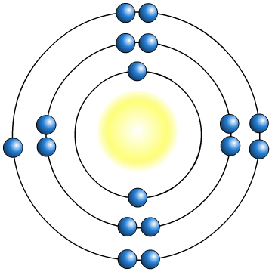

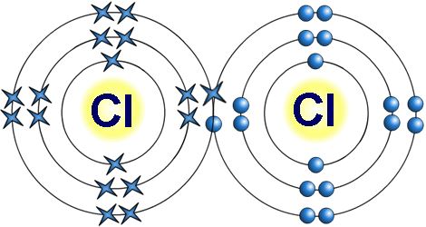

What is a covalent bond?
Non-metal elements usually just need one or two electrons to fill their outer shells. So how do they form a bond?
incomplete outer shells
Cl
Cl
The two non-metal atoms cannot form a bond by transferring electrons from one to another. Instead, they share electrons.
Each atom now has a full, stable outer shell.
The shared electrons join the atoms together. This is called a covalent bond.
Notes:
This slide covers the Science and Engineering Practice:
Developing and Using Models: Develop, revise, and/or use a model based on evidence to illustrate and/or predict the relationships between systems or between components of a system.

Slide 11
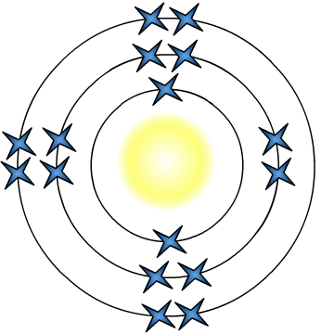



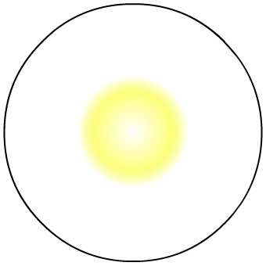
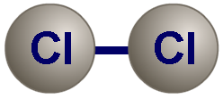
How is a covalent bond drawn?
A covalent bond consists of a shared pair of electrons.
Covalent bonds are the result of electrostatic attraction between the positively-charged nuclei of the atoms and the negatively-charged shared electrons.
Cl
Cl
covalent bond
Only outer shells of electrons are involved in bonding, so the inner shells do not always have to be included in diagrams. Two common ways to represent a covalent bond are:
simplified dot and cross diagram
Cl
Cl
ball and stick
–
Cl
Cl
Notes:
This slide covers the Science and Engineering Practice:
Developing and Using Models: Develop, revise, and/or use a model based on evidence to illustrate and/or predict the relationships between systems or between components of a system.

Slide 12
Covalent compounds
There are three different types of covalent molecules.
Simple covalent molecules: compounds that contain only a few atoms bonded together. There are weak electric forces between the molecules.
Polymers: long chains of molecules joined together. There are electric forces between the chains.
Giant covalent structures: millions of atoms are covalently bonded together.
The different structures of these types of compounds mean that they have different properties.
Notes:
Teacher notes
For more information about covalent compounds and the forces between simple covalent molecules, please refer to the Covalent Compounds and Intermolecular Forces presentations respectively.

Slide 13
Comparing covalent and ionic bonding
Notes:
Teacher notes
This drag and drop activity provides the opportunity for informal assessment of students’ understanding of the differences between covalent and ionic bonding. Appropriately colored voting cards could be used with this activity to increase class participation.

Slide 14

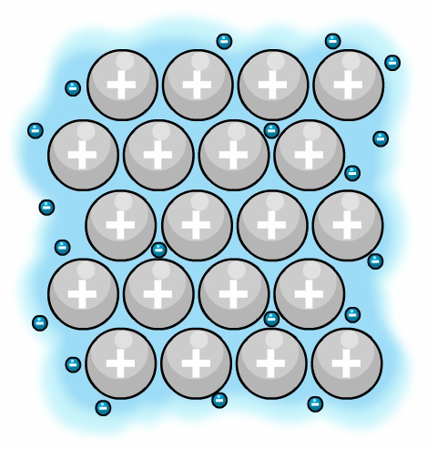
What is the structure of metals?
Metal particles are held together by strong metallic bonds and are arranged in tightly packed layers, forming a regular lattice structure.
sea of electrons
The outer electrons of the metal atoms are detached and create a “sea of electrons.”
These electrons are delocalized and are free to move through the structure. The metal atoms become positively-charged ions and are attracted to the sea of electrons. This strong attraction is known as metallic bonding.
metal ions
Notes:
Teacher notes
Please note that this diagram is not drawn to scale. It should be stressed to students that an electron is tiny compared to a metal ion. This means that the electrons are able to pass between the metal ions.
This slide covers the Science and Engineering Practice:
Developing and Using Models: Develop, revise, and/or use a model based on evidence to illustrate and/or predict the relationships between systems or between components of a system.

Slide 15
Metallic structures
Notes:
This slide covers the Science and Engineering Practice:
Developing and Using Models: Develop, revise, and/or use a model based on evidence to illustrate and/or predict the relationships between systems or between components of a system.

Slide 16

Strength of forces between particles
Electric forces hold atoms and molecules together.
The strength of these forces determines the properties of
a substance.
Use a data book to find out about the properties (such as melting and boiling points) of a range of substances with different types of bonding.
What does your research tell you about the strength of the forces between the particles (atoms, ions or molecules) in different types of structures?
Notes:
This slide covers the Science and Engineering Practice:
Constructing Explanations and Designing Solutions: Apply scientific ideas, principles, and/or evidence to provide an explanation of phenomena and solve design problems, taking into account possible unanticipated effects.

Slide 17
Bonding and structures
Use your understanding of chemical bonds and the results of your research to fill in the gaps in the table.
bonding | type of structure | strength of electric forces | melting point | state at room temperature
ionic
covalent
metallic
giant ionic
strong
very high
solid
simple
molecular
usually gas or liquid
very weak
low
usually solid,
sometimes liquid
polymer
fairly strong
high
giant
covalent
very strong
very high
solid
giant
metallic
solid (except mercury – liquid)
strong
very high
Notes:
Teacher notes
Students should understand that the forces affecting the bulk properties are between different particles in each case: in ionic compounds, the forces are between ions; in simple molecular compounds, the forces are between molecules; in polymers, the forces are between chains of molecules; in giant covalent structures, the forces are between atoms and, in metallic compounds, the forces are between ions and delocalized electrons.
This slide covers the Science and Engineering Practice:
Constructing Explanations and Designing Solutions: Apply scientific ideas, principles, and/or evidence to provide an explanation of phenomena and solve design problems, taking into account possible unanticipated effects.

