Slide 1
Electromagnetism

Slide 2
Information
Developing and Using Models
Constructing Explanations and Designing Solutions
1. Patterns
2. Cause and Effect
5. Energy and Matter

Slide 3
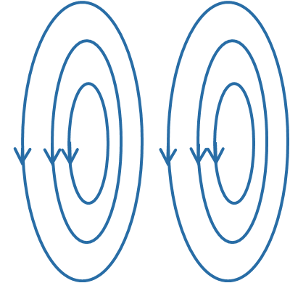

Current and magnetism
When a current flows through a conductor, it generates a magnetic field.
magnetic field
current
The magnetic field
is generated at right angles to the direction of the current.
For a straight wire, the strength of the magnetic field depends on:
the size of the current through the wire
the distance from the wire.

Slide 4
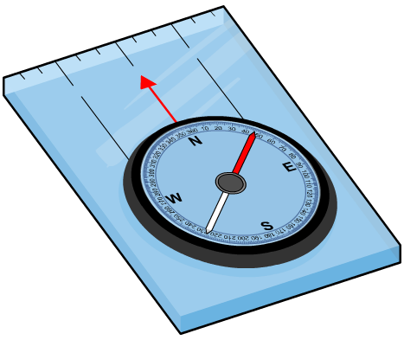
Demonstrating the effect of current
One way to demonstrate the magnetic effect of a current-carrying wire is to use a compass.
Compasses are designed to align with the magnetic field of the Earth. The needle points to the magnetic north pole.
If a compass is placed next to a wire, what will happen when the current is switched on?
The compass needle will be deflected by the magnetic field that the current generates.

Slide 5

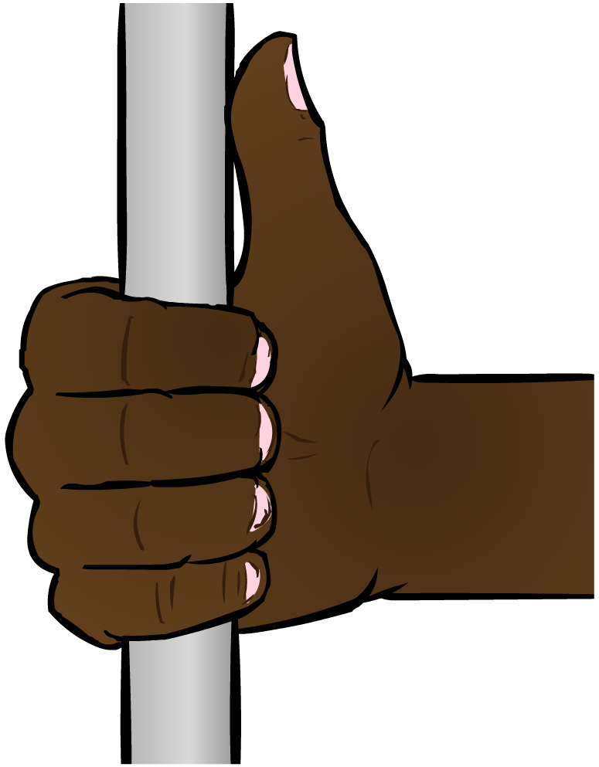
Field around a wire
The direction of the magnetic field around a straight wire can be worked out by using the right hand grip rule.
_
Grip a wire so that your thumb points in the direction of the conventional current (from the positive to the negative terminal of a battery).
Your fingers will curl around the wire in the direction of the magnetic field (from north
to south pole).
+
Notes:
This slide covers the Science and Engineering Practice:
Developing and Using Models: Develop and/or use multiple types of models to provide mechanistic accounts and/or predict phenomena, and move flexibly between model types based on merits and limitations.

Slide 6
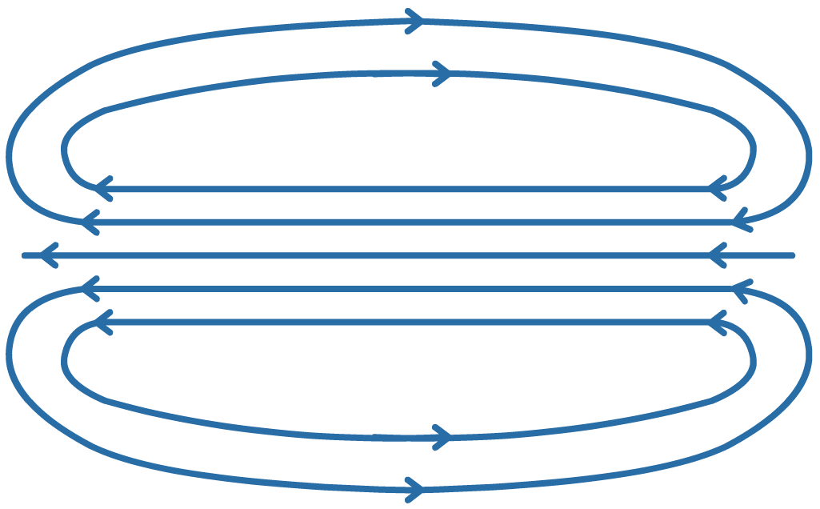
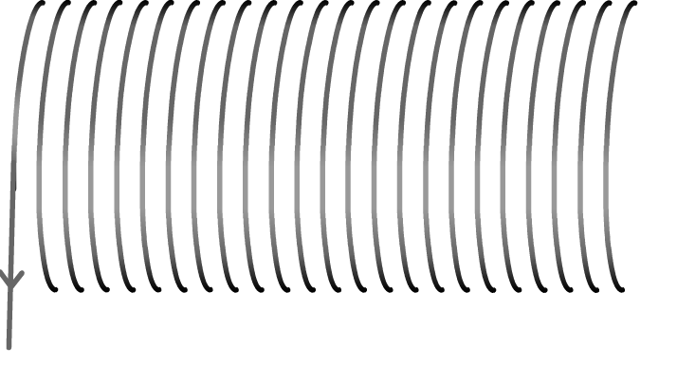
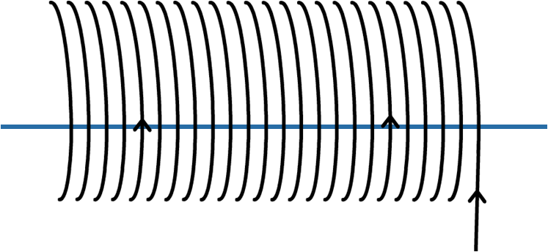
What is a solenoid?
To increase the strength of the magnetic field, the wire can be curled into a solenoid shape.
To understand why, consider the way that magnetic field lines interact in a single loop of wire.

Slide 7
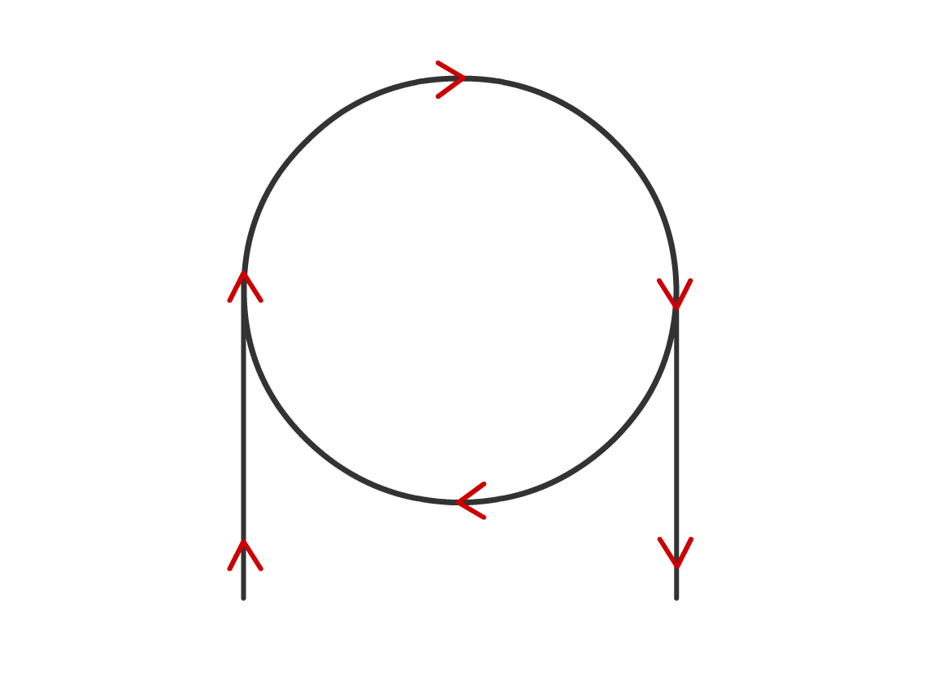
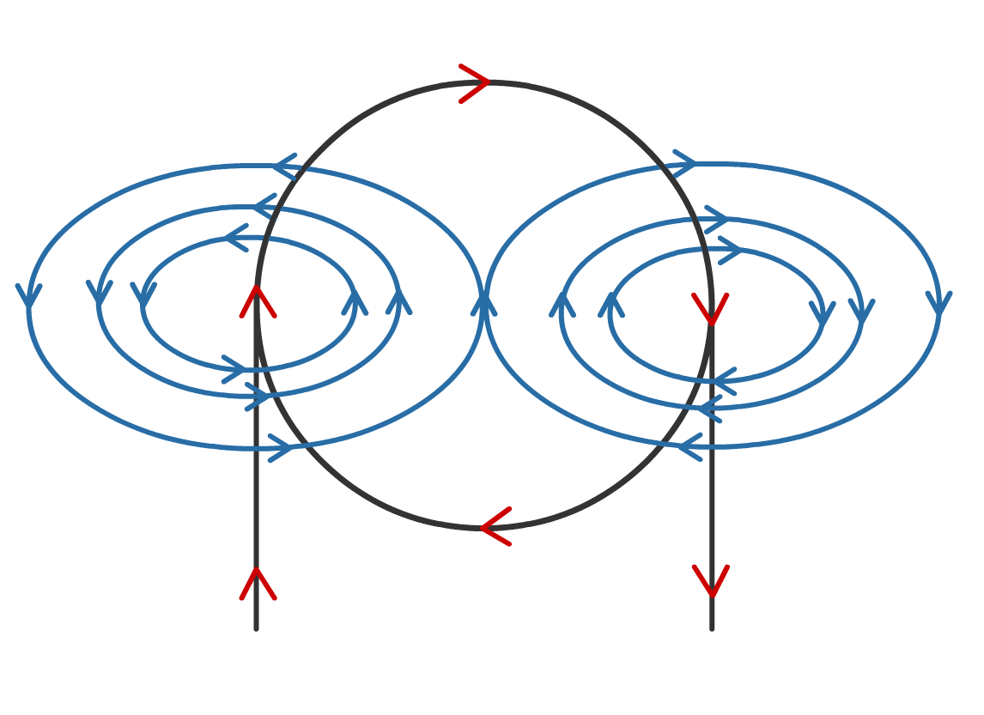
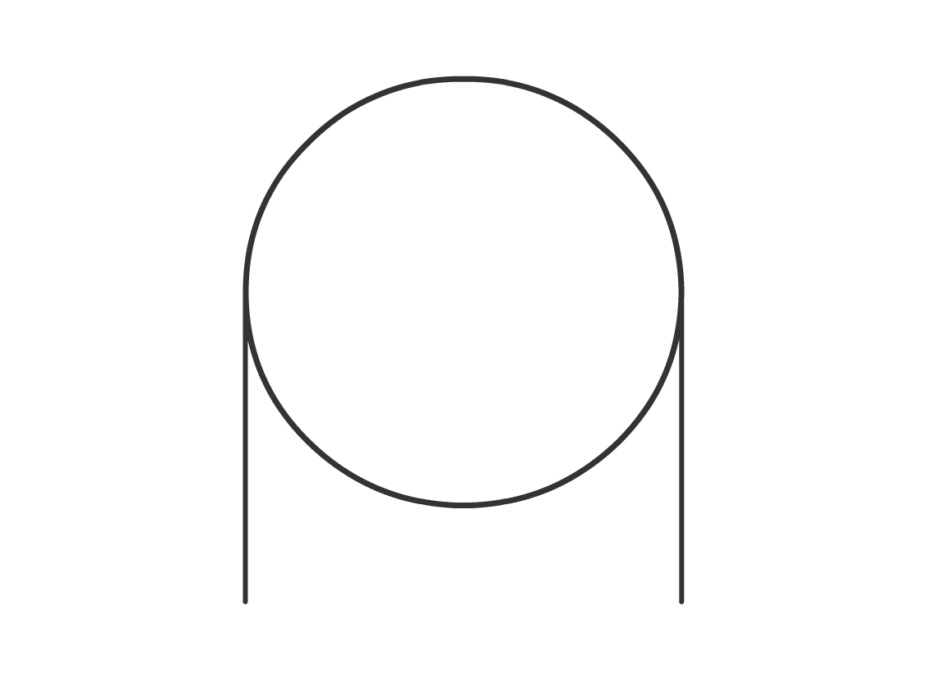
Understanding solenoids part one
The current flows around the loop.
The flow of charge generates a magnetic field around the wire.
… is acting in the
opposite direction
to the magnetic field generated here.
Notice that the magnetic field generated here…
Notes:
This slide covers the Science and Engineering Practice:
Constructing Explanations and Designing Solutions: Apply scientific ideas, principles, and/or evidence to provide an explanation of phenomena and solve design problems, taking into account possible unanticipated effects.

Slide 8
Understanding solenoids part two
Inside the loop, the magnetic field lines are pointing in the same direction. Field lines pointing in the same direction
add together.
Therefore, the magnetic field will be stronger inside the loop.
Notes:
This slide covers the Science and Engineering Practice:
Constructing Explanations and Designing Solutions: Apply scientific ideas, principles, and/or evidence to provide an explanation of phenomena and solve design problems, taking into account possible unanticipated effects.

Slide 9
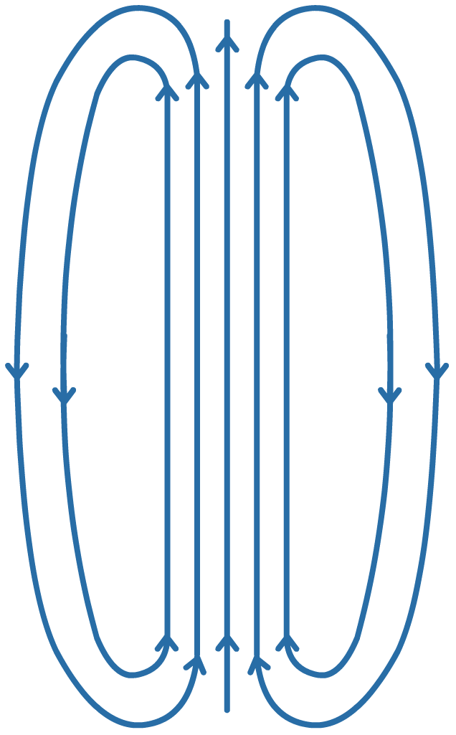
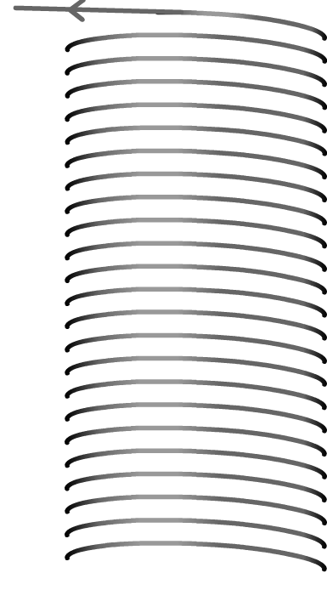
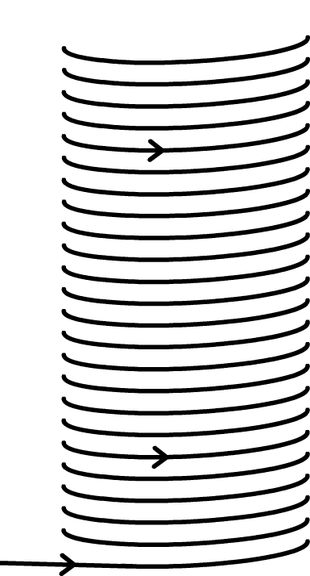
Electromagnets
When many loops are combined in a coil, the same concentrating effect is amplified many times.
The magnetic field of a solenoid is similar to the magnetic field of a bar magnet. Inside the coil, the magnetic field is straight and uniform.
To make the magnetic field even stronger, the solenoid can be wrapped around an iron core.
An electromagnet is made from
a solenoid with an iron core.
Notes:
This slide covers the Science and Engineering Practice:
Constructing Explanations and Designing Solutions: Apply scientific ideas, principles, and/or evidence to provide an explanation of phenomena and solve design problems, taking into account possible unanticipated effects.

Slide 10

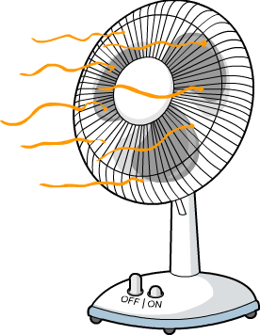
Electromagnetic devices
Unlike fixed magnets, the magnetic field of an electromagnet can be easily switched on or off in an electric circuit.
Magnetic fields can be used to make things move.
Motors that use electromagnets can therefore be used to
transfer electrical energy into kinetic energy.
Lots of electronic devices make use
of electromagnets. For example:
loudspeakers
hairdryers
fans
and many more!
Notes:
Teacher notes
For more information about motors, please refer to the Motors presentation.

Slide 11
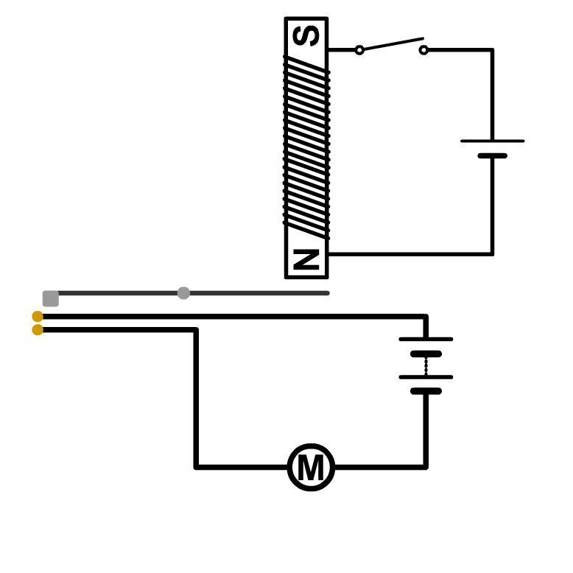
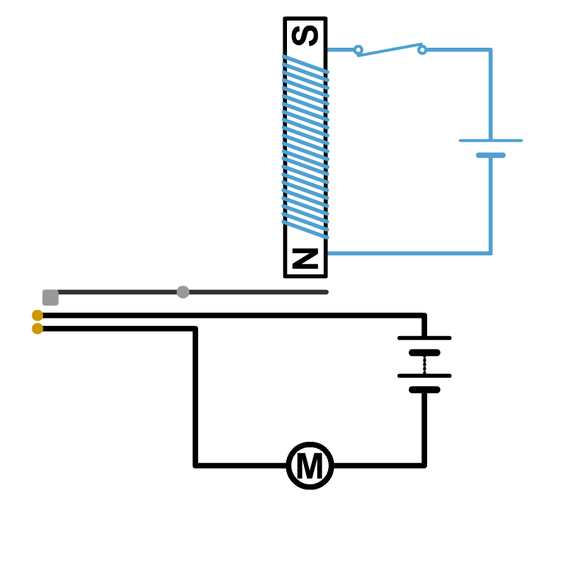
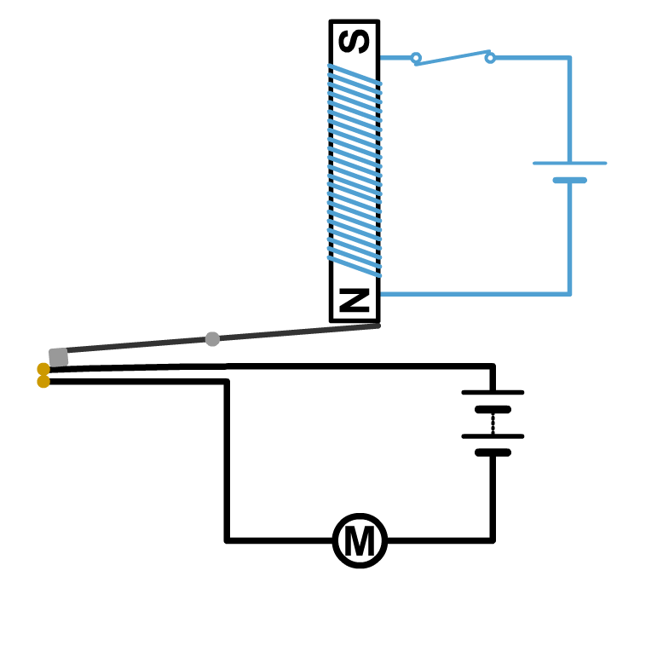
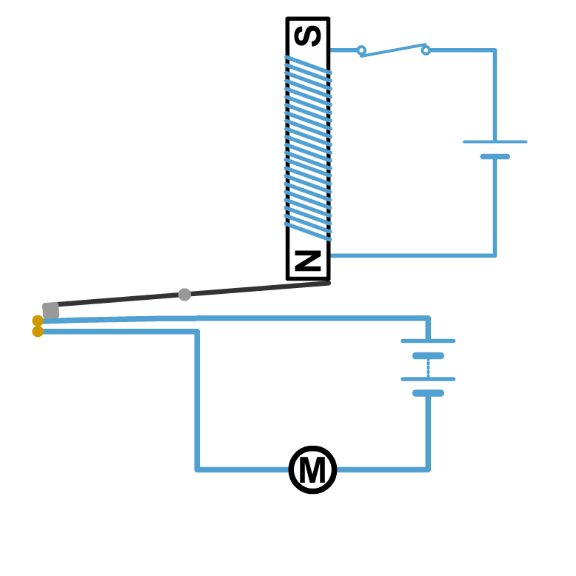
An electromagnetic circuit
Electromagnets are often used in a circuit called a relay.
switch
What will happen when the switch is closed?
iron core
Current will flow in the top circuit, turning the iron core into an electromagnet.
pivot
iron arm
One end of the iron arm
will be attracted to the end of the electromagnet, so
the other end will push the contacts together.
contacts
motor
The bottom circuit will be complete and the motor will operate.
Notes:
Teacher notes
This is a simplified diagram that does not show the mechanism by which the contacts would separate after the electromagnet is turned off. In most relay circuits, a spring would perform this function. It’s important to highlight that the top and bottom circuits are electrically independent; there is no current between them. This is the key feature that allows for a low-power circuit to control a high-power circuit safely.
Some examples of relay circuits in use include as alarms in security systems and in the ignition circuits of cars.

Slide 12


Currents and magnetic fields
Notes:
Teacher notes
This flash activity asks users to select a current image and the matching magnetic field diagram. It could be used to review the right hand grip rule or what the field lines of a solenoid look like compared to a straight wire.

Slide 13
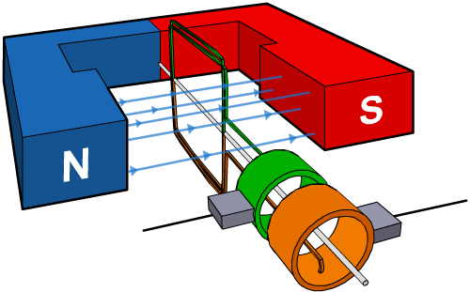
Magnetic and electric fields
Just as an electric current can cause a magnetic field, a changing magnetic field produces an electric field.
This means that a changing magnetic field can be used to generate an electric current. Generators use this principle to generate electricity.
A generator is a device that converts kinetic energy into electrical energy. It uses kinetic energy to move a coil of wire in a magnetic field. This creates an electric current.
Notes:
Teacher notes
For more information about generators, please refer to the The Generator Effect presentation.

Slide 14
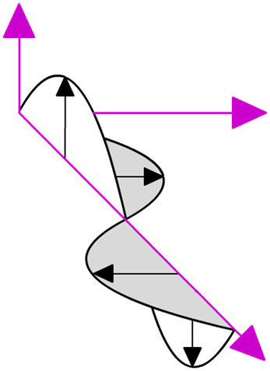
Electromagnetic waves
The fact that changing electric fields generate magnetic fields and vice versa explains how electromagnetic waves can transfer energy through a vacuum.
magnetic field
Electromagnetic waves are made of oscillating electric and magnetic fields.
electric field
The changing electric field produces a magnetic field, which produces an electric field, and so on.
wave direction
Notes:
Teacher notes
For more information about electromagnetic waves, please refer to the The Electromagnetic Spectrum presentation.

