Slide 1
Half-life

Slide 2
Information
Analyzing and Interpreting Data
Using Mathematics and Computational Thinking
Constructing Explanations and Designing Solutions
1. Patterns
3. Scale, Proportion, and Quantity
5. Energy and Matter
7. Stability and Change

Slide 3


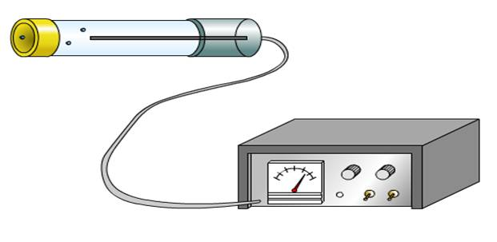

Activity of an isotope
Although atoms of the same element always have the
same number of protons, they can have different numbers
of neutrons. Atoms that differ in this way are called isotopes.
In a radioactive isotope, the nucleus is unstable and so it emits particles or waves to form a more stable atom. This process is called radioactive decay. It is a natural and completely random process.
The activity of a radioactive isotope is the number of atoms that decay per second. This can be detected and measured using instruments such as a Geiger counter.
Notes:
Teacher notes
The unit used to measure the activity of a radioactive isotope is the Becquerel (Bq).
This presentation is accompanied by the worksheet Half-life.

Slide 4



Decreasing radioactivity
Notes:
This slide covers the Science and Engineering Practice:
Constructing Explanations and Designing Solutions: Apply scientific ideas, principles, and/or evidence to provide an explanation of phenomena and solve design problems, taking into account possible unanticipated effects.

Slide 5


What is half-life?
Radioactive decay is a spontaneous process that cannot be controlled and is not affected by temperature.
We cannot predict when a particular nucleus will decay. However, every radioactive element has its own particular decay rate. This is called its half-life.
For example, the half-life of the isotope iodine-131 is eight days.
After eight days, half the nuclei in a sample of iodine-131 will have decayed.
Eight days later half the remaining
nuclei will have decayed, and so on.
Notes:
Teacher notes
The half-life of an isotope can also be defined as the average time taken for the count-rate (or activity) of an isotope sample to fall to half its initial level.

Slide 6
Calculating half-life
Notes:
This slide covers the Science and Engineering Practice:
Analyzing and Interpreting Data: Apply concepts of statistics and probability (including determining function fits to data, slope, intercept, and correlation coefficient for linear fits) to scientific and engineering questions and problems, using digital tools when feasible.

Slide 7
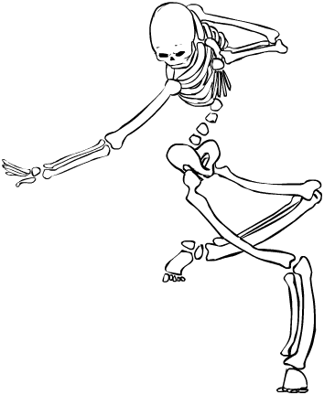
Dating a sample
Half-life can be used to do many useful calculations.
For example, the half-life of carbon-14 is 5,700 years. If a fossil bone has an activity of 25 counts/s, and a bone from a living body has an activity of 200 counts/s, how old is the fossil?
After one half-life, the activity will decrease by half to 100 counts/s.
After the second half-life, the activity decreases by half again to 50 counts/s.
After the third half-life, the activity decreases to 25 counts/s.
Three half-lives of carbon-14 have passed, so
3 × 5,700 years makes the fossil 17,100 years old.
Notes:
Teacher notes
Uranium dating can be used to estimate the age of igneous rocks. Uranium has a half-life of 4,500 million years, and each atom of uranium decays into an atom of lead.
This slide covers the Science and Engineering Practice:
Using Mathematics and Computational Thinking: Apply techniques of algebra and functions to represent and solve scientific and engineering problems.

Slide 8
Carbon dating
Notes:
This slide covers the Science and Engineering Practice:
Constructing Explanations and Designing Solutions: Apply scientific ideas, principles, and/or evidence to provide an explanation of phenomena and solve design problems, taking into account possible unanticipated effects.

Slide 9
Half-life calculations
Notes:
This slide covers the Science and Engineering Practice:
Using Mathematics and Computational Thinking: Apply techniques of algebra and functions to represent and solve scientific and engineering problems.

Slide 10
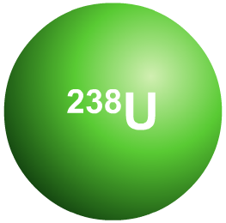

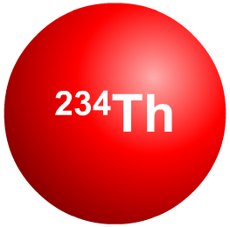
Net decline
We can also say something about how long a sample of a radioactive substance has been decaying by looking at the ratio of undecayed nuclei to decayed nuclei. This is known
as the net decline.
For example, when a pure sample of uranium-238 begins to decay, its nuclei will become thorium-234.
Over the course of 1 half-life the amount of thorium will increase from 0% to 50%. Over the second half-life this will increase from 50% to 75%, and so on.
At any time, this proportion can be expressed as a ratio. What is the ratio of thorium after 2 half-lives?
Notes:
Teacher notes
The ratio moves from 1:1 after 1 half life, to 1:3 after the second.
This slide covers the Science and Engineering Practice:
Using Mathematics and Computational Thinking: Apply ratios, rates, percentages, and unit conversions in the context of complicated measurement problems involving quantities with derived or compound units (such as mg/mL, kg/m3, acre-feet, etc.).

Slide 11
Calculating net decline as a ratio
If we can find out what the proportion of one element to another is in a sample, then its ratio will give us an idea of how old it is.
In an old sample, more of the radioactive nuclei will have decayed, so old samples have a higher ratio of the more stable element in them.
percentage
of uranium
percentage
of thorium
uranium : thorium
ratio
time
0
100
0
1:0
after 1 half-life
50
50
1:1
after 2 half-lives
25
75
1:3
after 3 half-lives
12.5
87.5
1:7
Notes:
This slide covers the Science and Engineering Practice:
Using Mathematics and Computational Thinking: Apply ratios, rates, percentages, and unit conversions in the context of complicated measurement problems involving quantities with derived or compound units (such as mg/mL, kg/m3, acre-feet, etc.).

Slide 12
Lengths of half-lives
Half-lives range from millionths of a second to millions of years.
radioisotope
half-life
boron-12
0.02 seconds
Some types of nuclei are more unstable than others and decay at a faster rate.
radium-226
1,602 years
uranium-235
710 million years
Xenon-133 is a radioactive isotope used for studying
lung function. Why does its half-life of 5.2 days make it suitable for this use?
Uranium-235, which is used in nuclear reactors and nuclear weapons, has a half-life of 710 million years. Why is the use of uranium-235 considered controversial?
Notes:
Teacher notes
At 5.2 days, the half-life of xenon-133 is long enough for medical tests to be carried out effectively, but short enough for it to have decayed completely in a matter of weeks.

Slide 13
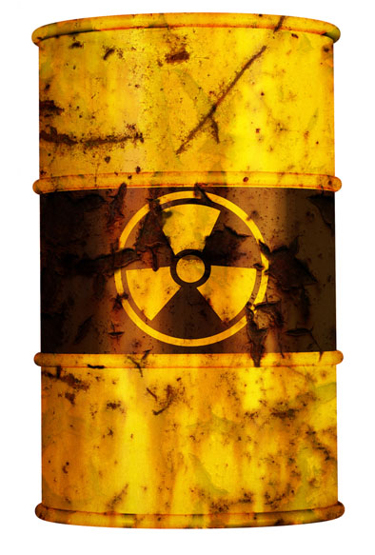
Nuclear waste
The waste from nuclear power stations may contaminate or irradiate the environment. How this waste is disposed of depends on how radioactive it is and the length of its half-life.
Low and intermediate level nuclear waste, such as contaminated clothing or radioactive sources used in medicine, can be encased in concrete and stored until it reaches safe radiation levels.
Some isotopes in high level waste, which includes used nuclear fuel, remain radioactive for thousands of years. High level waste is stored underwater for 20 years, then placed into concrete casks in underground storage.
Notes:
Teacher notes
Contamination happens when radioactive particles escape into the environment. Irradiation occurs when alpha, beta or gamma radiation ionizes atoms in material near to the waste.
Photo credit: © Dirk Ercken, shutterstock.com 2018

