Slide 1
Magnetism

Slide 2
Information
Asking Questions and Defining Problems
Developing and Using Models
Planning and Carrying Out Investigations
Constructing Explanations and Designing Solutions
1. Patterns
2. Cause and Effect
5. Energy and Matter

Slide 3


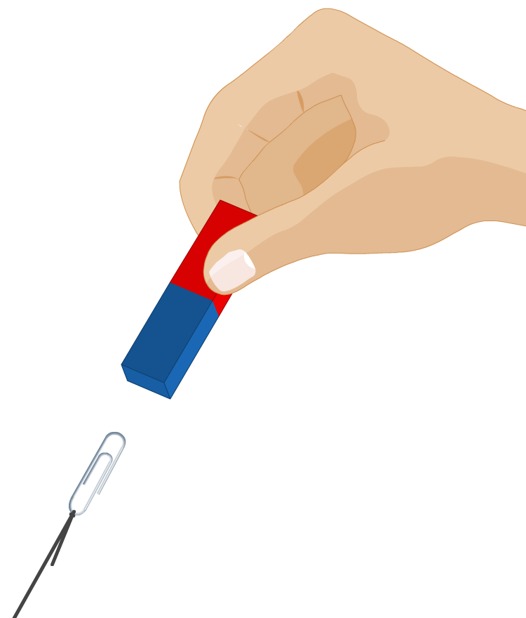

Forces and fields
Some forces, such as gravity, magnetism and the electric force, can act on objects that are not touching.
How do these forces act when objects are at a distance from each other?
Forces that act at a distance can be explained by fields that surround objects and can transfer energy through space.
For example, magnets are surrounded by magnetic fields.
Notes:
Teacher notes
For more information about gravity and the electric force, please refer to the Gravity and Electric Fields presentations respectively.
This slide covers the Science and Engineering Practices:
Asking Questions and Defining Problems: Ask questions to clarify and refine a model, an explanation, or an engineering problem.
Constructing Explanations and Designing Solutions: Apply scientific ideas, principles, and/or evidence to provide an explanation of phenomena and solve design problems, taking into account possible unanticipated effects.

Slide 4

What are magnets?
A magnet is a material that exerts a magnetic force on other magnets or magnetic materials. Iron, nickel and cobalt are all magnetic. Steel, which contains iron, is also magnetic.
Bar magnets are permanent magnets. This means they are always magnetized. The two ends of a magnet are called the north pole and the south pole.
Magnets attract magnetic materials. Magnets can also attract or repel other magnets.
How can you tell if a piece of metal is a magnet?
Notes:
Teacher notes
You can only tell if a metal is a magnet if it repels another magnet.

Slide 5
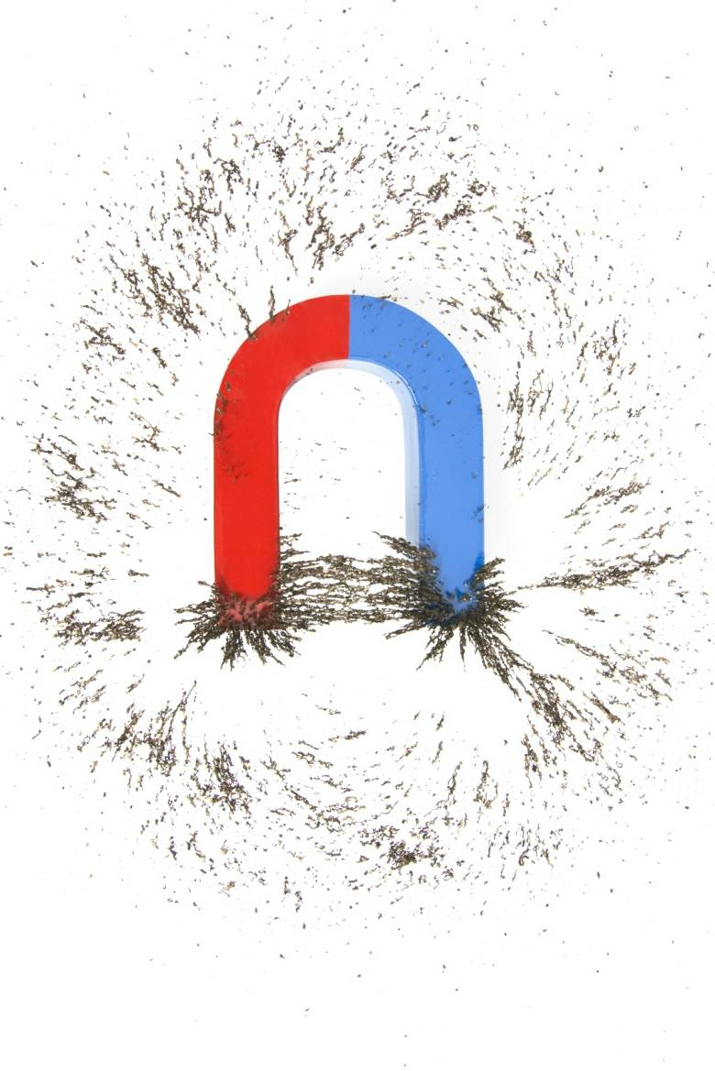
What is a magnetic field?
The region around a magnet where it has a magnetic effect is called its magnetic field.
When a magnetic material is placed in a magnetic field, it will experience a force.
The iron filings feel the effect of the magnetic field and line up along the direction of the forces in this region.
magnetic field
Notes:
Photo credit: © MilanB, shutterstock.com 2018

Slide 6


Shape of a magnetic field
Notes:
This slide covers the Science and Engineering Practice:
Planning and Carrying Out Investigations: Plan an investigation or test a design individually and collaboratively to produce data to serve as the basis for evidence as part of building and revising models, supporting explanations for phenomena, or testing solutions to problems. Consider possible variables or effects and evaluate the confounding investigation’s design to ensure variables are controlled.

Slide 7
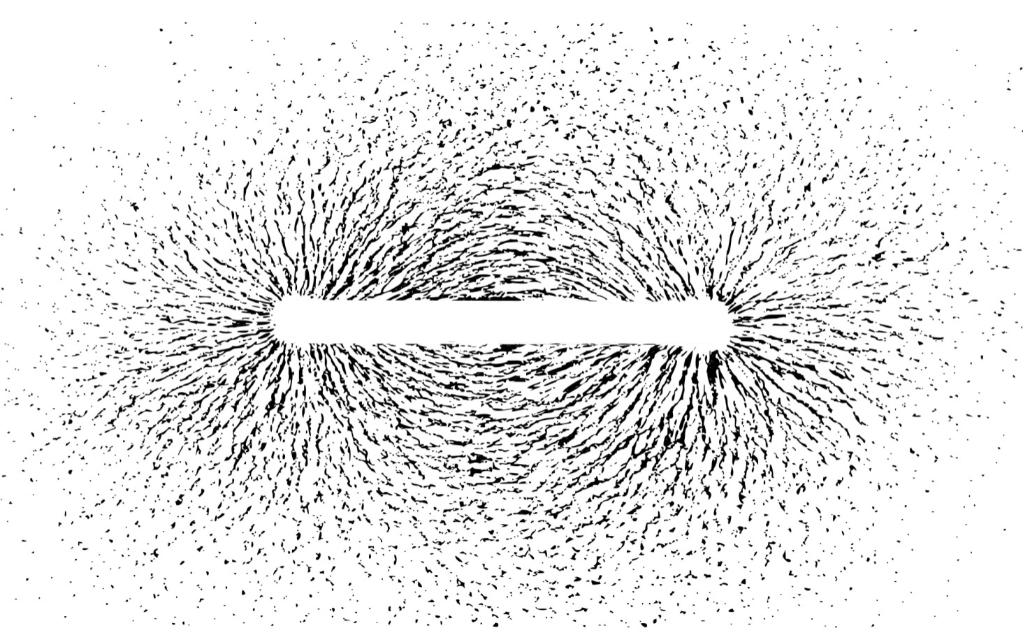
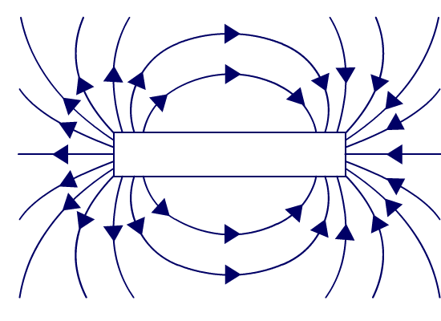

Magnetic field lines
The shape of a magnetic field can be shown by drawing magnetic field lines. These always point from the north pole of a magnet to the south pole, along the direction of the magnetic forces in each region.
Where is the magnetic field strongest?
the field is strongest at the poles
The closer together the magnetic field lines, the stronger the magnetic field.
the field is weakest further away from the poles
Notes:
This slide covers the Science and Engineering Practice:
Developing and Using Models: Develop, revise, and/or use a model based on evidence to illustrate and/or predict the relationships between systems or between components of a system.
Photo credit: © imagedb.com, shutterstock.com 2018

Slide 8


Attraction and repulsion
What happens if you bring two bar magnets together?
If a north pole and a south pole are brought together, they attract and the magnets are pulled together.
If two north poles or two south poles are brought together, they repel and the magnets push each other apart.
We say that unlike poles attract, and like poles repel.

Slide 9

Forces between magnets experiment
Notes:
This slide covers the Science and Engineering Practice:
Planning and Carrying Out Investigations: Plan an investigation or test a design individually and collaboratively to produce data to serve as the basis for evidence as part of building and revising models, supporting explanations for phenomena, or testing solutions to problems. Consider possible variables or effects and evaluate the confounding investigation’s design to ensure variables are controlled.

Slide 10
Investigating magnetic fields
Notes:
This slide covers the Science and Engineering Practice:
Planning and Carrying Out Investigations: Plan an investigation or test a design individually and collaboratively to produce data to serve as the basis for evidence as part of building and revising models, supporting explanations for phenomena, or testing solutions to problems. Consider possible variables or effects and evaluate the confounding investigation’s design to ensure variables are controlled.

Slide 11
Viewing magnetic fields: N poles together
Bring the north poles of two bar magnets together.
What happens to the magnets?
Next, bring the two north poles as close to each other as possible and place a piece of paper on top of the magnets.
1.
Carefully scatter iron filings onto the paper.
2.
Draw the pattern created by the iron filings.
Notes:
This slide covers the Science and Engineering Practice:
Planning and Carrying Out Investigations: Plan an investigation or test a design individually and collaboratively to produce data to serve as the basis for evidence as part of building and revising models, supporting explanations for phenomena, or testing solutions to problems. Consider possible variables or effects and evaluate the confounding investigation’s design to ensure variables are controlled.

Slide 12
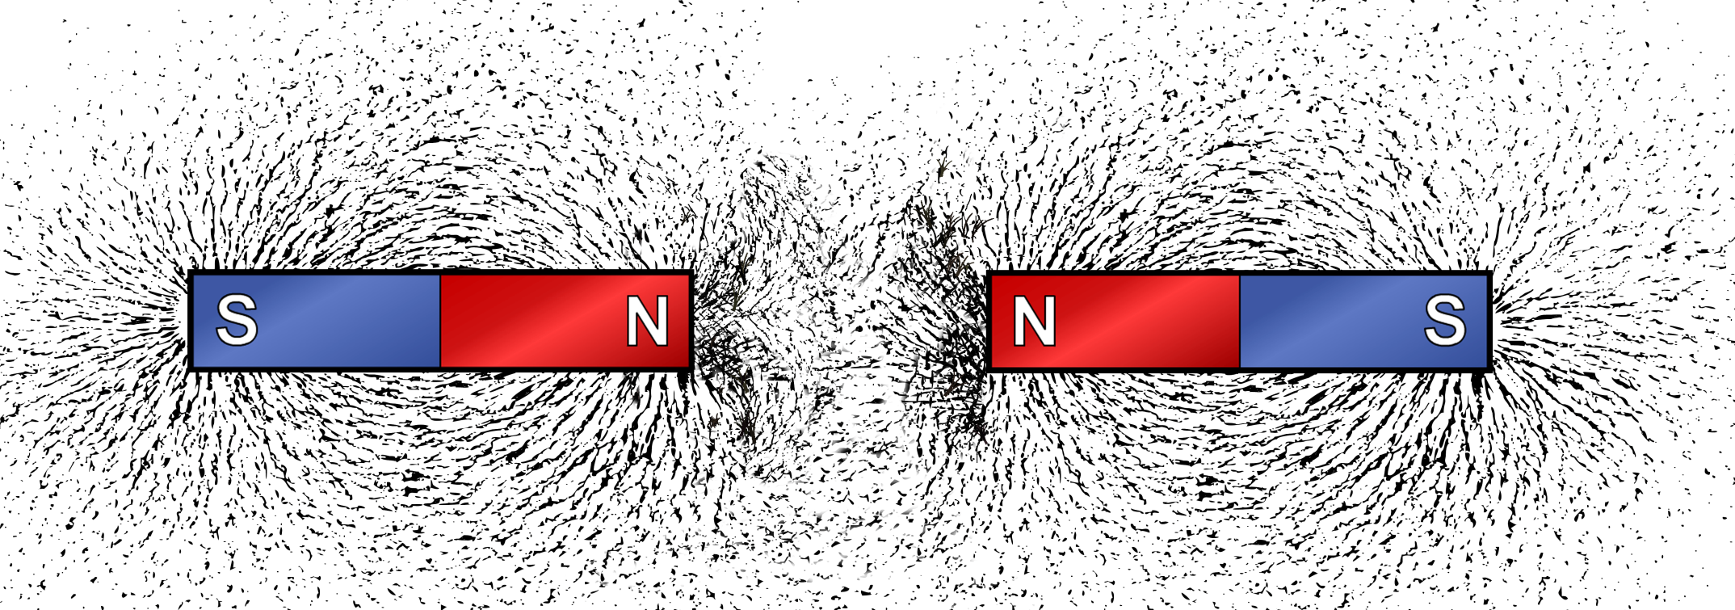
Magnetic field pattern: N poles together
What do you notice about the pattern of the lines of force in the region between the two north poles?
Notes:
This slide covers the Science and Engineering Practice:
Asking Questions and Defining Problems: Ask questions that arise from careful observation of phenomena, or unexpected results, to clarify and/or seek additional information.
Photo credit: © imagedb.com, shutterstock.com 2018

Slide 13

Viewing magnetic fields: N and S poles together
Bring the north and south poles of two bar magnets together.
What happens to the magnets?
Next, put the north and south poles close to each other, without letting them touch, and place a piece of paper on top.
1.
Carefully scatter iron filings onto the paper.
2.
Draw the pattern created by the iron filings.
Notes:
This slide covers the Science and Engineering Practice:
Planning and Carrying Out Investigations: Plan an investigation or test a design individually and collaboratively to produce data to serve as the basis for evidence as part of building and revising models, supporting explanations for phenomena, or testing solutions to problems. Consider possible variables or effects and evaluate the confounding investigation’s design to ensure variables are controlled.

Slide 14
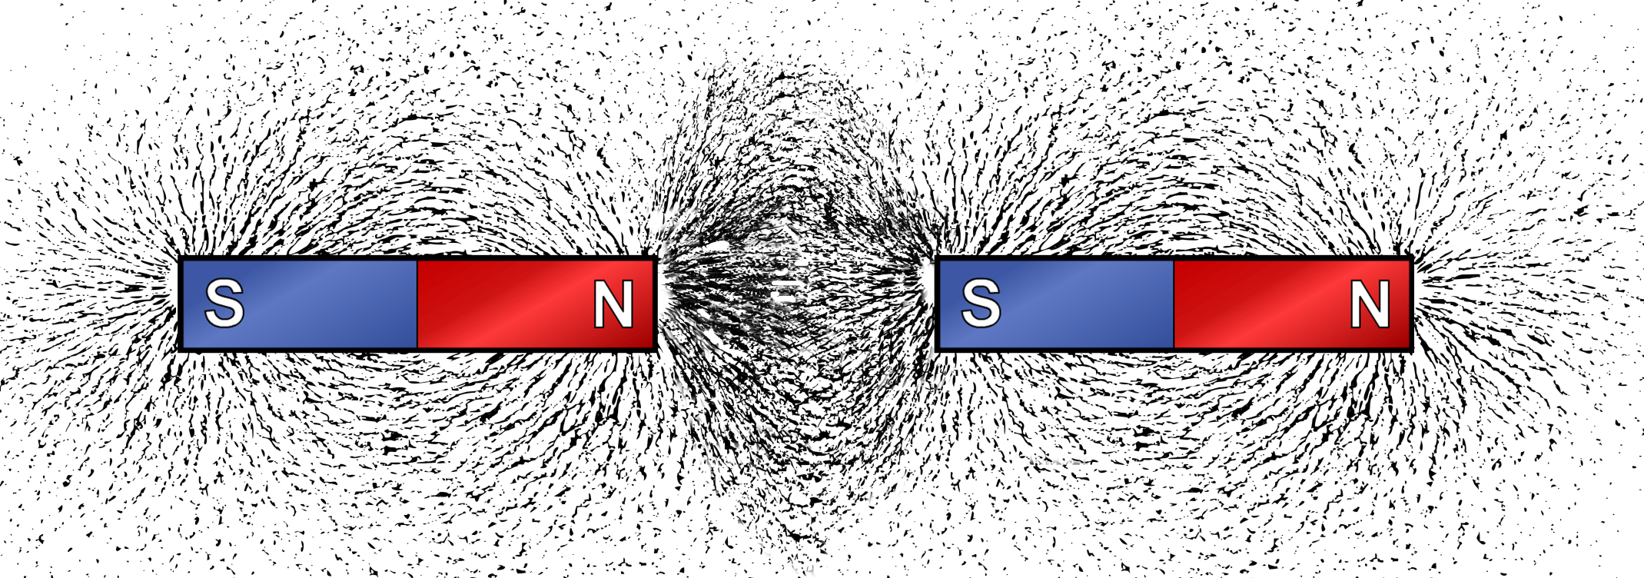
Magnetic field pattern: N and S poles together
What do you notice about the pattern of the lines of force in the region between the north and south poles?
How does this pattern compare with the pattern between the two north poles?
Notes:
This slide covers the Science and Engineering Practice:
Asking Questions and Defining Problems: Ask questions that arise from careful observation of phenomena, or unexpected results, to clarify and/or seek additional information.
Photo credit: © imagedb.com, shutterstock.com 2018

Slide 15
Energy in magnetic fields
Just as energy is stored in gravitational fields, energy is stored in magnetic fields. The energy stored in a field between two magnets depends on the relative positions of the magnets.
We call this energy magnetic potential energy.
When unlike poles face each other, magnetic potential energy increases as the distance between the poles increases.
If unlike poles are held apart and then released, the magnets will move toward each other. Energy is transferred from the magnetic field to kinetic energy in the magnets.
Notes:
Teacher notes
For more information about the energy stored in gravitational fields, please refer to the Gravity presentation.
This slide covers the Science and Engineering Practice:
Constructing Explanations and Designing Solutions: Apply scientific ideas, principles, and/or evidence to provide an explanation of phenomena and solve design problems, taking into account possible unanticipated effects.

Slide 16
Energy in repelling magnets
When like poles face each other, magnetic potential energy decreases as the distance between the poles increases.
If like poles are held together and then released, the magnets will move away from each other. Energy is transferred from the magnetic field to kinetic energy in the magnets.
To move the magnets back together, work must be done. This transfers energy to the magnetic field.
Notes:
Teacher notes
For more information about work, please refer to the Work and Power presentation.
This slide covers the Science and Engineering Practice:
Constructing Explanations and Designing Solutions: Apply scientific ideas, principles, and/or evidence to provide an explanation of phenomena and solve design problems, taking into account possible unanticipated effects.

Slide 17
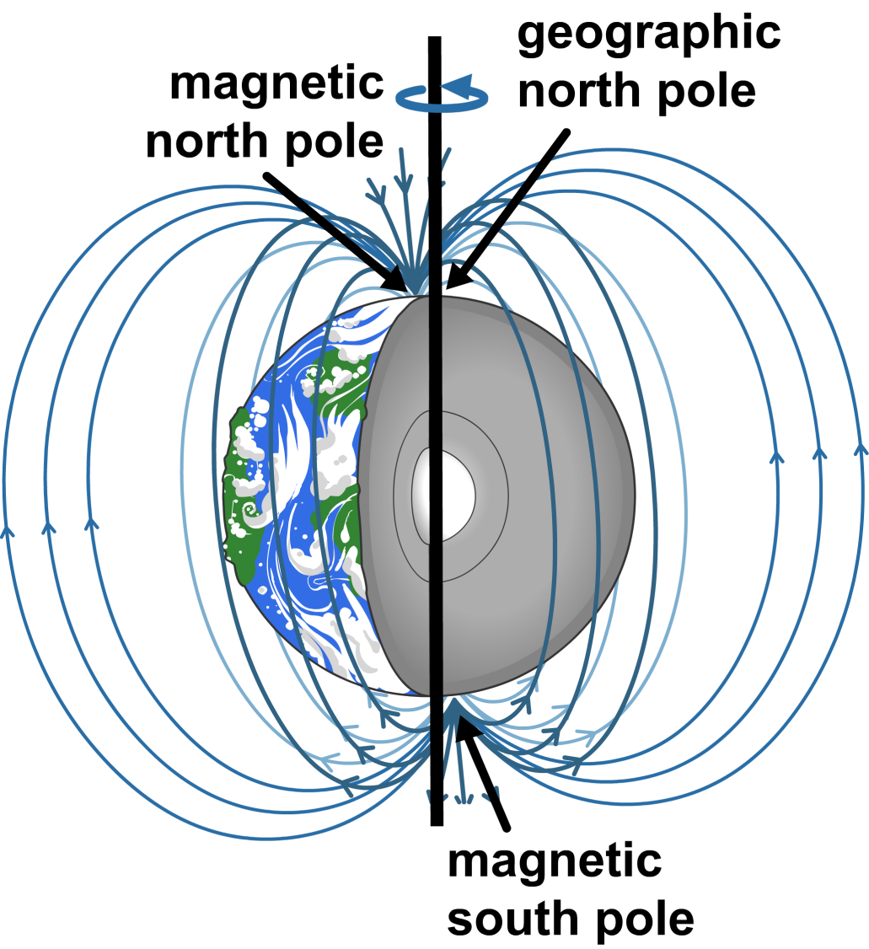
The Earth’s magnetic field
The Earth has a molten iron core. It is thought by scientists that the core’s rotation causes the Earth’s magnetic field.
This magnetic field is similar to a bar magnet but it is tilted 11 degrees from the rotational axis of the Earth.
The magnetic field deflects much of the ionizing radiation that comes from space and the Sun. This protects the Earth and all life on Earth.
Notes:
This slide covers the Science and Engineering Practice:
Developing and Using Models: Use a model to provide mechanistic accounts of phenomena.

Slide 18
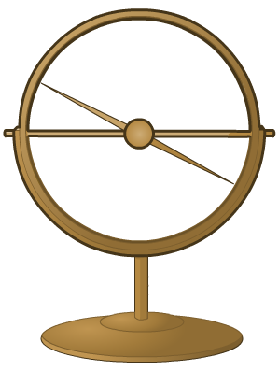
Evidence for the Earth’s magnetic field
When a magnet is suspended so that it is free to move,
it will line up with the magnetic field produced by the
Earth’s core.
A dipping compass is a type
of magnetic compass that is
held vertically. It can be used
to find the shape of the Earth’s
magnetic field.
The angle of the needle of a dipping compass shows the direction of the magnetic field at any point. For example, at the equator, the
needle will be horizontal.

Slide 19
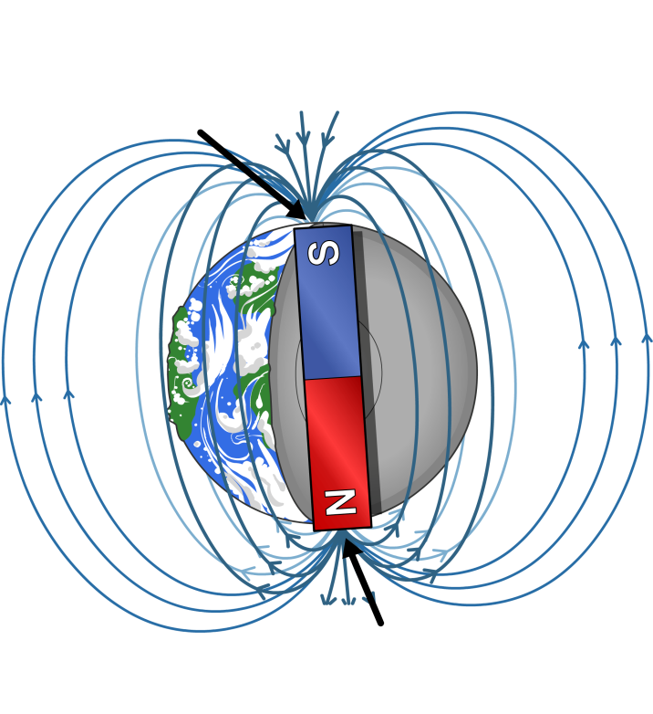
Using Earth’s magnetism for navigation
People have used magnetism to navigate for hundreds of years. The north poles of magnets, such as compass needles, are attracted to the North Pole of the Earth.
geographical North Pole
But if like poles repel, why is the
north pole of a magnet attracted to the North Pole of the Earth?
These poles were named before magnetism was properly understood. The “Magnetic North Pole” of the Earth is really a magnetic south pole.
geographical South Pole
Do you think that you would be able to use a compass to navigate on other planets, or on the Moon?
Notes:
Teacher notes
A compass will work on any planet that has a magnetic field. It would not work on the Moon because the Moon does not have its own bipolar magnetic field. If you were on another planet with a core similar to Earth’s that created a magnetic field, you would probably be able to use a compass.
This slide covers the Science and Engineering Practice:
Asking Questions and Defining Problems: Ask questions that arise from examining models or a theory, to clarify and/or seek additional information and relationships.

Slide 20
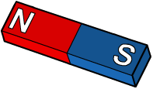
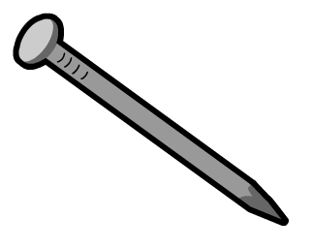
Induced magnets
A magnetic material will become a magnet when it is placed in a magnetic field. We say that it has become an induced magnet.
Unlike permanent magnets, induced magnets do not have their own magnetic field. This means that they lose their magnetism quickly when they are removed from another magnet’s magnetic field.
Induced magnetism always causes a force of attraction. The poles of an induced magnet will always be arranged so that the induced magnet is attracted to other magnets.
N
S

Slide 21
Magnets: true or false?

