Slide 1
Mass and
Weight

Slide 2
Information
Developing and Using Models
Using Mathematics and Computational Thinking
3. Scale, Proportion, and Quantity

Slide 3

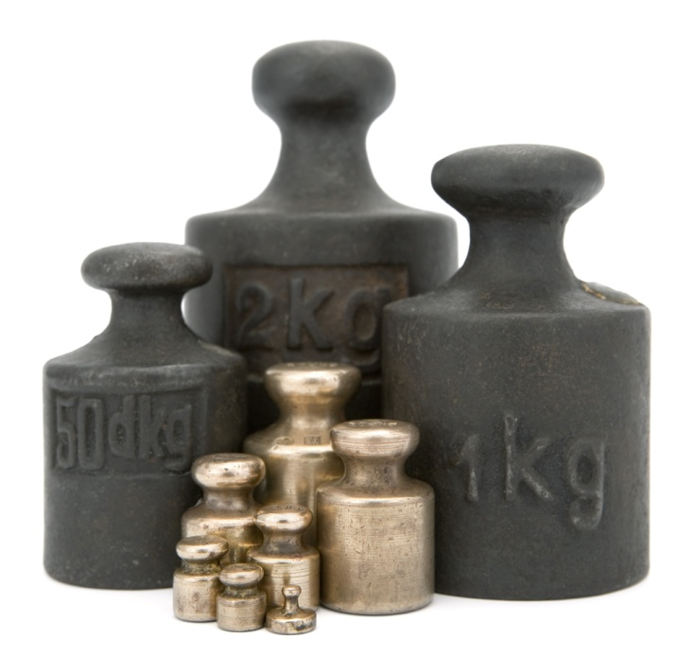

Weight and mass are not the same
Weight and mass are often confused, but they are not the same thing.
Mass is the amount of matter contained within an object. It is measured in kilograms.
Weight is a force. More precisely, it is the attractive force on a body caused by gravity. Like other forces, weight is measured in newtons and has both magnitude (size) and direction.
The weight of an object can change, but its mass will
remain constant.
Notes:
Teacher notes
Students at this level can assume that the mass of a body always remains constant.
Photo credit: © WitR, shutterstock.com 2018

Slide 4


Weight and mass on the Moon
Notes:
Teacher notes
This two-part sequence shows how gravity affects an astronaut’s movement on the Moon.

Slide 5

How do we calculate an object’s weight?
The weight of an object depends on its mass and the value of the gravitational field strength where that object is:
weight = mass × gravitational field strength
Weight, W, is measured in newtons (N).
Mass, m, is measured in kilograms (kg).
Gravitational field strength, g, is measured in newtons per kilogram (N/kg).
Close to the Earth’s surface, the gravitational field strength is approximately 10 N/kg.
Notes:
This slide covers the Science and Engineering Practice:
Developing and Using Models: Develop and/or use a model (including mathematical and computational) to generate data to support explanations, predict phenomena, analyze systems, and/or solve problems.

Slide 6
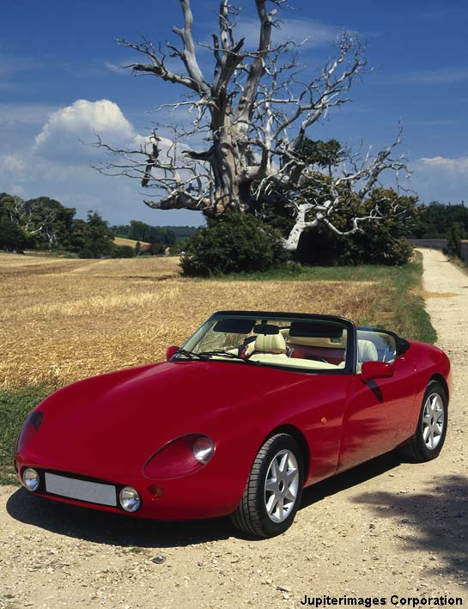
Calculating the weight of a car
A car has a mass of 1,000 kg.
What is the weight of the car?
(Use 10 N/kg as the value of the gravitational field strength.)
gravitational field strength
weight = mass ×
weight = 1,000 kg × 10 N/kg
weight = 10,000 N
Notes:
This slide covers the Science and Engineering Practice:
Using Mathematics and Computational Thinking: Apply techniques of algebra and functions to represent and solve scientific and engineering problems.
Photo credit: © Jupiterimages Corporation 2018

Slide 7
Calculating weight and mass
Notes:
Teacher notes
This multiple-choice quiz has five questions and provides an opportunity to assess students’ understanding of weight and mass calculations. Class voting or the use of colored traffic light cards could be used to make this a whole-class exercise.
This slide covers the Science and Engineering Practice:
Using Mathematics and Computational Thinking: Apply techniques of algebra and functions to represent and solve scientific and engineering problems.

Slide 8
Proportionality of mass and weight
Remember that:
weight = mass × gravitational field strength
What would happen to the weight if the mass was doubled whilst keeping the gravitational field strength constant?
It would also double.
What would happen to the weight if the mass was halved whilst keeping the gravitational field strength constant?
It would also halve.
Weight and mass are directly proportional. If mass increases, weight will increase too.

Slide 9
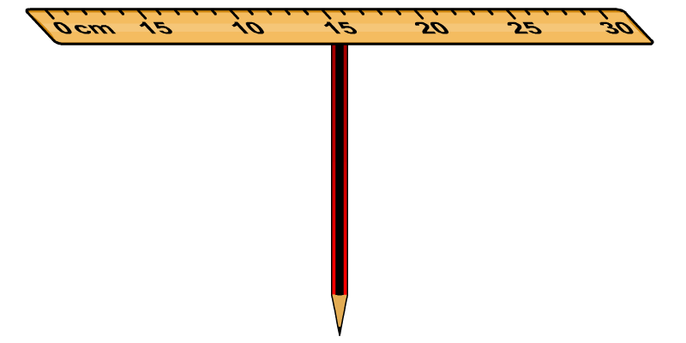
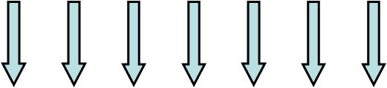

What is center of mass?
Can you balance a ruler on the flat end of a pencil?
If so, where do you put the pencil to make it balance?
The ruler is stationary when the weights of its entire length balance out.
This is equivalent to one force acting through the center of the ruler. It is as though the entire mass of the ruler is at one point
at the center of the ruler.
The point at which the weight of an object appears to act is called the center of mass of the object.

Slide 10

Finding a center of mass

Slide 11
Finding a center of mass

Slide 12
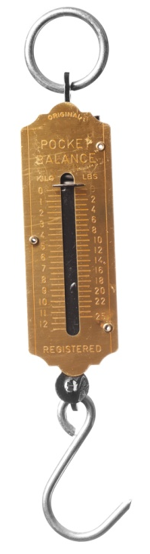
Measuring weight
The weight of an object can be measured using a spring balance, sometimes also called a newtonmeter or
a forcemeter.
A spring balance is made from a spring connected to a hook.
When a load is attached to the hook and left to hang, its weight pulls the hook downwards and stretches the spring.
The amount that the spring is stretched is proportional to the force applied. Heavier objects will stretch the spring more.
Notes:
Photo credit: © KalypsoWorldPhotography, shutterstock.com 2018

Slide 13
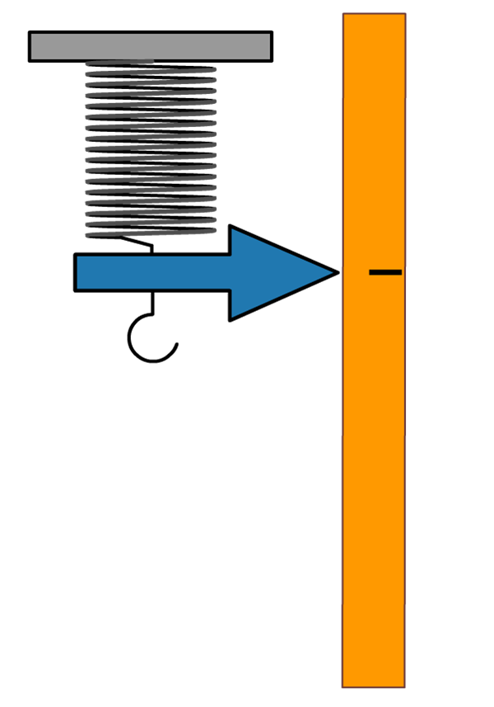
Calibrating a spring balance
The amount that the spring in a newtonmeter is extended by is
related to how much force is applied.
In order to convert that stretch in meters to a measure of force in newtons, a spring balance has to be calibrated.
0 N
To calibrate a newtonmeter, different masses with known weights are hung from it.
Initially, no mass is added. The spring is extended slightly by the weight of the hook.
This mark is labeled “0 N” on the scale.

Slide 14
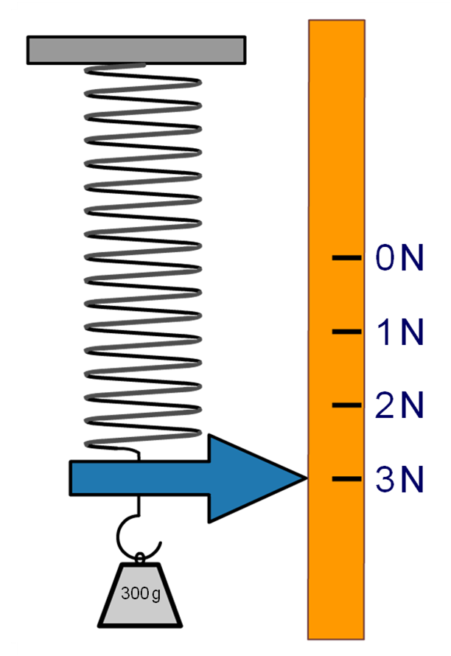
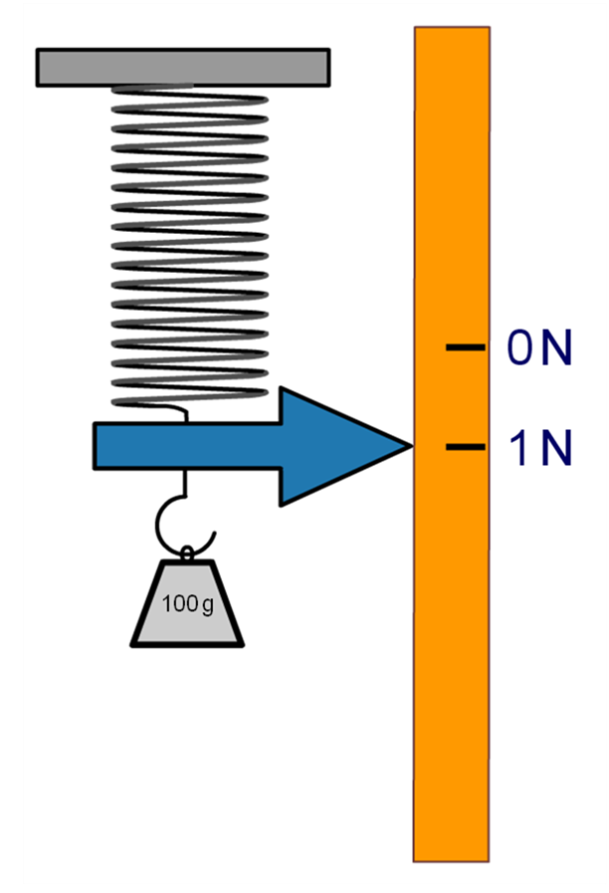
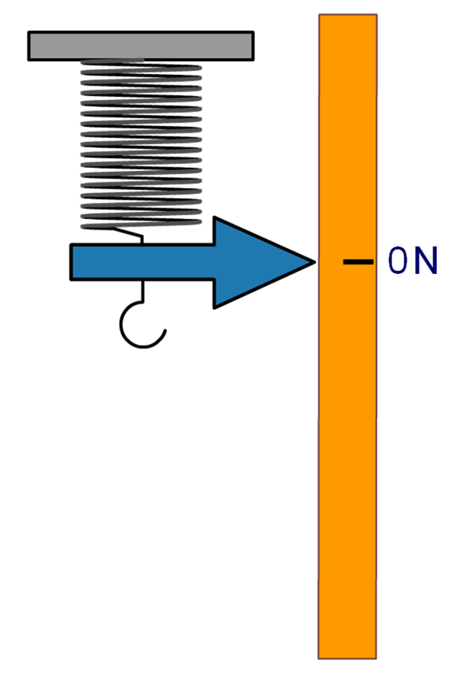
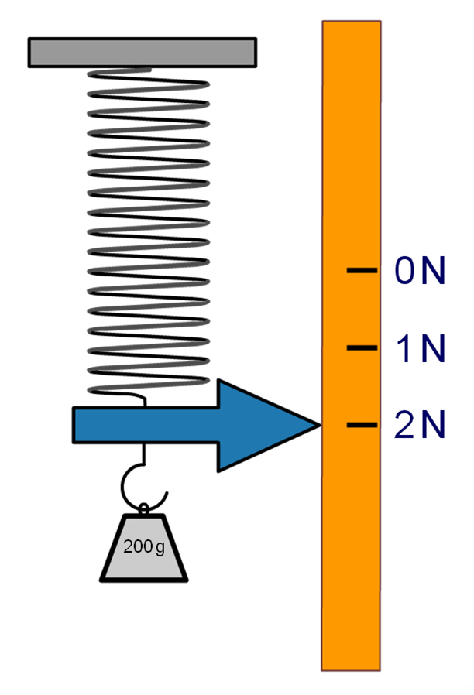
Calibrating a spring balance
A mass of 100 g is added. It exerts a downwards force of 1 N. The spring stretches.
The mark is labeled “1 N.”
The 100 g mass is replaced with a 200 g mass. It exerts a force of 2 N. The spring stretches further.
The mark is labeled “2 N.”
The 200 g mass is replaced with a 300 g mass. It exerts a force of 3 N. The spring stretches further.
200 g
300 g
The mark is labeled “3 N.”

