Slide 1
Motors

Slide 2
Information
Developing and Using Models
Planning and Carrying Out Investigations
Using Mathematics and Computational Thinking
Constructing Explanations and Designing Solutions
2. Cause and Effect
3. Scale, Proportion, and Quantity
5. Energy and Matter

Slide 3


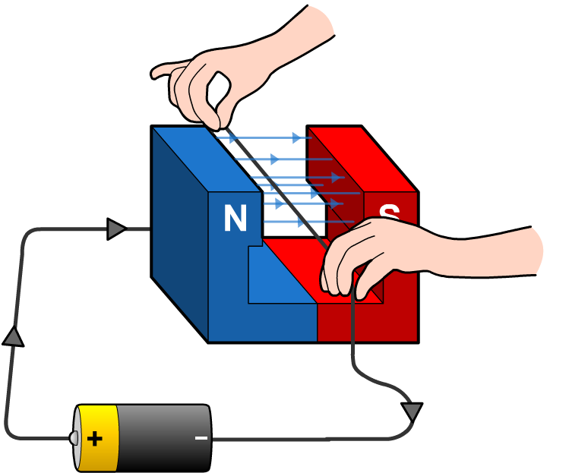

The motor effect
When a current flows through a wire held in the magnetic field of a magnet, the wire and the magnet exert a force on each other. The force on the wire can move the wire.
This is called the motor effect.
force
If the magnetic field and current are at right angles to each other, this results in the maximum force possible on the wire.
If the magnetic field and current are parallel to each other, there is no force.
What do you think happens if the wire is held at a different angle to the magnetic field?
Notes:
Teacher notes
If the wire is held at an angle between parallel and perpendicular, a force that is less than the maximum force will act on the wire. For able students, resolve the force vector into components parallel and perpendicular to the wire and explain that only the perpendicular force acts on the wire.
This presentation is accompanied by the worksheet Motors.

Slide 4




Wire in a magnetic field
Notes:
Teacher notes
This virtual experiment can be used as an introduction to the motor effect or as a summary exercise.
This slide covers the Science and Engineering Practice:
Planning and Carrying Out Investigations: Plan an investigation or test a design individually and collaboratively to produce data to serve as the basis for evidence as part of building and revising models, supporting explanations for phenomena, or testing solutions to problems. Consider possible variables or effects and evaluate the confounding investigation’s design to ensure variables are controlled.

Slide 5
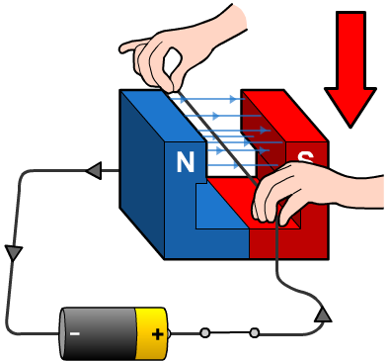
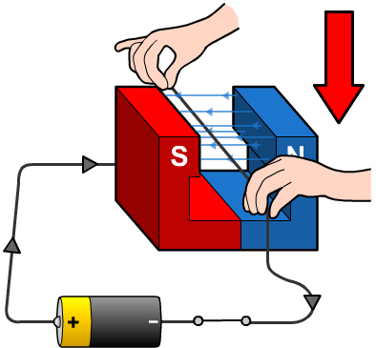
Changing the direction of the force
The direction of the force acting on a wire in an electromagnetic field can be reversed by:
reversing the current
reversing the magnetic field.
The direction of the force is therefore relative to both the direction of the magnetic field and the current.

Slide 6




Fleming’s left-hand rule
It is possible to predict the direction of the force acting on a wire – its motion – if the directions of the current and the magnetic field are known. Fleming’s left-hand rule is used to do this.
thuMb = Motion
First finger = magnetic Field
seCond finger = Current
Notes:
Teacher notes
Students should be made aware that the direction of a magnetic field is usually taken as being N-S rather than S-N, and the direction of current is the direction of conventional current, i.e. positive to negative.
This slide covers the Science and Engineering Practice:
Developing and Using Models: Develop, revise, and/or use a model based on evidence to illustrate and/or predict the relationships between systems or between components of a system.

Slide 7
Increasing the size of the force

Slide 8
The magnitude of the motor force
Since an increase in the current, the length of wire or the magnetic flux density all increase the force in the motor effect, they are all proportional to it.
force
When the wire is at right angles to the field, we can represent this relationship with the equation F = B I L:
F is the force in newtons (N)
B is the strength of the magnet, or magnetic flux density, in teslas (T)
I is the current in amps (A)
L is the length of wire within the magnetic field in meters (m).
1 tesla is equivalent to 1 N/A m.
Notes:
Teacher notes
A good opportunity to discuss the equivalence of units. Newtons per amp meter is clearly a non-standard unit, but perfectly correct!
This slide covers the Science and Engineering Practice:
Using Mathematics and Computational Thinking: Use mathematical, computational, and/or algorithmic representations of phenomena or design solutions to describe and/or support claims and/or explanations.

Slide 9
Calculating the force
A 20 cm length of wire is placed in a magnetic field of flux density 20 T (T stands for tesla, the unit of magnetic flux density). A current of 50 mA is passed through the wire.
What force is experienced by the wire?
Remember to use the formula:
F = B × I × L
Don’t forget to use the correct units:
length: meters (m)
current: amps (A)
magnetic flux density: tesla (T).
F = 20 × 0.05 × 0.2
F = 0.2 N
You can also rearrange this formula to find the other quantities.
Notes:
This slide covers the Science and Engineering Practices:
Using Mathematics and Computational Thinking: Use mathematical, computational, and/or algorithmic representations of phenomena or design solutions to describe and/or support claims and/or explanations.
Using Mathematics and Computational Thinking: Apply techniques of algebra and functions to represent and solve scientific and engineering problems.

Slide 10
Calculating the magnetic flux density
A wire is held between the poles of a strong permanent magnet. The wire is connected to a battery via a complete circuit, so a current flows.
force (3 N)
The battery delivers a current of 1.5 A through the wire which has 20 cm of its length in the magnetic field. A force of 3 N is experienced by the wire.
What is the magnetic flux density, B, and what are its units?
F
I L
F = B I L
B =
3 N
=
1.5 A × 0.2 m
= 10 T
Notes:
This slide covers the Science and Engineering Practices:
Using Mathematics and Computational Thinking: Use mathematical, computational, and/or algorithmic representations of phenomena or design solutions to describe and/or support claims and/or explanations.
Using Mathematics and Computational Thinking: Apply techniques of algebra and functions to represent and solve scientific and engineering problems.

Slide 11
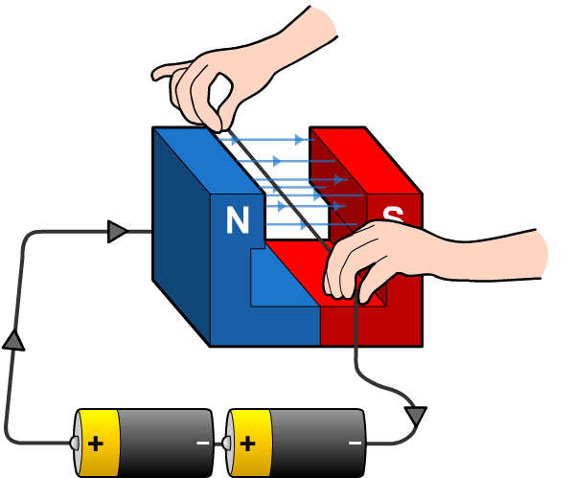
Calculating the force on a wire
If the wire is now held between the poles of the same permanent magnet but another battery is added so the current is doubled, what is the new force?
force (? N)
F = B I L
= 10 T × 3 A × 0.2 m
= 6 N
What length of wire would be required to increase the force to 15 N?
F
F = B I L
L =
B I
15 N
10 T × 3 A
=
= 0.5 m
If the magnetic field is not 50 cm long, how could you get this length of wire within it?
Notes:
Teacher notes
The answer is simply to coil the wire. However, if the whole coil is in the field, one half (with the current flowing in one direction) would experience an upwards force, and the other half (with the current flowing in the other direction) would experience a downwards force. To get a force in one direction you would put only half the coil in the field.
Students could be prepared for the next section by considering the question: what could a coil experiencing two opposing forces be useful for?
This slide covers the Science and Engineering Practices:
Using Mathematics and Computational Thinking: Use mathematical, computational, and/or algorithmic representations of phenomena or design solutions to describe and/or support claims and/or explanations.
Using Mathematics and Computational Thinking: Apply techniques of algebra and functions to represent and solve scientific and engineering problems.

Slide 12
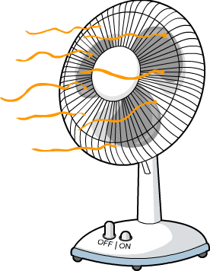
What is a motor?
An electric motor is a device that converts electrical energy into mechanical energy to produce a turning effect.
Most motors are powered using direct current (DC), which is produced by cells and batteries.
To build a simple electric motor,
all you need is a coil of wire, two opposing magnetic poles and
an electric current.
Which devices in your home
use an electric motor?
Notes:
Teacher notes
Devices in the home that use an electric motor include:
microwave
refrigerator
washing machine
vacuum cleaner
hairdryer
DVD player
computer
moving toys.
Cars also use electric motors to perform several functions, including in the starter motor and in the windows, windscreen wipers and fans.

Slide 13
Coil in a magnetic field
Notes:
Teacher notes
This virtual experiment introduces the concept of a current-carrying coil experiencing a rotational force. Ask students to brainstorm about the questions at the end of the activity. They are addressed on the following slides.
This slide covers the Science and Engineering Practice:
Planning and Carrying Out Investigations: Plan an investigation or test a design individually and collaboratively to produce data to serve as the basis for evidence as part of building and revising models, supporting explanations for phenomena, or testing solutions to problems. Consider possible variables or effects and evaluate the confounding investigation’s design to ensure variables are controlled.

Slide 14
DC electric motor simulation
Notes:
Teacher notes
This simulation takes the concepts from the previous slide to create an animated motor simulation. The current, forces and magnetic field can be toggled on and off, to aid visualization and understanding, and the speed and direction of rotation can be altered.
This slide covers the Science and Engineering Practice:
Constructing Explanations and Designing Solutions: Apply scientific ideas, principles, and/or evidence to provide an explanation of phenomena and solve design problems, taking into account possible unanticipated effects.

Slide 15
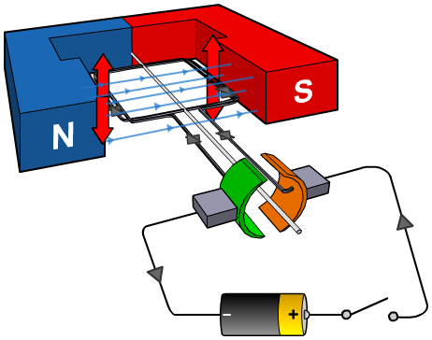
Producing continuous rotation
Unless the direction of the current is reversed every
half turn, the coil will stop rotating. This happens when
the current-carrying coil and the lines of force from the
permanent magnets are parallel.
A device called a commutator is used to break the circuit for a moment and change the direction of the current. This ensures that the coil turns continuously.
Notes:
This slide covers the Science and Engineering Practice:
Constructing Explanations and Designing Solutions: Apply scientific ideas, principles, and/or evidence to provide an explanation of phenomena and solve design problems, taking into account possible unanticipated effects.

