Slide 1
Newton’s
Second Law of Motion

Slide 2
Information
Asking Questions and Defining Problems
Developing and Using Models
Planning and Carrying Out Investigations
Analyzing and Interpreting Data
Using Mathematics and Computational Thinking
Constructing Explanations and Designing Solutions
1. Patterns
2. Cause and Effect
3. Scale, Proportion, and Quantity
7. Stability and Change

Slide 3



What is Newton’s second law?
Newton’s first law of motion states that an object changes velocity (change speed, direction or both) if the forces on the object are unbalanced. We say that there is a resultant force on the object.
A change in velocity is known as acceleration.
Newton’s second law of motion tells us the relationship between the acceleration of an object, the object’s mass and the resultant force acting on it.
What is the relationship between force, mass and acceleration?
Notes:
Teacher notes
For more information about Newton’s first law of motion and acceleration, please refer to the Newton’s First Law of Motion and Acceleration presentations respectively.

Slide 4




Investigating force and acceleration
Notes:
This slide covers the Science and Engineering Practices:
Asking Questions and Defining Problems: Ask questions to determine relationships, including quantitative relationships, between independent and dependent variables.
Planning and Carrying Out Investigations: Plan an investigation or test a design individually and collaboratively to produce data to serve as the basis for evidence as part of building and revising models, supporting explanations for phenomena, or testing solutions to problems. Consider possible variables or effects and evaluate the confounding investigation’s design to ensure variables are controlled.
Analyzing and Interpreting Data: Analyze data using tools, technologies, and/or models (e.g., computational, mathematical) in order to make valid and reliable scientific claims or determine an optimal design solution.
Analyzing and Interpreting Data: Apply concepts of statistics and probability (including determining function fits to data, slope, intercept, and correlation coefficient for linear fits) to scientific and engineering questions and problems, using digital tools when feasible.
Constructing Explanations and Designing Solutions: Make a quantitative and/or qualitative claim regarding the relationship between dependent and independent variables.

Slide 5
Investigating mass and acceleration
Notes:
This slide covers the Science and Engineering Practices:
Asking Questions and Defining Problems: Ask questions to determine relationships, including quantitative relationships, between independent and dependent variables.
Planning and Carrying Out Investigations: Plan an investigation or test a design individually and collaboratively to produce data to serve as the basis for evidence as part of building and revising models, supporting explanations for phenomena, or testing solutions to problems. Consider possible variables or effects and evaluate the confounding investigation’s design to ensure variables are controlled.
Analyzing and Interpreting Data: Analyze data using tools, technologies, and/or models (e.g., computational, mathematical) in order to make valid and reliable scientific claims or determine an optimal design solution.
Analyzing and Interpreting Data: Apply concepts of statistics and probability (including determining function fits to data, slope, intercept, and correlation coefficient for linear fits) to scientific and engineering questions and problems, using digital tools when feasible.
Constructing Explanations and Designing Solutions: Make a quantitative and/or qualitative claim regarding the relationship between dependent and independent variables.

Slide 6
Force, mass and acceleration
The results of the first investigation show that acceleration is proportional to the resultant force acting on the object. This can be represented by the equation:
acceleration = constant × force
The results of the second investigation show that acceleration is proportional to the mass of the object. This can be represented by the equation:
acceleration = constant ÷ mass
Combining these equations gives:
acceleration = force ÷ mass
Notes:
This slide covers the Science and Engineering Practice:
Developing and Using Models: Develop, revise, and/or use a model based on evidence to illustrate and/or predict the relationships between systems or between components of a system.

Slide 7
Newton’s second law
Newton’s second law of motion is commonly written as the equation:
force = mass × acceleration
or
F = m a
Force, F, is the resultant force of all the forces acting on an object and is measured in newtons (N).
Mass, m, is measured in kilograms (kg).
Acceleration, a, is measured in metres per second per second (m/s²).
Notes:
This slide covers the Science and Engineering Practice:
Developing and Using Models: Develop and/or use a model (including mathematical and computational) to generate data to support explanations, predict phenomena, analyze systems, and/or solve problems.

Slide 8
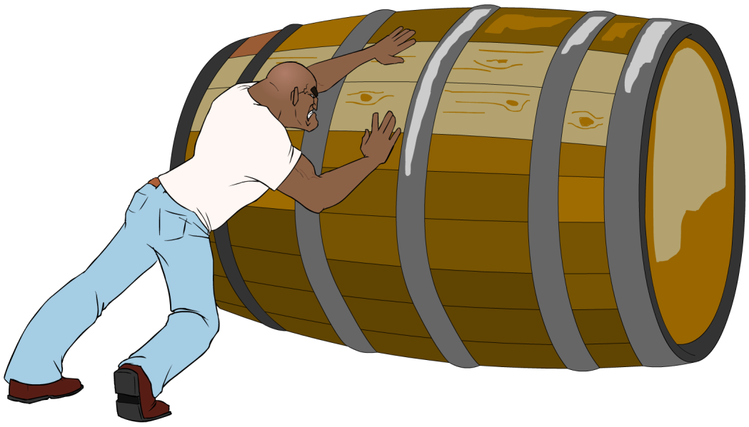
Inertia and mass
Inertia is the tendency of an object to continue in its state of rest or uniform motion.
Newton’s second law tells us that an object with a higher mass will require a larger force in order to change its speed or direction.
This means that the mass of an object is a measure of its inertia. It tells you how difficult it is to change the
velocity of the object.
Mass is defined as the ratio of force over acceleration.

Slide 9

Using F = ma
A car has a mass of 1,000 kg. What force must the car’s engine supply to cause an acceleration of 2 m/s²?
force = mass × acceleration
= 1,000 × 2
= 2,000 N
Notes:
This slide covers the Science and Engineering Practice:
Using Mathematics and Computational Thinking: Apply techniques of algebra and functions to represent and solve scientific and engineering problems.
Photo credit: © Piotr Gilko

Slide 10
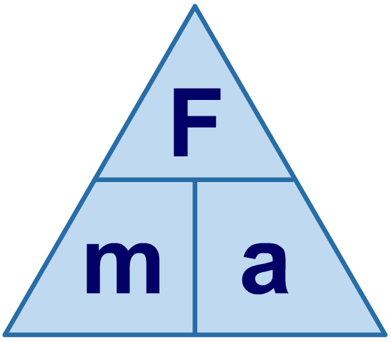

Using a formula triangle
A formula triangle helps you to rearrange a formula.
The formula triangle for force (F), mass (m) and acceleration (a) is shown below.
Cover the quantity that you are trying to work out to find
the rearranged formula needed for the calculation.
So to find acceleration (a), cover up a…
…which gives the formula…
÷
÷
F
m
a =
×

Slide 11

How do we find acceleration?
A lorry has a mass of 12,000 kg. What acceleration is caused by a force of 10,000 N?
force = mass × acceleration
acceleration =
force
mass
10,000
12,000
=
= 0.83 m/s²
Notes:
This slide covers the Science and Engineering Practice:
Using Mathematics and Computational Thinking: Apply techniques of algebra and functions to represent and solve scientific and engineering problems.
Photo credit: © Jelle Weidema

Slide 12

F = ma calculations
Notes:
Teacher notes
Question 2 aims to get students to think laterally and work out that acceleration due to gravity (10 m/s²) is needed to complete the calculation. For more information about acceleration due to gravity, please refer to the Acceleration and Gravity presentations.
This slide is accompanied by the worksheet Newton’s Second Law of Motion.
This slide covers the Science and Engineering Practice:
Using Mathematics and Computational Thinking: Apply techniques of algebra and functions to represent and solve scientific and engineering problems.

