Slide 1
Polarization

Slide 2
Information
Using Mathematics and Computational Thinking
Constructing Explanations and Designing Solutions
2. Cause and Effect

Slide 3





Polarization
Notes:
Teacher notes
The “missing” vibrations are absorbed by the polarizing filter.
This slide covers the Science and Engineering Practice:
Constructing Explanations and Designing Solutions: Apply scientific ideas, principles, and/or evidence to provide an explanation of phenomena and solve design problems, taking into account possible unanticipated effects.

Slide 4
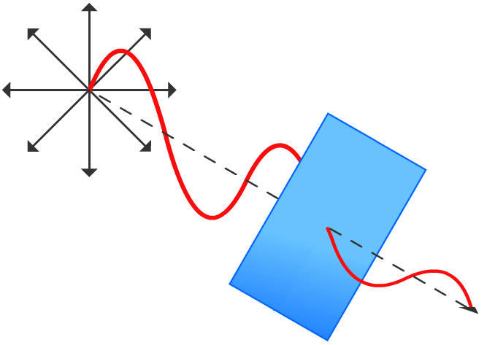

Malus’s law
If a beam of plane-polarized light is shone through a polarizer, its subsequent intensity, I, is calculated as follows:
I = I₀cos²θ
where:
I₀ = initial intensity of light
θ = angle of polarizer relative to position of initial polarized light
This is Malus’s law, named after Étienne-Louis Malus, a French physicist, mathematician and officer.
Notes:
This slide covers the Science and Engineering Practice:
Using Mathematics and Computational Thinking: Use mathematical, computational, and/or algorithmic representations of phenomena or design solutions to describe and/or support claims and/or explanations.

Slide 5

Uses of polarization
Polarizing filters in objects such as sunglasses can reduce glare by reducing the partially plane-polarized light created when light is reflected by transparent materials like water.
Polarizing filters are used by photographers to alter the appearance of the sky. This is because particles in the atmosphere cause partial polarization by scattering sunlight.
Polarization can be used in stress and strain analysis of certain plastics, such as plexiglas. Polarized light micrography is a useful technique in the analysis of crystal structures.
Notes:
Teacher notes
Students could be asked to research more examples of polarization in nature and technology.
Radio waves can also be polarized. Radio waves from transmitters are polarized, so receivers need to be rotated to the same plane to be able to receive the radio waves clearly and ensure a good reception.
Photo credit: Dirk Wiersma / Science Photo Library
Paracetamol crystals. Polarized light micrograph of crystals of the drug paracetamol, also known as acetaminophen. These radial crystal rosettes have been precipitated from an aqueous solution and imaged in transient, plane-polarized light. Paracetamol is an analgesic (pain-killer) and antipyretic (reduces fever).

