Slide 1
Properties of Waves

Slide 2
Information
Developing and Using Models
Planning and Carrying Out Investigations
Using Mathematics and Computational Thinking
Constructing Explanations and Designing Solutions
1. Patterns
2. Cause and Effect
3. Scale, Proportion, and Quantity

Slide 3


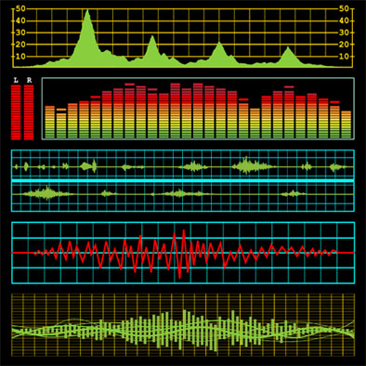

What is a wave?
Waves come in many different forms, such as seismic, sound, light and other electromagnetic waves, but they all transfer energy from one place to another.
All types of wave are caused by a vibrating source, and transfer energy without transferring matter.
In a transverse wave, the particles move up and down, so the direction of their movement is at right angles to the direction of the wave.
In a longitudinal wave, the particles vibrate back and forth, so the direction of their movement is parallel to the direction of the wave.
Notes:
Teacher notes
For more information about transverse and longitudinal waves, please refer to the Transverse and Longitudinal Waves presentation.
This presentation is accompanied by the worksheet Properties of Waves.
Photo credit: © zphoto, shutterstock.com 2018

Slide 4



What are the parts of a transverse wave?
Notes:
This slide covers the Science and Engineering Practice:
Developing and Using Models: Use a model to provide mechanistic accounts of phenomena.

Slide 5
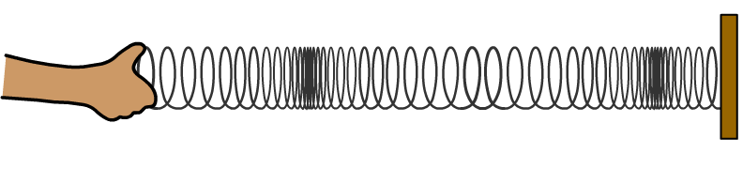
Wavelength
The wavelength of any wave is the distance between a point on one wave and the matching point on the next wave.
wavelength
wavelength
The wavelength is the same whichever two matching points are used to measure this distance.
The symbol used to represent wavelength is λ (lambda). Wavelength is measured in meters (m).
Notes:
This slide covers the Science and Engineering Practice:
Developing and Using Models: Use a model to provide mechanistic accounts of phenomena.

Slide 6
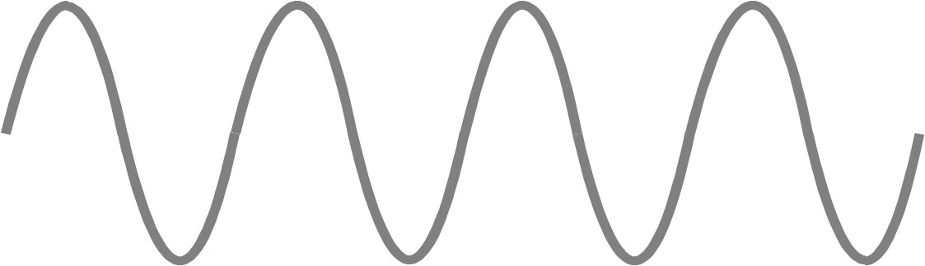
Frequency of waves
The frequency is the number of waves passing any point each second.
frequency = number of waves that passed a point / time
frequency is measured in hertz (Hz) = 1/second (1/s)
1 wave per second = 1 Hz
If this set of transverse waves pass a point in one second, what is the frequency?
4 Hz
1
2
3
4

Slide 7
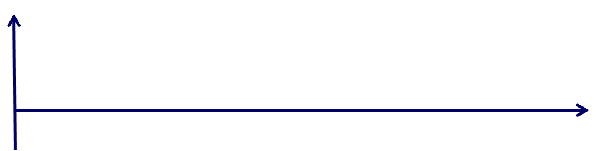
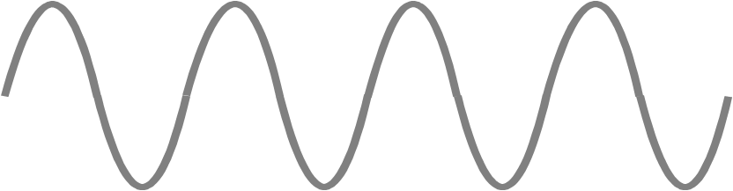
Frequency and time period
Frequency is defined as the number of waves per second. In the example below the frequency is 4 Hz.
1 s
time
0.25 s
The time period of a wave is the amount of time it takes for one wave to pass a point.
In this example, the time period of the wave is 0.25 seconds.
Time period (T) and frequency (f) are related by the equation:
1
1
f =
or
T =
T
f
Notes:
This slide covers the Science and Engineering Practice:
Developing and Using Models: Develop and/or use a model (including mathematical and computational) to generate data to support explanations, predict phenomena, analyze systems, and/or solve problems.

Slide 8
Frequency of waves – activity
Notes:
Teacher notes
This drag and drop activity could be used as a summary activity to check students’ understanding of the relationship between the number of waves, time and frequency. Class voting or the use of colored traffic light cards could make this a whole-class exercise.
This slide covers the Science and Engineering Practice:
Using Mathematics and Computational Thinking: Apply techniques of algebra and functions to represent and solve scientific and engineering problems.

Slide 9
What is wave speed?
Speed is a measure of how far an object travels in a given time. The speed (or velocity) of a wave tells you how quickly the wave travels or how quickly energy is transferred.
The speed of a wave is how far one point on the wave (for example, a particular peak or trough) travels in a given time. It can be calculated using the equation:
wave speed
distance point on wave travels
=
time taken
Distance traveled is measured in meters (m).
Time taken is measured in seconds (s).
Speed is measured in meters per second (m/s).
Notes:
This slide covers the Science and Engineering Practice:
Developing and Using Models: Develop and/or use a model (including mathematical and computational) to generate data to support explanations, predict phenomena, analyze systems, and/or solve problems.

Slide 10

Investigating waves
Notes:
This slide covers the Science and Engineering Practices:
Developing and Using Models: Develop and/or use a model (including mathematical and computational) to generate data to support explanations, predict phenomena, analyze systems, and/or solve problems.
Planning and Carrying Out Investigations: Plan and conduct an investigation individually and collaboratively to produce data to serve as the basis for evidence, and in the design: decide on types, how much, and accuracy of data needed to produce reliable measurements and consider limitations on the precision of the data (e.g., number of trials, cost, risk, time), and refine the design accordingly.
Using Mathematics and Computational Thinking: Use mathematical, computational, and/or algorithmic representations of phenomena or design solutions to describe and/or support claims and/or explanations.
Constructing Explanations and Designing Solutions: Apply scientific ideas, principles, and/or evidence to provide an explanation of phenomena and solve design problems, taking into account possible unanticipated effects.

Slide 11
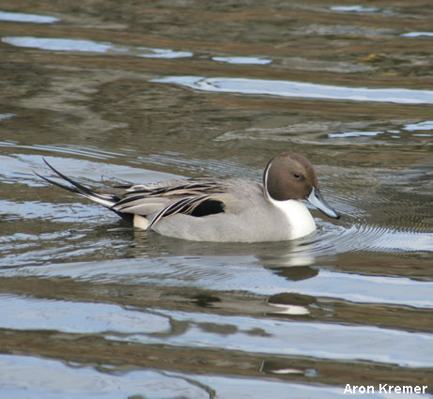
Wave speed, frequency and wavelength
These waves are traveling across the surface of a pond. The length of each wave is 0.25 m.
Two waves pass the duck each second, so the frequency is 2 Hz.
This means that the waves travel 0.5 m each second, so the speed of the waves is 0.5 m/s.
So the connection between speed, frequency and wavelength is:
speed = frequency × wavelength
0.5 m/s = 2 Hz × 0.25 m
Notes:
This slide covers the Science and Engineering Practice:
Using Mathematics and Computational Thinking: Apply techniques of algebra and functions to represent and solve scientific and engineering problems.
Photo credit: © Aron Kremer

Slide 12
What is the formula for wave speed?
For any set of waves, the wave speed (v) can be calculated from the frequency (f) and wavelength (λ) using this formula:
wave speed = frequency × wavelength
v = f × λ
What are the units of speed, frequency and wavelength?
Wave speed, v, is measured in meters per second (m/s).
Frequency, f, is measured in hertz (Hz).
Wavelength, λ, is measured in meters (m).
Notes:
This slide covers the Science and Engineering Practice:
Developing and Using Models: Develop and/or use a model (including mathematical and computational) to generate data to support explanations, predict phenomena, analyze systems, and/or solve problems.

Slide 13
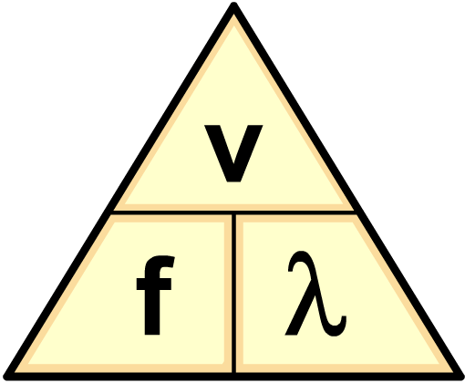

Can I use a formula triangle?
A formula triangle helps you to rearrange a formula.
The formula triangle for wave speed (v), frequency (f) and wavelength (λ) is shown below.
Cover the quantity that you are trying to work out, which gives the rearranged formula needed for the calculation.
So to find frequency (f), cover up f…
…which gives the formula…
÷
÷
v
f =
λ
×

Slide 14

Calculating wave speed – example
These waves are rippling across a pond.
The frequency of the waves is 0.2 Hz and the length of each wave is estimated
at 0.15 m. What is the
wave speed?
wave speed = frequency × wavelength
= 0.2 Hz × 0.15 m
= 0.03 m/s
Notes:
This slide covers the Science and Engineering Practice:
Using Mathematics and Computational Thinking: Apply techniques of algebra and functions to represent and solve scientific and engineering problems.
Photo credit: © photos.com, 2018

Slide 15

The speed of sound waves
Natasha is doing an experiment to measure the speed of sound waves in air. She stands a distance of 20 m from a wall, claps her hands and times how long it takes to hear the echo of the clap.
The distance traveled by the sound wave is twice the distance to the wall. The sound wave takes 0.12 s to travel this distance.
The speed of the sound wave can be calculated using the equation:
speed = distance ÷ time
= 40 m ÷ 0.12 s
= 333 m/s
Notes:
This slide covers the Science and Engineering Practice:
Using Mathematics and Computational Thinking: Apply techniques of algebra and functions to represent and solve scientific and engineering problems.

Slide 16

The speed of electromagnetic waves
All electromagnetic waves travel at 300,000,000 m/s through a vacuum. This value is approximately their speed through air.
Such large numbers are usually expressed in standard form:
300,000,000 m/s = 3 × 10⁸ m/s
A typical radio station may broadcast
at a frequency of 98 MHz. Calculate the wavelength of this radio wave.
λ = v ÷ f
= 3 × 10⁸ m/s ÷ 98 × 10⁶ Hz
= 3.1 m
Notes:
This slide covers the Science and Engineering Practice:
Using Mathematics and Computational Thinking: Apply techniques of algebra and functions to represent and solve scientific and engineering problems.

Slide 17
Wave speed problems
Notes:
This slide covers the Science and Engineering Practice:
Using Mathematics and Computational Thinking: Apply techniques of algebra and functions to represent and solve scientific and engineering problems.

