Slide 1
Speed and Velocity

Slide 2
Information
Using Mathematics and Computational Thinking
3. Scale, Proportion, and Quantity
7. Stability and Change

Slide 3


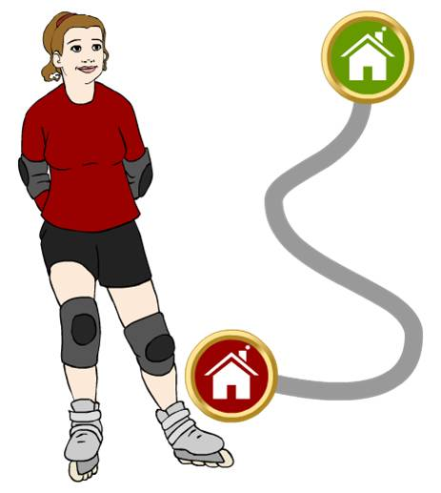

Distance and displacement
Distance is how far an object moves. It is a scalar quantity, so does not involve direction.
Displacement is a vector quantity that gives the net distance from the starting point, with an indication of direction. It is not the same as the distance an object has traveled.
For example, Jody roller skates
a distance of 2.1 km to her
friend Selma’s house.
displacement = 1.1 km
distance
traveled
= 2.1 km
Her displacement, however, is only 1.1 km north east. This is
the “straight line” distance
from her starting point.
Notes:
Teacher notes
For more information about scalars and vectors, please refer to the Scalars and Vectors presentation.
This presentation is accompanied by the worksheet Speed and Velocity.

Slide 4
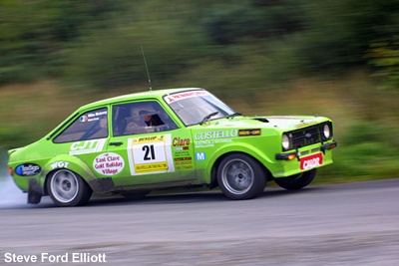
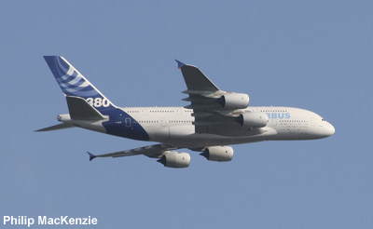
What is speed?
Speed is a measure of how far an object moves in a given time. It is a scalar quantity, so does not involve direction.
This car is traveling at
60 mph. This means the car travels 60 miles every hour.
This jet is traveling at 350 m/s. This means the jet travels
350 meters every second.
Notes:
Teacher notes
Students could be asked why the non-SI mph is the most common unit used when talking generally about speed.
Photo credits: car © Steve Ford Elliott, plane © Philip MacKenzie

Slide 5
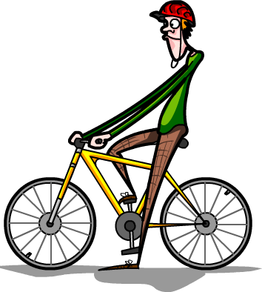
Speed of a person
Objects do not usually travel at a constant speed. When a person walks, runs, cycles or drives a car, their speed changes constantly.
The speed at which a person walks, runs or cycles depends on several factors, including the age and fitness of the person, the terrain over which they are
traveling and the distance traveled.
While the speed of a person varies, typical values are:
walking ~ 1.5 m/s
running ~ 3 m/s
cycling ~ 6 m/s.

Slide 6

Sound and wind
It is not only objects that move with a constantly changing speed. The speed of sound and the speed of wind also vary.
The speed of sound depends on a number of factors, including the material that the sound is moving through. The speed of sound in air is typically around 330 m/s.
The speed of wind varies enormously.
A light breeze travels at around 3 m/s,
but a gale travels at about 20 m/s,
and some hurricanes can reach
speeds of over 70 m/s.
That’s over 150 mph!
The speed of wind affects
the speed of sound in air.

Slide 7

How is speed calculated?
The average speed of an object can be calculated using this equation:
average speed
distance traveled
time taken
=
Distance traveled is measured in meters (m).
Time taken is measured in seconds (s).
Speed is measured in meters per second (m/s).
The standard unit for speed in physics is m/s, but other units such as kilometers per hour (km/h) are more convenient when measuring the speed of vehicles. Why is this?
Notes:
This slide covers the Science and Engineering Practice:
Using Mathematics and Computational Thinking: Use mathematical, computational, and/or algorithmic representations of phenomena or design solutions to describe and/or support claims and/or explanations.

Slide 8
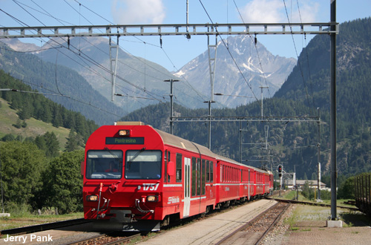
Calculating speed question
A train takes 100 seconds to travel 1,500 m. What is the average speed of the train?
speed =
distance
time
1,500
100
=
= 15 m/s
Notes:
This slide covers the Science and Engineering Practice:
Using Mathematics and Computational Thinking: Apply techniques of algebra and functions to represent and solve scientific and engineering problems.
Photo credit: © Jerry Pank

Slide 9
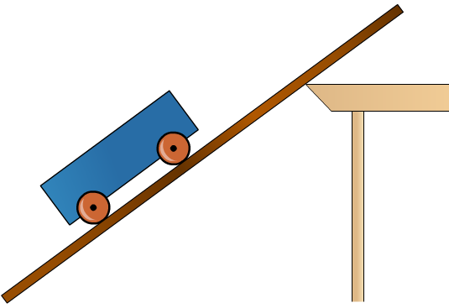
Investigating speed
Nathan is investigating the speed of a cart as it moves down a wooden ramp.
He measures the distance that the cart travels down the ramp and then uses a stopwatch to time how long it takes.
The cart travels a distance of 1.6 m and takes 4 s. What is the average speed of the cart?
average speed =
distance
time
=
1.6
4
= 0.4 m/s
Notes:
This slide covers the Science and Engineering Practice:
Using Mathematics and Computational Thinking: Apply techniques of algebra and functions to represent and solve scientific and engineering problems.

Slide 10

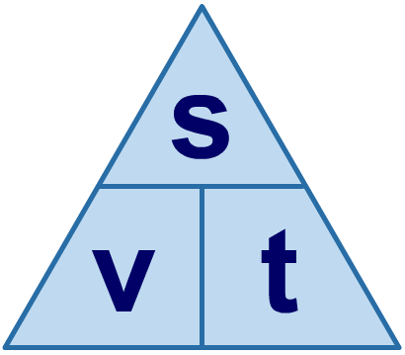
Using a formula triangle
A formula triangle helps you to rearrange a formula. The formula triangle for speed (v), distance (s) and time (t) is shown below.
Covering the quantity that you are trying to work out gives the rearranged formula needed for the calculation.
…which gives the formula…
So to find distance (s), cover up s…
s = v t
÷
÷
×

Slide 11
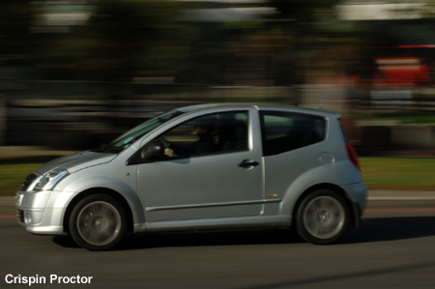
Calculating speed question
A car travels at 25 m/s for 3 minutes. How far does it travel?
speed =
distance
time
distance = speed × time
= 25 × 180
= 4,500 m = 4.5 km
Notes:
This slide covers the Science and Engineering Practices:
Using Mathematics and Computational Thinking: Apply techniques of algebra and functions to represent and solve scientific and engineering problems.
Using Mathematics and Computational Thinking: Apply ratios, rates, percentages, and unit conversions in the context of complicated measurement problems involving quantities with derived or compound units (such as mg/mL, kg/m3, acre-feet, etc.).
Photo credit: © Crispin Proctor

Slide 12
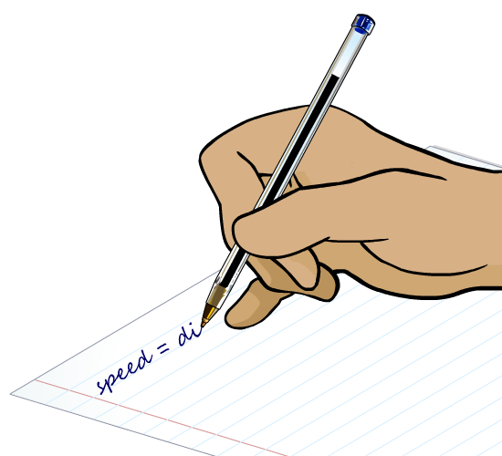
Converting units of speed
Speed is the ratio of distance to time. Units of speed are always expressed as a unit of distance to a unit of time, such as meters per second, or miles per hour.
To convert from one unit of speed to another, you can write the speed as a ratio of distance to time, then convert the units of the distance and time.
For example, to convert 5 km/h into m/s:
5 km
5 km/h =
1 hour
(5 × 1,000) m
=
(1 × 60 × 60) s
5,000 m
=
= 1.39 m/s
3600 s
Notes:
This slide covers the Science and Engineering Practice:
Using Mathematics and Computational Thinking: Apply ratios, rates, percentages, and unit conversions in the context of complicated measurement problems involving quantities with derived or compound units (such as mg/mL, kg/m3, acre-feet, etc.).

Slide 13


Speed, distance, time calculations
Notes:
This slide covers the Science and Engineering Practices:
Using Mathematics and Computational Thinking: Apply techniques of algebra and functions to represent and solve scientific and engineering problems.
Using Mathematics and Computational Thinking: Apply ratios, rates, percentages, and unit conversions in the context of complicated measurement problems involving quantities with derived or compound units (such as mg/mL, kg/m3, acre-feet, etc.).

Slide 14
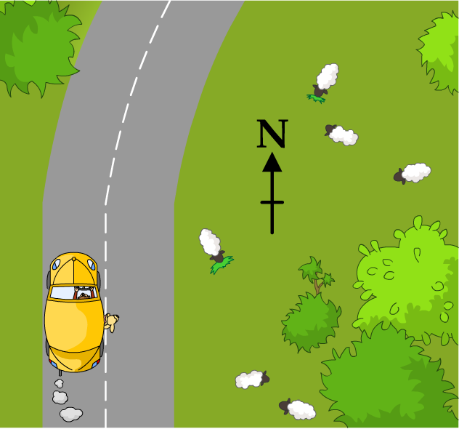
How is velocity different to speed?
The speed of an object does not depend on the direction in which it is traveling. The velocity of an object is the speed of the object in a given direction. Velocity is a vector quantity.
The car is traveling north with a velocity
of 10 m/s.
As the car goes round the corner, the speed of the car remains constant but the car changes direction, so the velocity of the car changes.

Slide 15
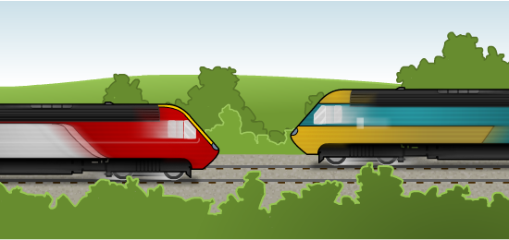
Velocities of a pair of moving objects
If two trains are traveling at 25 m/s on parallel tracks, but in opposite directions, do they have the same velocity?
No – velocity is a measure of direction as well as speed.
How are these different velocities written?
Train A has a velocity of 25 m/s.
Train B has a velocity of –25 m/s.
Notes:
Teacher notes
You may wish to point out to your class that either train could be assigned the positive velocity, as long as the other train is given a negative velocity.

Slide 16
Velocities

Slide 17
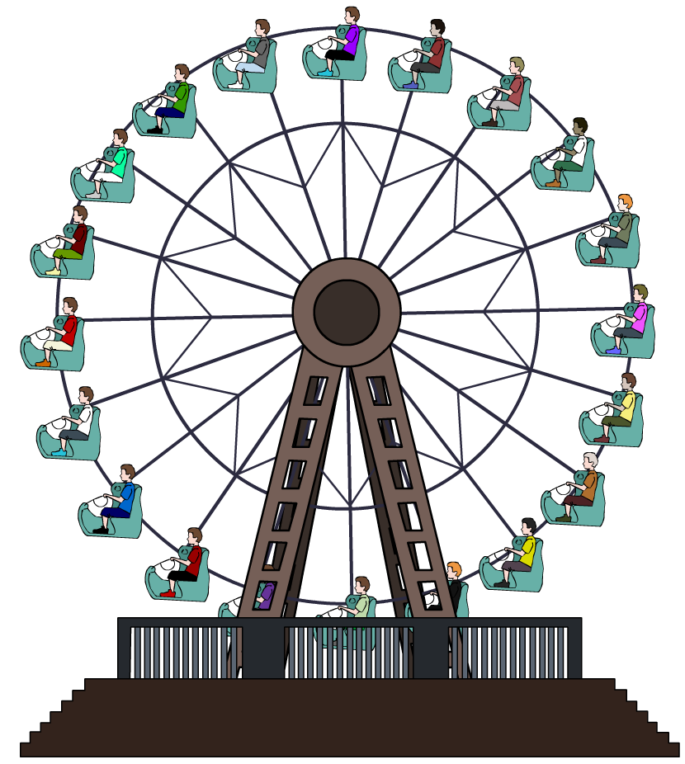








Constant speed, but changing velocity?
The velocity of an object depends on the object’s direction as well as its speed. This means that an object with a constant speed but changing direction has a changing velocity.
If an object is traveling in a circle, it is always changing direction. This means that an object traveling in a circle always has a changing velocity, even if the speed of
the object is constant.
For example, a Ferris Wheel turns at a constant rate. When someone rides on a Ferris Wheel, they move at a constant speed, but they are constantly changing direction, so their velocity is always changing.
Notes:
Teacher notes
Students could be asked to think of other examples of objects that travel in a circle with constant speed.
For more information about circular motion, please refer to the Circular Motion presentation.

Slide 18
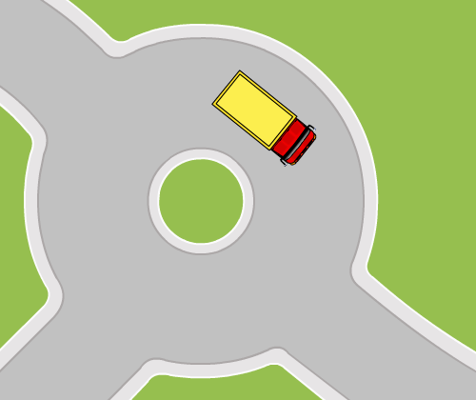
Motion in a circle
Suppose a truck drives round a circular roundabout at a constant speed. The truck is constantly changing direction,
so it is always changing velocity.
If the truck drives all the way round the roundabout, the distance the truck has traveled is the circumference of
the circle, but the truck’s displacement is zero.
The average velocity of an
object is given by:
average velocity
displacement
=
time
This means that the truck has
an average velocity of zero after one complete circle.

