Slide 1
Transverse and
Longitudinal
Waves

Slide 2
Information
Developing and Using Models
1. Patterns
5. Energy and Matter

Slide 3

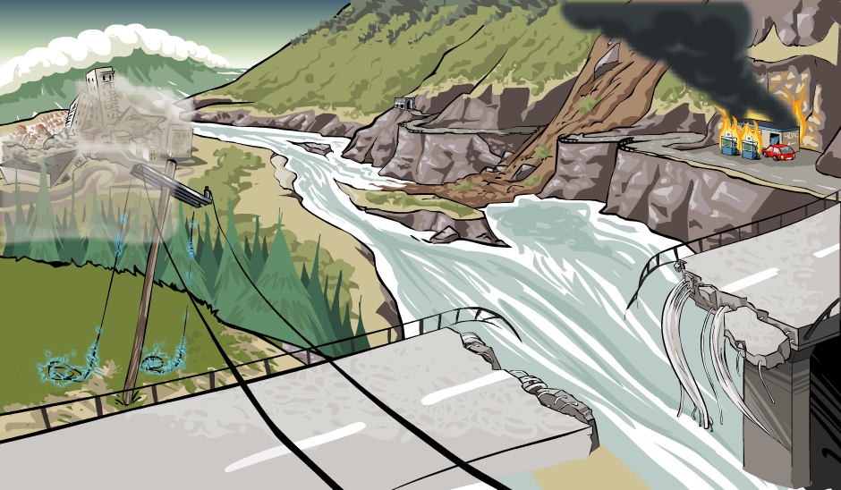

What is a wave?
Waves come in many different forms but they all transfer energy from one place to another. For example:
Seismic waves carry energy from earthquakes through the Earth, which shake the ground.
Sound waves are emitted from vibrating loudspeakers making our eardrums vibrate.
All types of wave are caused by a vibrating source, and transfer energy without transferring matter. All waves can be reflected, refracted and diffracted.
Notes:
Teacher notes
For more information about reflection, refraction and diffraction, please refer to the Reflection and Refraction on Waves and Diffraction presentations respectively.

Slide 4

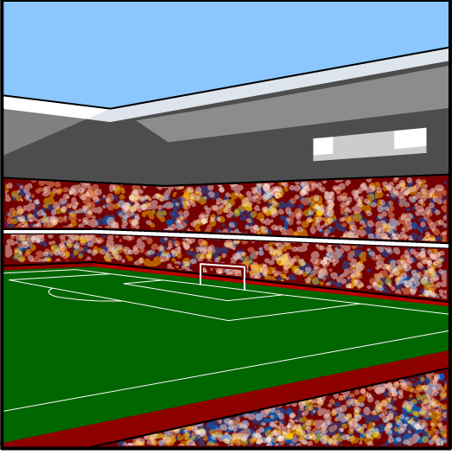
What are transverse waves?
When a group of people in a stadium decide to start a wave, the wave travels around the stadium.
The wave is an example of a transverse wave, as
are waves on a water surface.
In a transverse wave, the particles move up and down, so the direction of their movement is at right angles to the direction of the wave. It is the wave that travels, not the medium the wave is moving through.
Think about the people standing up and down in the same place as the wave moves around the stadium.
Notes:
This slide covers the Science and Engineering Practice:
Developing and Using Models: Use a model to provide mechanistic accounts of phenomena.

Slide 5
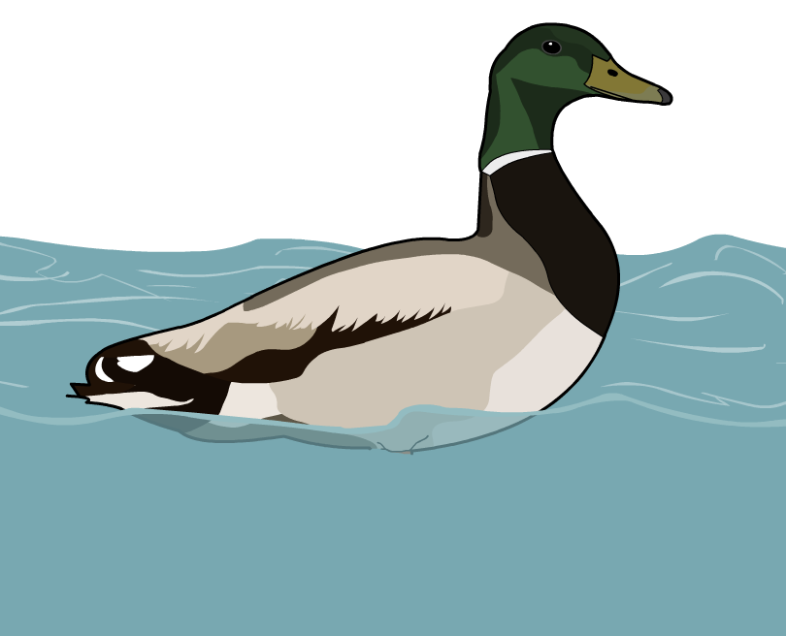
Transverse waves example
A water wave is an example of a transverse wave.
As a water wave moves through water, particles in the
water move up and down, at right angles to the direction
of the wave. The particles do not travel with the wave, but move about a fixed position.
This can be shown by the behavior of a duck floating on
a water surface. As a wave moves through the water below the duck, the water, and therefore the duck, moves up and down.
The duck and the water do not travel; only the wave travels.

Slide 6

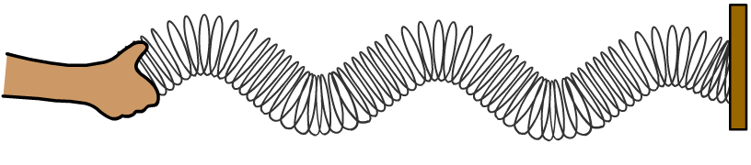

What do transverse waves look like?
A Slinky can be used to model transverse waves, by moving one end of the Slinky up and down.
coils vibrate
up and down
source moves
up and down
direction of wave
The wave travels away from the source. The direction of the wave makes a right angle with the movement of the source.
In a transverse wave, the coils do not travel horizontally; each coil of the Slinky just vibrates up and down.
Notes:
This slide covers the Science and Engineering Practice:
Developing and Using Models: Use a model to provide mechanistic accounts of phenomena.

Slide 7


Simulation of a transverse wave
Notes:
Teacher notes
This simulation of the movement of a transverse wave could be used as an introduction to the way the particles in this type of wave move, or as a summary exercise to check students’ understanding of transverse waves.
This slide covers the Science and Engineering Practice:
Developing and Using Models: Use a model to provide mechanistic accounts of phenomena.

Slide 8
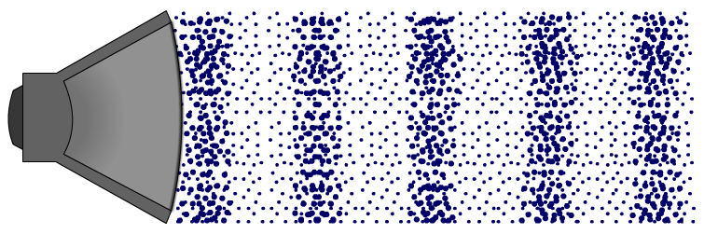
What are longitudinal waves?
Sound travels as waves made by vibrating air particles.
Sound waves are an example of longitudinal waves.
In a longitudinal wave, the particles vibrate back and forth, so the direction of their movement is parallel to the direction of the wave.
Notes:
Teacher notes
For more information about sound waves, please refer to the Sound Waves presentation.

Slide 9
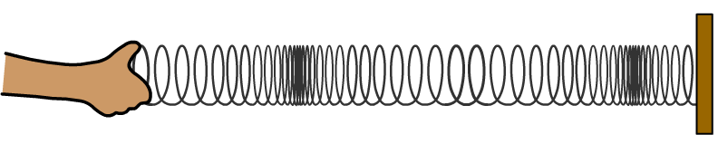


What do longitudinal waves look like?
A Slinky can be used to model longitudinal waves, by moving one end of the Slinky left and right.
source moves
left and right
coils vibrate
left and right
direction of wave
The wave travels away from the source. The direction of the wave is parallel to the movement of the source.
In a longitudinal wave, the coils do not travel horizontally; each coil of the Slinky just vibrates left and right.
Notes:
This slide covers the Science and Engineering Practice:
Developing and Using Models: Use a model to provide mechanistic accounts of phenomena.

Slide 10
What are the parts of a longitudinal wave?
Certain parts of a longitudinal wave have special names.
Sections that are pushed together are called compressions, and those that are stretched out are called rarefactions.
compression
rarefaction
Sound waves are longitudinal waves. When someone speaks, the air particles vibrate as a longitudinal wave and so compressions and rarefactions are formed in the air.
P waves, the primary waves produced by earthquakes, are also longitudinal waves, which push and pull the Earth.
Notes:
This slide covers the Science and Engineering Practice:
Developing and Using Models: Use a model to provide mechanistic accounts of phenomena.

Slide 11
Simulation of a longitudinal wave
Notes:
Teacher notes
This simulation of the movement of a longitudinal wave could be used as an introduction to the way the particles in this type of wave move, or as a summary exercise to check students’ understanding of longitudinal waves.
This slide covers the Science and Engineering Practice:
Developing and Using Models: Use a model to provide mechanistic accounts of phenomena.

Slide 12
Transverse or longitudinal waves?
Notes:
Teacher notes
This drag and drop activity could be used as a summary exercise to check students’ knowledge of examples of longitudinal and transverse waves. Class voting or the use of colored traffic light cards could make this a whole-class exercise.

Slide 13
Transverse and longitudinal waves

